Slide 1
“The Earth Is The Lord’s”
Genesis 1:1 - Psalms 24:1-2

Slide 2
Introduction
The Bible teaches that God created the heavens and the earth – Gen. 1:1; Jer. 10:12
David declared that the earth and it fulness belong to God!
“In the beginning God created the heavens and the earth”
“The earth is the LORD’S, and all its fullness, The world and those who dwell therein. For He has founded it upon the seas, And established it upon the waters” – Psa. 24:1-2; 33:6-9
This Photo by Unknown Author is licensed under CC BY
Notes:
Genesis 1:1 KJV 1 In the beginning God created the heaven and the earth.
Jeremiah 10:12 KJV 12 He hath made the earth by his power, he hath established the world by his wisdom, and hath stretched out the heavens by his discretion.
Psalms 24:1-2 KJV 1 The earth is the LORD'S, and the fulness thereof; the world, and they that dwell therein. 2 For he hath founded it upon the seas, and established it upon the floods.
Psalms 33:6-9 KJV 6 By the word of the LORD were the heavens made; and all the host of them by the breath of his mouth. 7 He gathereth the waters of the sea together as an heap: he layeth up the depth in storehouses. 8 Let all the earth fear the LORD: let all the inhabitants of the world stand in awe of him. 9 For he spake, and it was done; he commanded, and it stood fast.

Slide 3
Introduction
Even though God gave man dominion over every living thing on earth – Gen. 1:28
And the devil (“the god of this world” – 2 Cor. 4:4) has great influence, it remains true that “The earth is the Lord’s and all its fulness” – Psa. 24:1-2
Just how extensive does the earth and it fulness belong to God?
We will notice what the Bible teaches about what God owns!
Notes:
Genesis 1:28 KJV 28 And God blessed them, and God said unto them, Be fruitful, and multiply, and replenish the earth, and subdue it: and have dominion over the fish of the sea, and over the fowl of the air, and over every living thing that moveth upon the earth.
2 Corinthians 4:4 KJV 4 In whom the god of this world hath blinded the minds of them which believe not, lest the light of the glorious gospel of Christ, who is the image of God, should shine unto them.
Psalms 24:1-2 KJV 1 The earth is the LORD'S, and the fulness thereof; the world, and they that dwell therein. 2 For he hath founded it upon the seas, and established it upon the floods.

Slide 4
Heavens & Earth
Moses declared the extent of God’s ownership – Duet. 10:14
The entire physical realm – the earth included, belongs to God who created them – Acts 17:24
God will use the earth as he pleases but all physical matter will melt with fervent heat
2 Pet. 3:7, 10-12; cf. Matt. 24:35
God Owns
The…
“Behold, the heaven and the heaven of heavens is the LORD’S thy God, the earth also, with all that therein is”
This Photo by Unknown Author is licensed under CC BY-NC-ND
Notes:
Deuteronomy 10:12-18 KJV 12 And now, Israel, what doth the LORD thy God require of thee, but to fear the LORD thy God, to walk in all his ways, and to love him, and to serve the LORD thy God with all thy heart and with all thy soul, 13 To keep the commandments of the LORD, and his statutes, which I command thee this day for thy good? 14 Behold, the heaven and the heaven of heavens is the LORD'S thy God, the earth also, with all that therein is. 15 Only the LORD had a delight in thy fathers to love them, and he chose their seed after them, even you above all people, as it is this day. 16 Circumcise therefore the foreskin of your heart, and be no more stiffnecked. 17 For the LORD your God is God of gods, and Lord of lords, a great God, a mighty, and a terrible, which regardeth not persons, nor taketh reward: 18 He doth execute the judgment of the fatherless and widow, and loveth the stranger, in giving him food and raiment.
Acts 17:24 KJV 24 God that made the world and all things therein, seeing that he is Lord of heaven and earth, dwelleth not in temples made with hands;
2 Peter 3:7 KJV 7 But the heavens and the earth, which are now, by the same word are kept in store, reserved unto fire against the day of judgment and perdition of ungodly men. 8 But, beloved, be not ignorant of this one thing, that one day is with the Lord as a thousand years, and a thousand years as one day. 9 The Lord is not slack concerning his promise, as some men count slackness; but is longsuffering to us-ward, not willing that any should perish, but that all should come to repentance. 10 But the day of the Lord will come as a thief in the night; in the which the heavens shall pass away with a great noise, and the elements shall melt with fervent heat, the earth also and the works that are therein shall be burned up. 11 Seeing then that all these things shall be dissolved, what manner of persons ought ye to be in all holy conversation and godliness, 12 Looking for and hasting unto the coming of the day of God, wherein the heavens being on fire shall be dissolved, and the elements shall melt with fervent heat?
Matthew 24:35-42 KJV 35 Heaven and earth shall pass away, but my words shall not pass away. 36 But of that day and hour knoweth no man, no, not the angels of heaven, but my Father only. 37 But as the days of Noe were, so shall also the coming of the Son of man be. 38 For as in the days that were before the flood they were eating and drinking, marrying and giving in marriage, until the day that Noe entered into the ark, 39 And knew not until the flood came, and took them all away; so shall also the coming of the Son of man be. 40 Then shall two be in the field; the one shall be taken, and the other left. 41 Two women shall be grinding at the mill; the one shall be taken, and the other left. 42 Watch therefore: for ye know not what hour your Lord doth come.

Slide 5
Plants and Animals
The psalmist spoke of God who owns the trees – Psa. 104:16
God so declared Himself the owner of every wild beast and all cattle – Psa. 50:10-13
The whole realm of the plant and animal kingdoms belong to God! – Gen. 1:11-25; 2:19-20
God Owns
The…
“The trees of the LORD are full of sap; the cedars of Lebanon, which He hath planted”
“For every beast of the forest is mine, and the cattle upon a thousand hills” – v. 10
This Photo by Unknown Author is licensed under CC BY-SA
Notes:
Psalms 104:14-16 KJV 14 He causeth the grass to grow for the cattle, and herb for the service of man: that he may bring forth food out of the earth; 15 And wine that maketh glad the heart of man, and oil to make his face to shine, and bread which strengtheneth man's heart. 16 The trees of the LORD are full of sap; the cedars of Lebanon, which he hath planted;
Psalms 50:10-13 KJV 10 For every beast of the forest is mine, and the cattle upon a thousand hills. 11 I know all the fowls of the mountains: and the wild beasts of the field are mine. 12 If I were hungry, I would not tell thee: for the world is mine, and the fulness thereof.
Genesis 1:11-25 KJV 11 And God said, Let the earth bring forth grass, the herb yielding seed, and the fruit tree yielding fruit after his kind, whose seed is in itself, upon the earth: and it was so. 12 And the earth brought forth grass, and herb yielding seed after his kind, and the tree yielding fruit, whose seed was in itself, after his kind: and God saw that it was good. 13 And the evening and the morning were the third day. 14 And God said, Let there be lights in the firmament of the heaven to divide the day from the night; and let them be for signs, and for seasons, and for days, and years: 15 And let them be for lights in the firmament of the heaven to give light upon the earth: and it was so. 16 And God made two great lights; the greater light to rule the day, and the lesser light to rule the night: he made the stars also. 17 And God set them in the firmament of the heaven to give light upon the earth, 18 And to rule over the day and over the night, and to divide the light from the darkness: and God saw that it was good. 19 And the evening and the morning were the fourth day. 20 And God said, Let the waters bring forth abundantly the moving creature that hath life, and fowl that may fly above the earth in the open firmament of heaven. 21 And God created great whales, and every living creature that moveth, which the waters brought forth abundantly, after their kind, and every winged fowl after his kind: and God saw that it was good. 22 And God blessed them, saying, Be fruitful, and multiply, and fill the waters in the seas, and let fowl multiply in the earth. 23 And the evening and the morning were the fifth day. 24 And God said, Let the earth bring forth the living creature after his kind, cattle, and creeping thing, and beast of the earth after his kind: and it was so. 25 And God made the beast of the earth after his kind, and cattle after their kind, and every thing that creepeth upon the earth after his kind: and God saw that it was good.
Genesis 2:19-20 KJV 19 And out of the ground the LORD God formed every beast of the field, and every fowl of the air; and brought them unto Adam to see what he would call them: and whatsoever Adam called every living creature, that was the name thereof. 20 And Adam gave names to all cattle, and to the fowl of the air, and to every beast of the field; but for Adam there was not found an help meet for him.

Slide 6
Silver and Gold
God spoke through Haggai to the remnant that returned from Babylon saying…
Even though some people may amass great physical wealth, all things belong to God
Luke 12:13-31; cf. 1 Pet. 1:18-19
Acts 3:1-11; 1 Pet. 4:7-11; 2 Tim. 2:19-21
God Owns
The…
“The silver is mine, and the gold is mine, saith the LORD of hosts”
Hag. 2:8
“For we brought nothing into this world, and it is certain we can carry nothing out” – 1 Tim. 6:7
Notes:
Haggai 2:8 KJV 8 The silver is mine, and the gold is mine, saith the LORD of hosts.
Haggai was a prophet of God that prophesied to the Jews who had returned to Jerusalem from Babylon during the year 536 BC (i.e., the first year of Cyrus over Babylon / cf. Ezra 1:1-2). These Jews were led back to Jerusalem to rebuild the temple of Jehovah that had been destroyed by the Babylonians. Seventy years had been spent in Babylonian captivity as foretold by Jeremiah (cf. Jer. 25:11). God had commanded that the temple now be constructed (cf. Ezra 1:1-2; 6:14). Zerubbabel returns to Jerusalem with 50,000 people to build the temple under the authority of Cyrus (cf. Ezra 1:1-2 / see also Isa. 44:28).
“For thus saith Jehovah of hosts: yet once, it is a little while, and I will shake the heavens, and the earth, and the sea, and the dry land; and I will shake all nations; and the precious things of all nations shall come; and I will fill this house with glory, saith Jehovah of hosts. The silver is mine, and the gold is mine, saith Jehovah of hosts. The latter glory of this house shall be greater than the former, saith Jehovah of hosts; and in this place will I give peace, saith Jehovah of hosts” (2:6-9).
Luke 12:13-31 KJV 13 And one of the company said unto him, Master, speak to my brother, that he divide the inheritance with me. 14 And he said unto him, Man, who made me a judge or a divider over you? 15 And he said unto them, Take heed, and beware of covetousness: for a man's life consisteth not in the abundance of the things which he possesseth. 16 And he spake a parable unto them, saying, The ground of a certain rich man brought forth plentifully: 17 And he thought within himself, saying, What shall I do, because I have no room where to bestow my fruits? 18 And he said, This will I do: I will pull down my barns, and build greater; and there will I bestow all my fruits and my goods. 19 And I will say to my soul, Soul, thou hast much goods laid up for many years; take thine ease, eat, drink, and be merry. 20 But God said unto him, Thou fool, this night thy soul shall be required of thee: then whose shall those things be, which thou hast provided? 21 So is he that layeth up treasure for himself, and is not rich toward God. 22 And he said unto his disciples, Therefore I say unto you, Take no thought for your life, what ye shall eat; neither for the body, what ye shall put on. 23 The life is more than meat, and the body is more than raiment. 24 Consider the ravens: for they neither sow nor reap; which neither have storehouse nor barn; and God feedeth them: how much more are ye better than the fowls? 25 And which of you with taking thought can add to his stature one cubit? 26 If ye then be not able to do that thing which is least, why take ye thought for the rest? 27 Consider the lilies how they grow: they toil not, they spin not; and yet I say unto you, that Solomon in all his glory was not arrayed like one of these. 28 If then God so clothe the grass, which is to day in the field, and to morrow is cast into the oven; how much more will he clothe you, O ye of little faith? 29 And seek not ye what ye shall eat, or what ye shall drink, neither be ye of doubtful mind. 30 For all these things do the nations of the world seek after: and your Father knoweth that ye have need of these things. 31 But rather seek ye the kingdom of God; and all these things shall be added unto you.
1 Peter 1:18-19 KJV 18 Forasmuch as ye know that ye were not redeemed with corruptible things, as silver and gold, from your vain conversation received by tradition from your fathers; 19 But with the precious blood of Christ, as of a lamb without blemish and without spot:
Acts 3:1-11 KJV 1 Now Peter and John went up together into the temple at the hour of prayer, being the ninth hour. 2 And a certain man lame from his mother's womb was carried, whom they laid daily at the gate of the temple which is called Beautiful, to ask alms of them that entered into the temple; 3 Who seeing Peter and John about to go into the temple asked an alms. 4 And Peter, fastening his eyes upon him with John, said, Look on us. 5 And he gave heed unto them, expecting to receive something of them. 6 Then Peter said, Silver and gold have I none; but such as I have give I thee: In the name of Jesus Christ of Nazareth rise up and walk. 7 And he took him by the right hand, and lifted him up: and immediately his feet and ankle bones received strength. 8 And he leaping up stood, and walked, and entered with them into the temple, walking, and leaping, and praising God. 9 And all the people saw him walking and praising God: 10 And they knew that it was he which sat for alms at the Beautiful gate of the temple: and they were filled with wonder and amazement at that which had happened unto him. 11 And as the lame man which was healed held Peter and John, all the people ran together unto them in the porch that is called Solomon's, greatly wondering.
1 Peter 4:7-11 KJV 7 But the end of all things is at hand: be ye therefore sober, and watch unto prayer. 8 And above all things have fervent charity among yourselves: for charity shall cover the multitude of sins. 9 Use hospitality one to another without grudging. 10 As every man hath received the gift, even so minister the same one to another, as good stewards of the manifold grace of God. 11 If any man speak, let him speak as the oracles of God; if any man minister, let him do it as of the ability which God giveth: that God in all things may be glorified through Jesus Christ, to whom be praise and dominion for ever and ever. Amen.
2 Timothy 2:19-21 KJV 19 Nevertheless the foundation of God standeth sure, having this seal, The Lord knoweth them that are his. And, Let every one that nameth the name of Christ depart from iniquity. 20 But in a great house there are not only vessels of gold and of silver, but also of wood and of earth; and some to honour, and some to dishonour. 21 If a man therefore purge himself from these, he shall be a vessel unto honour, sanctified, and meet for the master's use, and prepared unto every good work.
1 Timothy 6:6-8 KJV 6 But godliness with contentment is great gain. 7 For we brought nothing into this world, and it is certain we can carry nothing out. 8 And having food and raiment let us be therewith content.

Slide 7
Whole of Humanity
The psalmist declared that the earth and all who dwell there in are God’s
Each person is not their own master. We are owned by God and will give account to Him
God Owns
The….
“The earth is the LORD’S, and the fulness thereof; the world, and they that dwell therein” – Psa. 24:1
“For we must all appear before the judgment seat of Christ; that every one may receive the things done in his body, according to that he hath done, whether it be good or bad”
2 Cor. 5:10
This Photo by Unknown Author is licensed under CC BY
Notes:
Psalms 24:1-2 KJV 1 The earth is the LORD'S, and the fulness thereof; the world, and they that dwell therein. 2 For he hath founded it upon the seas, and established it upon the floods.
2 Corinthians 5:10-11 KJV 10 For we must all appear before the judgment seat of Christ; that every one may receive the things done in his body, according to that he hath done, whether it be good or bad. 11 Knowing therefore the terror of the Lord, we persuade men; but we are made manifest unto God; and I trust also are made manifest in your consciences.

Slide 8
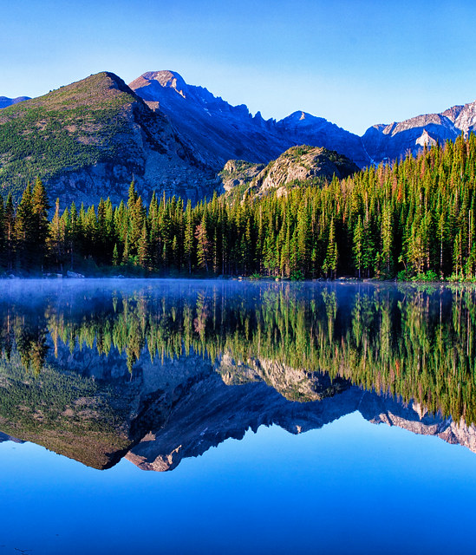
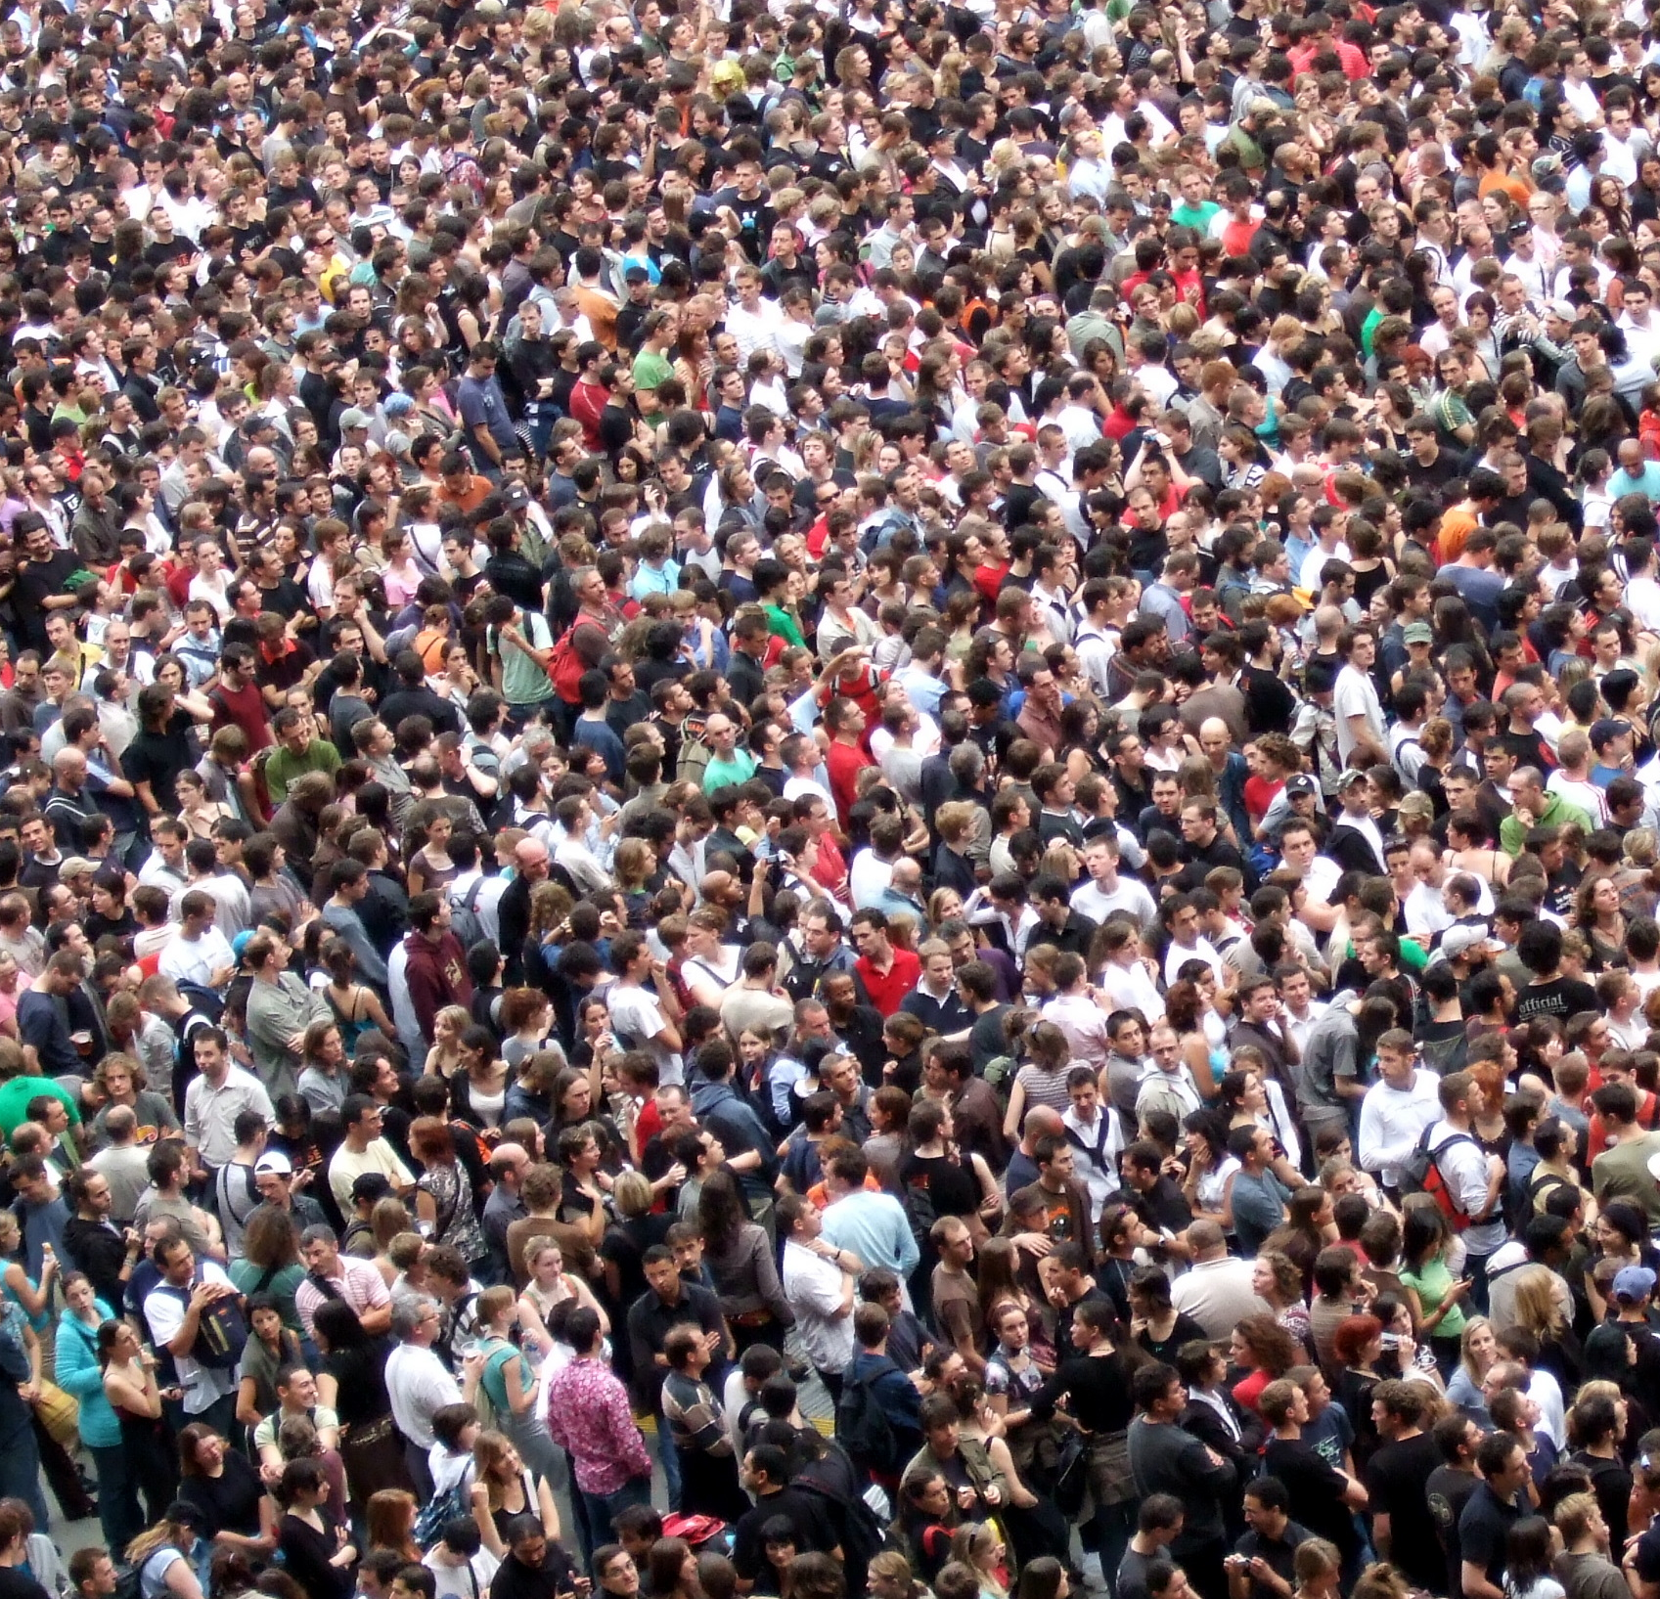
CONCLUSION
While the earth and all things belong to God our Creator, there is a special sense in which Christians belong to God, as expressed by the apostle Paul who wrote of our special relationship and responsibility toward God…
This Photo by Unknown Author is licensed under CC BY-SA
This Photo by Unknown Author is licensed under CC BY-NC-ND
This Photo by Unknown Author is licensed under CC BY

Slide 9
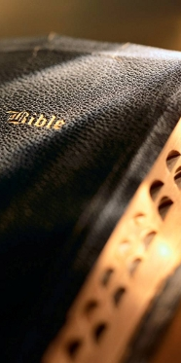
1 Corinthians 6:19-20
“What? know ye not that your body is the temple of the Holy Ghost which is in you, which ye have of God, and ye are not your own? For ye are bought with a price: therefore glorify God in your body, and in your spirit, which are God’s”
Cf. John 17:8-10; Eccl. 12:6-7
Are you living in a way that honors your Creator and Owner?
This Photo by Unknown Author is licensed under CC BY-NC-ND
Notes:
John 17:8-10 KJV 8 For I have given unto them the words which thou gavest me; and they have received them, and have known surely that I came out from thee, and they have believed that thou didst send me. 9 I pray for them: I pray not for the world, but for them which thou hast given me; for they are thine. 10 And all mine are thine, and thine are mine; and I am glorified in them.
Ecclesiastes 12:6-7 KJV 6 Or ever the silver cord be loosed, or the golden bowl be broken, or the pitcher be broken at the fountain, or the wheel broken at the cistern. 7 Then shall the dust return to the earth as it was: and the spirit shall return unto God who gave it.

Slide 10
Sirs, What MUST I do…?
Acts
16:30
Alien sinners MUST…
Hear the Gospel of Christ – Rom. 10:17; Heb. 11:6
Believe the Gospel – John 8:24
Repent of sin in your life – Acts 17:30
Confess that Jesus is the Son of God – Matt. 10:32
Be baptized to wash away your sins – Acts 2:38
An erring child of God MUST…
Repent and Pray for Forgiveness – 1 John 1:7-9
Christians MUST “be faithful unto death”
Endure sufferings to gain the crown – Rev. 2:10
Notes:
Acts 16:30-33 KJV 30 And brought them out, and said, Sirs, what must I do to be saved? 31 And they said, Believe on the Lord Jesus Christ, and thou shalt be saved, and thy house. 32 And they spake unto him the word of the Lord, and to all that were in his house. 33 And he took them the same hour of the night, and washed their stripes; and was baptized, he and all his, straightway.
Rom. 10:17 - So then faith cometh by hearing, and hearing by the word of God.
Heb 11:6 But without faith it is impossible to please him: for he that cometh to God must believe that he is, and that he is a rewarder of them that diligently seek him.
Jn. 8:24 - I said therefore unto you, that ye shall die in your sins: for if ye believe not that I am he, ye shall die in your sins.
Acts 17:30-31 - And the times of this ignorance God winked at; but now commandeth all men every where to repent: 31 Because he hath appointed a day, in the which he will judge the world in righteousness by that man whom he hath ordained; whereof he hath given assurance unto all men, in that he hath raised him from the dead.
Matt. 10:32 - Whosoever therefore shall confess me before men, him will I confess also before my Father which is in heaven.
Acts 8:36-37 NKJV 36 Now as they went down the road, they came to some water. And the eunuch said, "See, here is water. What hinders me from being baptized?" 37 Then Philip said, "If you believe with all your heart, you may." And he answered and said, "I believe that Jesus Christ is the Son of God.“38 So he commanded the chariot to stand still. And both Philip and the eunuch went down into the water, and he baptized him.
Acts 2:38 - Then Peter said unto them, Repent, and be baptized every one of you in the name of Jesus Christ for the remission of sins, and ye shall receive the gift of the Holy Ghost.
1 Jn. 1:7-9 - But if we walk in the light, as he is in the light, we have fellowship one with another, and the blood of Jesus Christ his Son cleanseth us from all sin. 8 If we say that we have no sin, we deceive ourselves, and the truth is not in us. 9 If we confess our sins, he is faithful and just to forgive us our sins, and to cleanse us from all unrighteousness.
Rev. 2:10 - Fear none of those things which thou shalt suffer: behold, the devil shall cast some of you into prison, that ye may be tried; and ye shall have tribulation ten days: be thou faithful unto death, and I will give thee a crown of life.

