Slide 1
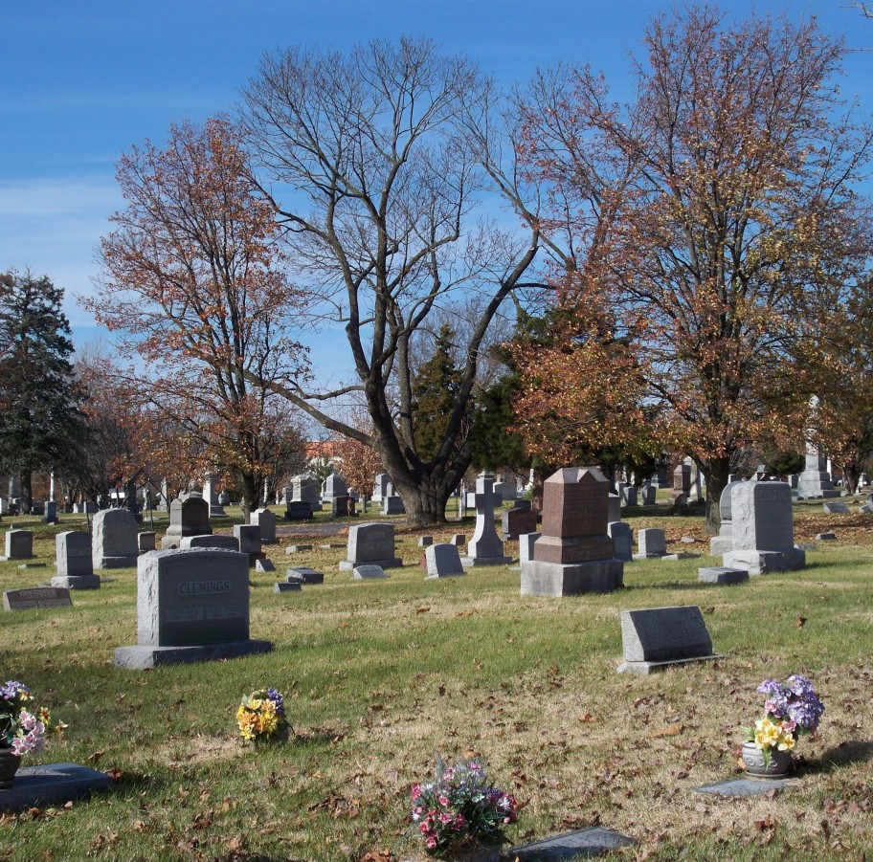
What Death Does Not Do

Slide 2
Hebrews 9:27-28
“27 And as it is appointed unto men once to die, but after this the judgment: 28 So Christ was once offered to bear the sins of many; and unto them that look for him shall he appear the second time without sin unto salvation.”

Slide 3
Introduction
Physical death is a certainty – all men will die if Christ does not come first – Heb. 9:27
This fact is recognized by the living of this world – Eccl. 9:1-5
Death is experienced by man and animal alike – Eccl. 3:19-21
Multitudes of things could be said about death!
But what does death NOT DO?
Notes:
Hebrews 9:27-28 ASV 27 And inasmuch as it is appointed unto men once to die, and after this cometh judgment; 28 so Christ also, having been once offered to bear the sins of many, shall appear a second time, apart from sin, to them that wait for him, unto salvation.
Ecclesiastes 9:1-5 KJV 1 For all this I considered in my heart even to declare all this, that the righteous, and the wise, and their works, are in the hand of God: no man knoweth either love or hatred by all that is before them. 2 All things come alike to all: there is one event to the righteous, and to the wicked; to the good and to the clean, and to the unclean; to him that sacrificeth, and to him that sacrificeth not: as is the good, so is the sinner; and he that sweareth, as he that feareth an oath. 3 This is an evil among all things that are done under the sun, that there is one event unto all: yea, also the heart of the sons of men is full of evil, and madness is in their heart while they live, and after that they go to the dead. 4 For to him that is joined to all the living there is hope: for a living dog is better than a dead lion. 5 For the living know that they shall die: but the dead know not any thing, neither have they any more a reward; for the memory of them is forgotten.
Ecclesiastes 3:19-22 KJV 19 For that which befalleth the sons of men befalleth beasts; even one thing befalleth them: as the one dieth, so dieth the other; yea, they have all one breath; so that a man hath no preeminence above a beast: for all is vanity. 20 All go unto one place; all are of the dust, and all turn to dust again. 21 Who knoweth the spirit of man that goeth upward, and the spirit of the beast that goeth downward to the earth? 22 Wherefore I perceive that there is nothing better, than that a man should rejoice in his own works; for that is his portion: for who shall bring him to see what shall be after him?

Slide 4
Make Sin Right
All men will be judged – Heb. 9:27
This judgment will be righteous judgment
  Acts 17:30-32
The works of every man will be examined in judgment – Eccl. 12:14
We will stand before Christ when judged
  2 Cor. 5:10
From what is written on some headstones, we might conclude that only good people die – Matt. 7:21-23
Death Does Not
Notes:
Hebrews 9:27-28 ASV 27 And inasmuch as it is appointed unto men once to die, and after this cometh judgment; 28 so Christ also, having been once offered to bear the sins of many, shall appear a second time, apart from sin, to them that wait for him, unto salvation.
Ecclesiastes 12:13-14 NKJV 13 Let us hear the conclusion of the whole matter: Fear God and keep His commandments, For this is man's all. 14 For God will bring every work into judgment, Including every secret thing, Whether good or evil.
2 Corinthians 5:10 ASV 10 For we must all be made manifest before the judgment-seat of Christ; that each one may receive the things done in the body, according to what he hath done, whether it be good or bad.
Matthew 7:21-23 ASV 21 Not every one that saith unto me, Lord, Lord, shall enter into the kingdom of heaven; but he that doeth the will of my Father who is in heaven. 22 Many will say to me in that day, Lord, Lord, did we not prophesy by thy name, and by thy name cast out demons, and by thy name do many mighty works? 23 And then will I profess unto them, I never knew you: depart from me, ye that work iniquity.

Slide 5
End One’s Influence
We have a great influence on others by our lives – Heb. 11:4; Rev. 14:13
It was said upon the death of a young girl by her friends that “it was easier to be good when she was around”
  Her legacy lived on after her death! This girl had a great influence on those she left behind
Dorcus was remembered by her “good works and alms deeds” – Acts 9:36-39
What influence do we have on others?
Death Does Not
Notes:
Hebrews 11:4 KJV 4 By faith Abel offered unto God a more excellent sacrifice than Cain, by which he obtained witness that he was righteous, God testifying of his gifts: and by it he being dead yet speaketh.
Revelation 14:13 KJV 13 And I heard a voice from heaven saying unto me, Write, Blessed are the dead which die in the Lord from henceforth: Yea, saith the Spirit, that they may rest from their labours; and their works do follow them.
Acts 9:36-39 KJV 36 Now there was at Joppa a certain disciple named Tabitha, which by interpretation is called Dorcas: this woman was full of good works and almsdeeds which she did. 37 And it came to pass in those days, that she was sick, and died: whom when they had washed, they laid her in an upper chamber. 38 And forasmuch as Lydda was nigh to Joppa, and the disciples had heard that Peter was there, they sent unto him two men, desiring him that he would not delay to come to them. 39 Then Peter arose and went with them. When he was come, they brought him into the upper chamber: and all the widows stood by him weeping, and shewing the coats and garments which Dorcas made, while she was with them.

Slide 6
Mean Non-existence
Some denominations believe that the soul ends at death
Jehovah’s Witnesses teach doctrine of annihilation and the Seventh-day Adventist the doctrine of soul sleep
The Bible teaches the soul does not cease to exist at death – Luke 16:22-23
  James 2:26
  Matt. 10:28; 22:32
  Eccl. 12:5, 7
  2 Cor. 4:17-18
Death Does Not
Notes:
Luke 16:22-23 KJV 22 And it came to pass, that the beggar died, and was carried by the angels into Abraham's bosom: the rich man also died, and was buried; 23 And in hell he lift up his eyes, being in torments, and seeth Abraham afar off, and Lazarus in his bosom.
James 2:26 KJV 26 For as the body without the spirit is dead, so faith without works is dead also.
Matthew 10:28 KJV 28 And fear not them which kill the body, but are not able to kill the soul: but rather fear him which is able to destroy both soul and body in hell.
Matthew 22:32 KJV 32 I am the God of Abraham, and the God of Isaac, and the God of Jacob? God is not the God of the dead, but of the living.
Ecclesiastes 12:5-7 KJV 5 Also when they shall be afraid of that which is high, and fears shall be in the way, and the almond tree shall flourish, and the grasshopper shall be a burden, and desire shall fail: because man goeth to his long home, and the mourners go about the streets: 6 Or ever the silver cord be loosed, or the golden bowl be broken, or the pitcher be broken at the fountain, or the wheel broken at the cistern. 7 Then shall the dust return to the earth as it was: and the spirit shall return unto God who gave it.
2 Corinthians 4:17-18 KJV 17 For our light affliction, which is but for a moment, worketh for us a far more exceeding and eternal weight of glory; 18 While we look not at the things which are seen, but at the things which are not seen: for the things which are seen are temporal; but the things which are not seen are eternal.

Slide 7
Erase One’s Memory
There was recognition in the hadean realm – Luke 16:22-30
It is said of some OT characters – “he was gathered to his people”
  Abraham – Gen. 25:8
  Ishmael – Gen. 25:17
  Jacob – Gen. 49:29
  Moses – Duet. 32:50
This phrase indicates a reunion of sorts in the hadean realm of those who die
Death Does Not
Cannot mean burial place for the burial place of Moses is not revealed – Duet. 34:5-6
Notes:
Luke 16:22-30 – Read text
Abraham - Genesis 25:8 KJV 8 Then Abraham gave up the ghost, and died in a good old age, an old man, and full of years; and was gathered to his people.
Abraham lived to be 175 years old. The scriptures tell us that he was “gathered to his people” at death. This phrase seems to indicate a reunion of sorts in the hadean world of those who die.
Ishmael - Genesis 25:17 KJV 17 And these are the years of the life of Ishmael, an hundred and thirty and seven years: and he gave up the ghost and died; and was gathered unto his people.
Jacob - Genesis 49:29-33 KJV 29 And he charged them, and said unto them, I am to be gathered unto my people: bury me with my fathers in the cave that is in the field of Ephron the Hittite, 30 In the cave that is in the field of Machpelah, which is before Mamre, in the land of Canaan, which Abraham bought with the field of Ephron the Hittite for a possession of a burying place. 31 There they buried Abraham and Sarah his wife; there they buried Isaac and Rebekah his wife; and there I buried Leah. 32 The purchase of the field and of the cave that is therein was from the children of Heth. 33 And when Jacob had made an end of commanding his sons, he gathered up his feet into the bed, and yielded up the ghost, and was gathered unto his people.
Moses - Deuteronomy 32:48-51 KJV 48 And the LORD spake unto Moses that selfsame day, saying, 49 Get thee up into this mountain Abarim, unto mount Nebo, which is in the land of Moab, that is over against Jericho; and behold the land of Canaan, which I give unto the children of Israel for a possession: 50 And die in the mount whither thou goest up, and be gathered unto thy people; as Aaron thy brother died in mount Hor, and was gathered unto his people: 51 Because ye trespassed against me among the children of Israel at the waters of Meribah-Kadesh, in the wilderness of Zin; because ye sanctified me not in the midst of the children of Israel.
Cannot mean the burying place, for said of Moses, Deut. 32:50, yet God buried him in secret place. Deuteronomy 34:5-6 KJV 5 So Moses the servant of the LORD died there in the land of Moab, according to the word of the LORD. 6 And he buried him in a valley in the land of Moab, over against Bethpeor: but no man knoweth of his sepulchre unto this day.

Slide 8
Offer a Second Chance
Some denominations such as the Catholics and Mormons teach “second chance after death” doctrines
The rich man did not have a second chance, and neither will we – Luke 16:25-31
Now is the time to prepare for our day of death – 2 Cor. 6:2; Rom. 1:16-17; 6:17-18
Death Does Not
“And beside all this, between us and you there is a great gulf fixed: so that they which would pass from hence to you cannot; neither can they pass to us, that would come from thence” – Luke 16:26 KJV
Notes:
Luke 16:25-31 KJV 25 But Abraham said, Son, remember that thou in thy lifetime receivedst thy good things, and likewise Lazarus evil things: but now he is comforted, and thou art tormented. 26 And beside all this, between us and you there is a great gulf fixed: so that they which would pass from hence to you cannot; neither can they pass to us, that would come from thence. 27 Then he said, I pray thee therefore, father, that thou wouldest send him to my father's house: 28 For I have five brethren; that he may testify unto them, lest they also come into this place of torment. 29 Abraham saith unto him, They have Moses and the prophets; let them hear them. 30 And he said, Nay, father Abraham: but if one went unto them from the dead, they will repent. 31 And he said unto him, If they hear not Moses and the prophets, neither will they be persuaded, though one rose from the dead.
2 Corinthians 6:1-2 KJV 1 We then, as workers together with him, beseech you also that ye receive not the grace of God in vain. 2 (For he saith, I have heard thee in a time accepted, and in the day of salvation have I succoured thee: behold, now is the accepted time; behold, now is the day of salvation.) Paul cites Isa 49:8 Thus saith the LORD, In an acceptable time have I heard thee, and in a day of salvation have I helped thee: and I will preserve thee, and give thee for a covenant of the people, to establish the earth, to cause to inherit the desolate heritages;
Romans 1:16-17 KJV 16 For I am not ashamed of the gospel of Christ: for it is the power of God unto salvation to every one that believeth; to the Jew first, and also to the Greek. 17 For therein is the righteousness of God revealed from faith to faith: as it is written, The just shall live by faith.
Romans 6:17-18 KJV 17 But God be thanked, that ye were the servants of sin, but ye have obeyed from the heart that form of doctrine which was delivered you. 18 Being then made free from sin, ye became the servants of righteousness.

Slide 9
Separate Us From God’s Love
God’s love never ceases for man
2 Pet. 3:9; John 3:16; 1 John. 4:9; Rom. 5:6-8
“For I am persuaded, that neither death, nor life, nor angels, nor principalities, nor things present, nor things to come, nor powers, nor height, nor depth, nor any other creature, shall be able to separate us from the love of God, which is in Christ Jesus our Lord” – Rom. 8:38-39, ASV
Death Does Not
Notes:
2 Peter 3:9 ASV 9 The Lord is not slack concerning his promise, as some count slackness; but is longsuffering to you-ward, not wishing that any should perish, but that all should come to repentance.
John 3:16-17 KJV 16 For God so loved the world, that he gave his only begotten Son, that whosoever believeth in him should not perish, but have everlasting life. 17 For God sent not his Son into the world to condemn the world; but that the world through him might be saved.\
1 John 4:9 KJV 9 In this was manifested the love of God toward us, because that God sent his only begotten Son into the world, that we might live through him.
Romans 5:6-8 ASV 6 For while we were yet weak, in due season Christ died for the ungodly. 7 For scarcely for a righteous man will one die: for peradventure for the good man some one would even dare to die. 8 But God commendeth his own love toward us, in that, while we were yet sinners, Christ died for us.

Slide 10
Exempt One From Judgment
No man will miss God’s appointed day of judgment
“And inasmuch as it is appointed unto men once to die, and after this cometh judgment” – Heb. 9:27, ASV
Death Does Not
“For we must all be made manifest before the judgment-seat of Christ; that each one may receive the things done in the body, according to what he hath done, whether it be good or bad” – 2 Cor. 5:10, ASV

Slide 11
Exempt Unbelievers From The Wrath of God
God is longsuffering but not forever suffering – 2 Pet 3:9-11
He will come…
“with fire and brimstone” – Rev. 21:8
“in flaming fire” – 2 Thess. 1:7-12
“knowing the terror of the Lord” – 2 Cor. 5:11
“righteous scarcely be saved” – 1 Pet. 4:17-19
“the latter end is worse” – 2 Pet. 2:20-22
Death Does Not
Notes:
2 Peter 3:9-11 KJV 9 The Lord is not slack concerning his promise, as some men count slackness; but is longsuffering to us-ward, not willing that any should perish, but that all should come to repentance. 10 But the day of the Lord will come as a thief in the night; in the which the heavens shall pass away with a great noise, and the elements shall melt with fervent heat, the earth also and the works that are therein shall be burned up. 11 Seeing then that all these things shall be dissolved, what manner of persons ought ye to be in all holy conversation and godliness,
Revelation 21:8 KJV 8 But the fearful, and unbelieving, and the abominable, and murderers, and whoremongers, and sorcerers, and idolaters, and all liars, shall have their part in the lake which burneth with fire and brimstone: which is the second death.
2 Thessalonians 1:7-10 KJV 7 And to you who are troubled rest with us, when the Lord Jesus shall be revealed from heaven with his mighty angels, 8 In flaming fire taking vengeance on them that know not God, and that obey not the gospel of our Lord Jesus Christ: 9 Who shall be punished with everlasting destruction from the presence of the Lord, and from the glory of his power; 10 When he shall come to be glorified in his saints, and to be admired in all them that believe (because our testimony among you was believed) in that day/
2 Corinthians 5:11 NKJV 11 Knowing, therefore, the terror of the Lord, we persuade men; but we are well known to God, and I also trust are well known in your consciences.
1 Peter 4:17-19 ASV 17 For the time is come for judgment to begin at the house of God: and if it begin first at us, what shall be the end of them that obey not the gospel of God? 18 And if the righteous is scarcely saved, where shall the ungodly and sinner appear? 19 Wherefore let them also that suffer according to the will of God commit their souls in well-doing unto a faithful Creator.
1 Peter 4:17-19 KJV 17 For the time is come that judgment must begin at the house of God: and if it first begin at us, what shall the end be of them that obey not the gospel of God? 18 And if the righteous scarcely be saved, where shall the ungodly and the sinner appear? 19 Wherefore let them that suffer according to the will of God commit the keeping of their souls to him in well doing, as unto a faithful Creator.
2 Peter 2:20-22 KJV 20 For if after they have escaped the pollutions of the world through the knowledge of the Lord and Saviour Jesus Christ, they are again entangled therein, and overcome, the latter end is worse with them than the beginning. 21 For it had been better for them not to have known the way of righteousness, than, after they have known it, to turn from the holy commandment delivered unto them. 22 But it is happened unto them according to the true proverb, The dog is turned to his own vomit again; and the sow that was washed to her wallowing in the mire.

Slide 12
Conclusion
Let us strive to properly evaluate death
Be prepared for it BEFORE it comes
James 1:9-12; 4:13-15
“For, All flesh is as grass, And all the glory thereof as the flower of grass. The grass withereth, and the flower falleth” – 1 Pet. 1:24, ASV
Notes:
James 1:9-12 ASV 9 But let the brother of low degree glory in his high estate: 10 and the rich, in that he is made low: because as the flower of the grass he shall pass away. 11 For the sun ariseth with the scorching wind, and withereth the grass: and the flower thereof falleth, and the grace of the fashion of it perisheth: so also shall the rich man fade away in his goings. 12 Blessed is the man that endureth temptation; for when he hath been approved, he shall receive the crown of life, which the Lord promised to them that love him.
James 4:13-15 ASV 13 Come now, ye that say, To-day or tomorrow we will go into this city, and spend a year there, and trade, and get gain: 14 whereas ye know not what shall be on the morrow. What is your life? For ye are a vapor, that appeareth for a little time, and then vanisheth away. 15 For that ye ought to say, If the Lord will, we shall both live, and do this or that.
1 Peter 1:22-25 ASV 22 Seeing ye have purified your souls in your obedience to the truth unto unfeigned love of the brethren, love one another from the heart fervently: 23 having been begotten again, not of corruptible seed, but of incorruptible, through the word of God, which liveth and abideth. 24 For, All flesh is as grass, And all the glory thereof as the flower of grass. The grass withereth, and the flower falleth: 25 But the word of the Lord abideth for ever. And this is the word of good tidings which was preached unto you.

Slide 13
“…what shall we do?”
Acts
2:37
Alien sinners MUST…
Hear the Gospel – Romans 10:17; Hebrews 11:6
Obey the Gospel of Christ – Hebrews 5:8-9
Repent of sin in your life – Acts 17:30-31
Confess that Christ is God’s Son – Acts 8:38
Be baptized to wash away your sins – Acts 2:38
  A wayward child of God MUST…
Repent and pray for forgiveness – 1 John 1:7-9
Christians MUST “be faithful unto death”
Rev. 2:10b
Notes:
Acts 2:37-38 KJV 37 Now when they heard this, they were pricked in their heart, and said unto Peter and to the rest of the apostles, Men and brethren, what shall we do? 38 Then Peter said unto them, Repent, and be baptized every one of you in the name of Jesus Christ for the remission of sins, and ye shall receive the gift of the Holy Ghost.
Rom. 10:17 - So then faith cometh by hearing, and hearing by the word of God.
Heb. 11:6 But without faith it is impossible to please him: for he that cometh to God must believe that he is, and that he is a rewarder of them that diligently seek him.
Heb. 5:8-9 KJV 8 Though he were a Son, yet learned he obedience by the things which he suffered; 9 And being made perfect, he became the author of eternal salvation unto all them that obey him; 31 Becaus
Acts 17:30-31 - And the times of this ignorance God winked at; but now commandeth all men every where to repent:because he hath appointed a day, in the which he will judge the world in righteousness by that man whom he hath ordained; whereof he hath given assurance unto all men, in that he hath raised him from the dead.
Acts 8:36-37 KJV 36 And as they went on their way, they came unto a certain water: and the eunuch said, See, here is water; what doth hinder me to be baptized? 37 And Philip said, If thou believest with all thine heart, thou mayest. And he answered and said, I believe that Jesus Christ is the Son of God.
Acts 2:38 - Then Peter said unto them, Repent, and be baptized every one of you in the name of Jesus Christ for the remission of sins, and ye shall receive the gift of the Holy Ghost.
1 Jn. 1:7-9 - But if we walk in the light, as he is in the light, we have fellowship one with another, and the blood of Jesus Christ his Son cleanseth us from all sin. 8 If we say that we have no sin, we deceive ourselves, and the truth is not in us. 9 If we confess our sins, he is faithful and just to forgive us our sins, and to cleanse us from all unrighteousness.
Rev. 2:10 - Fear none of those things which thou shalt suffer: behold, the devil shall cast some of you into prison, that ye may be tried; and ye shall have tribulation ten days: be thou faithful unto death, and I will give thee a crown of life.

