Slide 1
The Return Of Christ
John 14:1-3, 28

Slide 2
INTRODUCTION
There have been many predictions by men concerning the date when Christ will return
Some believe that His return will be soon
Some doubt He is going come again
Many men have made predictions of the date of Christ’s return!

Slide 3
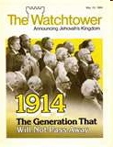
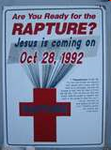
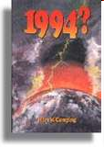
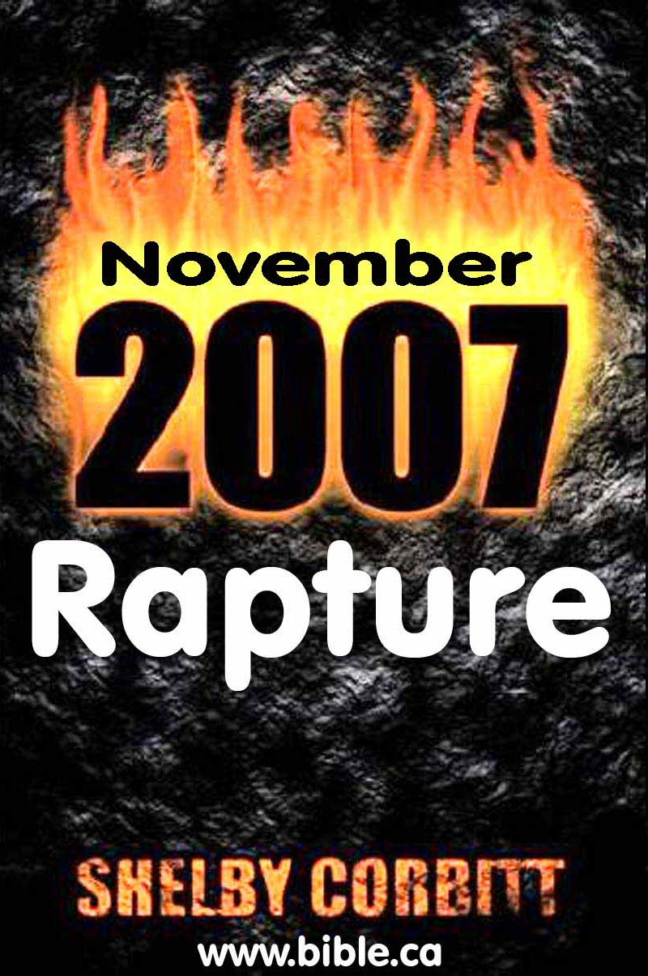
Predictions By False Teachers
EVERY Prediction By Man Has AND Will Fail!
William Miller (SDA) Oct. 22, 1844 – “The Great Disappointment”
Ellen G. White (SDA) - 1850’s (she would see it, but died in 1915)
Joseph Smith (Mormon) – by 1891 or earlier
Charles T. Russell (JW’s) – 1914
Pat Robertson, of the CBN – by the end of 1982
Lee Jang Rim of “Mission for the Coming Days” – Oct. 28, 1992
Harold Camping – Predicted May 21, 1994, and later May 21, 2011
Shelby Corbett – 2007 Rapture
Ron Weinland – (Church of God) predicted April 17, 2008, later predicted May 27, 2012

Slide 4
Deuteronomy 18:18-22, NKJV
“18 I will raise up for them a Prophet like you from among their brethren, and will put My words in His mouth, and He shall speak to them all that I command Him.
19 And it shall be that whoever will not hear My words, which He speaks in My name, I will require it of him.
20 But the prophet who presumes to speak a word in My name, which I have not commanded him to speak, or who speaks in the name of other gods, that prophet shall die.'
21 And if you say in your heart, ‘How shall we know the word which the LORD has not spoken?’
22 when a prophet speaks in the name of the LORD, if the thing does not happen or come to pass, that is the thing which the LORD has not spoken; the prophet has spoken it presumptuously; you shall not be afraid of him”
Notes:
Acts 3:19-26 KJV 19 Repent ye therefore, and be converted, that your sins may be blotted out, when the times of refreshing shall come from the presence of the Lord; 20 And he shall send Jesus Christ, which before was preached unto you: 21 Whom the heaven must receive until the times of restitution of all things, which God hath spoken by the mouth of all his holy prophets since the world began. 22 For Moses truly said unto the fathers, A prophet shall the Lord your God raise up unto you of your brethren, like unto me; him shall ye hear in all things whatsoever he shall say unto you. 23 And it shall come to pass, that every soul, which will not hear that prophet, shall be destroyed from among the people. 24 Yea, and all the prophets from Samuel and those that follow after, as many as have spoken, have likewise foretold of these days. 25 Ye are the children of the prophets, and of the covenant which God made with our fathers, saying unto Abraham, And in thy seed shall all the kindreds of the earth be blessed. 26 Unto you first God, having raised up his Son Jesus, sent him to bless you, in turning away every one of you from his iniquities.

Slide 5
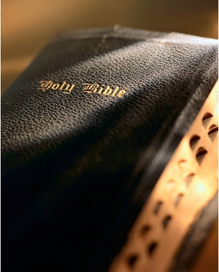
What Does The Bible Teach About Christs’ Return?
This Photo by Unknown Author is licensed under CC BY-NC-ND

Slide 6
Jesus Promised to Return
He comforted His disciples about His departure – “…I will come again and receive you…” – John 14:1-3, 28
He spoke of His “coming in a cloud with power and great glory”
Luke 21:27; cf. 1 Thess. 4:16-17; Rev. 1:7
He also said His coming will be with “glory and all the holy angels”
Matt. 25:31
The Bible Teaches
Notes:
John 14:1-3 NKJV 1 "Let not your heart be troubled; you believe in God, believe also in Me. 2 "In My Father's house are many mansions; if it were not so, I would have told you. I go to prepare a place for you. 3 "And if I go and prepare a place for you, I will come again and receive you to Myself; that where I am, there you may be also.
John 14:28 NKJV 28 "You have heard Me say to you, 'I am going away and coming back to you.' If you loved Me, you would rejoice because I said, 'I am going to the Father,' for My Father is greater than I.
Luke 21:25-28 NKJV 25 "And there will be signs in the sun, in the moon, and in the stars; and on the earth distress of nations, with perplexity, the sea and the waves roaring; 26 "men's hearts failing them from fear and the expectation of those things which are coming on the earth, for the powers of heaven will be shaken. 27 "Then they will see the Son of Man coming in a cloud with power and great glory. 28 "Now when these things begin to happen, look up and lift up your heads, because your redemption draws near.“
1 Thessalonians 4:16-17 KJV 16 For the Lord himself shall descend from heaven with a shout, with the voice of the archangel, and with the trump of God: and the dead in Christ shall rise first: 17 Then we which are alive and remain shall be caught up together with them in the clouds, to meet the Lord in the air: and so shall we ever be with the Lord.
Revelation 1:7 KJV 7 Behold, he cometh with clouds; and every eye shall see him, and they also which pierced him: and all kindreds of the earth shall wail because of him. Even so, Amen
Matthew 25:31-33 NKJV 31 "When the Son of Man comes in His glory, and all the holy angels with Him, then He will sit on the throne of His glory. 32 "All the nations will be gathered before Him, and He will separate them one from another, as a shepherd divides his sheep from the goats. 33 "And He will set the sheep on His right hand, but the goats on the left.

Slide 7
Angels Announced His Return
The first message given from God to man after His ascension was by angels (“two men in white apparel”) who declared His return – Acts 1:9-11
Angels will also accompany Christ upon His return – Matt. 13:41
Cf. Matt 25:31; 2 Thess. 1:7-9
The Bible Teaches
Notes:
Acts 1:9-11 NKJV 9 Now when He had spoken these things, while they watched, He was taken up, and a cloud received Him out of their sight. 10 And while they looked steadfastly toward heaven as He went up, behold, two men stood by them in white apparel, 11 who also said, "Men of Galilee, why do you stand gazing up into heaven? This same Jesus, who was taken up from you into heaven, will so come in like manner as you saw Him go into heaven.“
Matthew 13:41-42 NKJV 41 "The Son of Man will send out His angels, and they will gather out of His kingdom all things that offend, and those who practice lawlessness, 42 "and will cast them into the furnace of fire. There will be wailing and gnashing of teeth.
Matthew 25:31-33 NKJV 31 "When the Son of Man comes in His glory, and all the holy angels with Him, then He will sit on the throne of His glory. 32 "All the nations will be gathered before Him, and He will separate them one from another, as a shepherd divides his sheep from the goats. 33 "And He will set the sheep on His right hand, but the goats on the left.
2 Thessalonians 1:7-9 NKJV 7 and to give you who are troubled rest with us when the Lord Jesus is revealed from heaven with His mighty angels, 8 in flaming fire taking vengeance on those who do not know God, and on those who do not obey the gospel of our Lord Jesus Christ. 9 These shall be punished with everlasting destruction from the presence of the Lord and from the glory of His power,

Slide 8
NT Writers Said He Will Return
The New Testament writers were inspired of God – 2 Tim. 3:16-17
1 Cor. 2:9-13; Eph. 3:2-5
Paul wrote “the commandments of the Lord” – 1 Cor. 14:37
In Paul’s letter to the saints in Thessalonica he wrote of the coming of Christ – 1 Thess. 4:16, 18
The Bible Teaches
Notes:
2 Timothy 3:16-17 KJV 16 All scripture is given by inspiration of God, and is profitable for doctrine, for reproof, for correction, for instruction in righteousness: 17 That the man of God may be perfect, throughly furnished unto all good works.
1 Corinthians 2:9-13 ASV 9 but as it is written, Things which eye saw not, and ear heard not, And which entered not into the heart of man, Whatsoever things God prepared for them that love him. 10 But unto us God revealed them through the Spirit: for the Spirit searcheth all things, yea, the deep things of God. 11 For who among men knoweth the things of a man, save the spirit of the man, which is in him? even so the things of God none knoweth, save the Spirit of God. 12 But we received, not the spirit of the world, but the spirit which is from God; that we might know the things that were freely given to us of God. 13 Which things also we speak, not in words which man's wisdom teacheth, but which the Spirit teacheth; combining spiritual things with spiritual words.
Ephesians 3:1-5 NKJV 1 For this reason I, Paul, the prisoner of Christ Jesus for you Gentiles-- 2 if indeed you have heard of the dispensation of the grace of God which was given to me for you, 3 how that by revelation He made known to me the mystery (as I have briefly written already, 4 by which, when you read, you may understand my knowledge in the mystery of Christ), 5 which in other ages was not made known to the sons of men, as it has now been revealed by the Spirit to His holy apostles and prophets.
1 Corinthians 14:37 KJV 37 If any man think himself to be a prophet, or spiritual, let him acknowledge that the things that I write unto you are the commandments of the Lord.
1 Thessalonians 4:13-18
13 But we would not have you ignorant, brethren, concerning them that fall asleep; that ye sorrow not, even as the rest, who have no hope.
14 For if we believe that Jesus died and rose again, even so them also that are fallen asleep in Jesus will God bring with him.
15 For this we say unto you by the word of the Lord, that we that are alive, that are left unto the coming of the Lord, shall in no wise precede them that are fallen asleep.
16 For the Lord himself shall descend from heaven, with a shout, with the voice of the archangel, and with the trump of God: and the dead in Christ shall rise first;
17 then we that are alive, that are left, shall together with them be caught up in the clouds, to meet the Lord in the air: and so shall we ever be with the Lord.
18 Wherefore comfort one another with these words.

Slide 9
His Coming Will Be Seen By All
Some claimed “the resurrection is past already” – 2 Tim. 2:18
Many believe in a “rapture” of the saved to heaven and no one will see Him. But this idea is foreign to the New Testament – Phil. 2:10-11
When Christ returns, the NT teaches that “every eye shall see Him and they also which pierced him”
Rev. 1:7
The Bible Teaches
Notes:
2 Timothy 2:14-19 NKJV 14 Remind them of these things, charging them before the Lord not to strive about words to no profit, to the ruin of the hearers. 15 Be diligent to present yourself approved to God, a worker who does not need to be ashamed, rightly dividing the word of truth. 16 But shun profane and idle babblings, for they will increase to more ungodliness. 17 And their message will spread like cancer. Hymenaeus and Philetus are of this sort, 18 who have strayed concerning the truth, saying that the resurrection is already past; and they overthrow the faith of some. 19 Nevertheless the solid foundation of God stands, having this seal: "The Lord knows those who are His," and, "Let everyone who names the name of Christ depart from iniquity.“
Philippians 2:9-11 KJV 9 Wherefore God also hath highly exalted him, and given him a name which is above every name: 10 That at the name of Jesus every knee should bow, of things in heaven, and things in earth, and things under the earth; 11 And that every tongue should confess that Jesus Christ is Lord, to the glory of God the Father.
Revelation 1:7 KJV 7 Behold, he cometh with clouds; and every eye shall see him, and they also which pierced him: and all kindreds of the earth shall wail because of him. Even so, Amen.

Slide 10
All Things Of A Material Nature Will Be Destroyed
“But the day of the Lord will come as a thief in the night, in which the heavens will pass away with a great noise, and the elements will melt with fervent heat; both the earth and the works that are in it will be burned up” – 2 Pet. 3:10ff
This world and all it contains will be no more – “burned up”!
The Bible Teaches
Notes:
2 Peter 3:9-12 NKJV 9 The Lord is not slack concerning His promise, as some count slackness, but is longsuffering toward us, not willing that any should perish but that all should come to repentance. 10 But the day of the Lord will come as a thief in the night, in which the heavens will pass away with a great noise, and the elements will melt with fervent heat; both the earth and the works that are in it will be burned up. 11 Therefore, since all these things will be dissolved, what manner of persons ought you to be in holy conduct and godliness, 12 looking for and hastening the coming of the day of God, because of which the heavens will be dissolved, being on fire, and the elements will melt with fervent heat?

Slide 11
ALL The Dead Of All Time Will Be Raised When Christ Comes
Jesus taught in: John 5:28-29
“Marvel not at this: for the hour is coming, in the which all that are in the graves shall hear his voice, And shall come forth; they that have done good, unto the resurrection of life; and they that have done evil, unto the resurrection of damnation.”
ONE resurrection – but two distinct outcomes – “life” or “damnation” at the same hour (time)! – Acts 24:15
The Bible Teaches
Notes:
Acts 24:14-15 NKJV 14 "But this I confess to you, that according to the Way which they call a sect, so I worship the God of my fathers, believing all things which are written in the Law and in the Prophets. 15 "I have hope in God, which they (his accusers) themselves also accept, that there will be a resurrection of the dead, both of the just and the unjust.

Slide 12
NO Man Knows When He Will Come – Only God The Father
Jesus said that no man knows the day or hour, only His Father
Matt. 24:36
When this day comes, many will be caught off-guard – not prepared
2 Pet. 3:10; cf., Matt. 25:1-13
Paul taught Christians to always be on-guard, watchful and prepared
1 Thess. 5:1-9
The Bible Teaches
Notes:
Matthew 24:34-39 NKJV 34 "Assuredly, I say to you, this generation will by no means pass away till all these things take place. 35 "Heaven and earth will pass away, but My words will by no means pass away. 36 "But of that day and hour no one knows, not even the angels of heaven, but My Father only. 37 "But as the days of Noah were, so also will the coming of the Son of Man be. 38 "For as in the days before the flood, they were eating and drinking, marrying and giving in marriage, until the day that Noah entered the ark, 39 "and did not know until the flood came and took them all away, so also will the coming of the Son of Man be.
2 Peter 3:10 NKJV 10 But the day of the Lord will come as a thief in the night, in which the heavens will pass away with a great noise, and the elements will melt with fervent heat; both the earth and the works that are in it will be burned up.
Matt. 25:1 NKJV 1 "Then the kingdom of heaven shall be likened to ten virgins who took their lamps and went out to meet the bridegroom.
2 "Now five of them were wise, and five were foolish.
3 "Those who were foolish took their lamps and took no oil with them,
4 "but the wise took oil in their vessels with their lamps.
5 "But while the bridegroom was delayed, they all slumbered and slept.
6 "And at midnight a cry was heard: 'Behold, the bridegroom is coming; go out to meet him!'
7 "Then all those virgins arose and trimmed their lamps.
8 "And the foolish said to the wise, 'Give us some of your oil, for our lamps are going out.'
9 "But the wise answered, saying, 'No, lest there should not be enough for us and you; but go rather to those who sell, and buy for yourselves.'
10 "And while they went to buy, the bridegroom came, and those who were ready went in with him to the wedding; and the door was shut.
11 "Afterward the other virgins came also, saying, 'Lord, Lord, open to us!'
12 "But he answered and said, 'Assuredly, I say to you, I do not know you.'
13 "Watch therefore, for you know neither the day nor the hour in which the Son of Man is coming.
1 Thess 5:1 NKJV 1 But concerning the times and the seasons, brethren, you have no need that I should write to you.
2 For you yourselves know perfectly that the day of the Lord so comes as a thief in the night.
3 For when they say, "Peace and safety!" then sudden destruction comes upon them, as labor pains upon a pregnant woman. And they shall not escape.
4 But you, brethren, are not in darkness, so that this Day should overtake you as a thief.
5 You are all sons of light and sons of the day. We are not of the night nor of darkness.
6 Therefore let us not sleep, as others do, but let us watch and be sober.
7 For those who sleep, sleep at night, and those who get drunk are drunk at night.
8 But let us who are of the day be sober, putting on the breastplate of faith and love, and as a helmet the hope of salvation.
9 For God did not appoint us to wrath, but to obtain salvation through our Lord Jesus Christ,

Slide 13
Jesus Promised to Return
Angels Announced His Return
The New Testament Writers Said He Will Come
His Coming Will Be Seen By All
All Things Of A Material Nature Will Be Destroyed
All The Dead Of All Time Will Be Raised
No Man Knows When He Will Come – Only God The Father
REVIEW

Slide 14
Prepare For This Day To Come
Obey the Gospel of Christ
Acts 2:38; 2 Thess. 1:7, 8
“search the scriptures daily”
Acts 17:11
“live soberly, righteously and Godly”
Titus 2:11, 12
“Take heed, watch and pray”
Mark 13:32-33
“be thou faithful unto death”
Rev. 2:10b; 2 Tim. 4:8
CONCLUSION
Notes:
Acts 2:37-38 KJV 37 Now when they heard this, they were pricked in their heart, and said unto Peter and to the rest of the apostles, Men and brethren, what shall we do? 38 Then Peter said unto them, Repent, and be baptized every one of you in the name of Jesus Christ for the remission of sins, and ye shall receive the gift of the Holy Ghost.
2 Thess. 1:7-8 - And to you who are troubled rest with us, when the Lord Jesus shall be revealed from heaven with his mighty angels, 8 In flaming fire taking vengeance on them that know not God, and that obey not the gospel of our Lord Jesus Christ:
Acts 17:11 - These were more noble than those in Thessalonica, in that they received the word with all readiness of mind, and searched the scriptures daily, whether those things were so.
Titus 2:11-12 - For the grace of God that bringeth salvation hath appeared to all men, 12 Teaching us that, denying ungodliness and worldly lusts, we should live soberly, righteously, and godly, in this present world;
Mark 13:32-33 KJV 32 But of that day and that hour knoweth no man, no, not the angels which are in heaven, neither the Son, but the Father. 33 Take ye heed, watch and pray: for ye know not when the time is.
Rev. 2:10 - Fear none of those things which thou shalt suffer: behold, the devil shall cast some of you into prison, that ye may be tried; and ye shall have tribulation ten days: be thou faithful unto death, and I will give thee a crown of life.
2 Tim. 4:8 - Henceforth there is laid up for me a crown of righteousness, which the Lord, the righteous judge, shall give me at that day: and not to me only, but unto all them also that love his appearing.

Slide 15
Sirs, What MUST I do…?
Acts
16:30
Alien sinners MUST…
Hear the Gospel of Christ – Rom. 10:17; Heb. 11:6
Believe the Gospel – John 8:24
Repent of sin in your life – Acts 17:30
Confess that Jesus is the Son of God – Matt. 10:34
Be baptized to wash away your sins – Acts 2:38
An erring child of God MUST…
Repent and Pray for Forgiveness – 1 John 1:7-9
Christians MUST “be faithful unto death”
Endure sufferings to gain the crown – Rev. 2:10
Notes:
Acts 16:30-33 KJV 30 And brought them out, and said, Sirs, what must I do to be saved? 31 And they said, Believe on the Lord Jesus Christ, and thou shalt be saved, and thy house. 32 And they spake unto him the word of the Lord, and to all that were in his house. 33 And he took them the same hour of the night, and washed their stripes; and was baptized, he and all his, straightway.
Rom. 10:17 - So then faith cometh by hearing, and hearing by the word of God.
Heb 11:6 But without faith it is impossible to please him: for he that cometh to God must believe that he is, and that he is a rewarder of them that diligently seek him.
Jn. 8:24 - I said therefore unto you, that ye shall die in your sins: for if ye believe not that I am he, ye shall die in your sins.
Acts 17:30-31 - And the times of this ignorance God winked at; but now commandeth all men every where to repent: 31 Because he hath appointed a day, in the which he will judge the world in righteousness by that man whom he hath ordained; whereof he hath given assurance unto all men, in that he hath raised him from the dead.
Matt. 10:34 - Whosoever therefore shall confess me before men, him will I confess also before my Father which is in heaven.
Acts 8:36-37 NKJV 36 Now as they went down the road, they came to some water. And the eunuch said, "See, here is water. What hinders me from being baptized?" 37 Then Philip said, "If you believe with all your heart, you may." And he answered and said, "I believe that Jesus Christ is the Son of God.“38 So he commanded the chariot to stand still. And both Philip and the eunuch went down into the water, and he baptized him.
Acts 2:38 - Then Peter said unto them, Repent, and be baptized every one of you in the name of Jesus Christ for the remission of sins, and ye shall receive the gift of the Holy Ghost.
1 Jn. 1:7-9 - But if we walk in the light, as he is in the light, we have fellowship one with another, and the blood of Jesus Christ his Son cleanseth us from all sin. 8 If we say that we have no sin, we deceive ourselves, and the truth is not in us. 9 If we confess our sins, he is faithful and just to forgive us our sins, and to cleanse us from all unrighteousness.
Rev. 2:10 - Fear none of those things which thou shalt suffer: behold, the devil shall cast some of you into prison, that ye may be tried; and ye shall have tribulation ten days: be thou faithful unto death, and I will give thee a crown of life.

