Slide 1
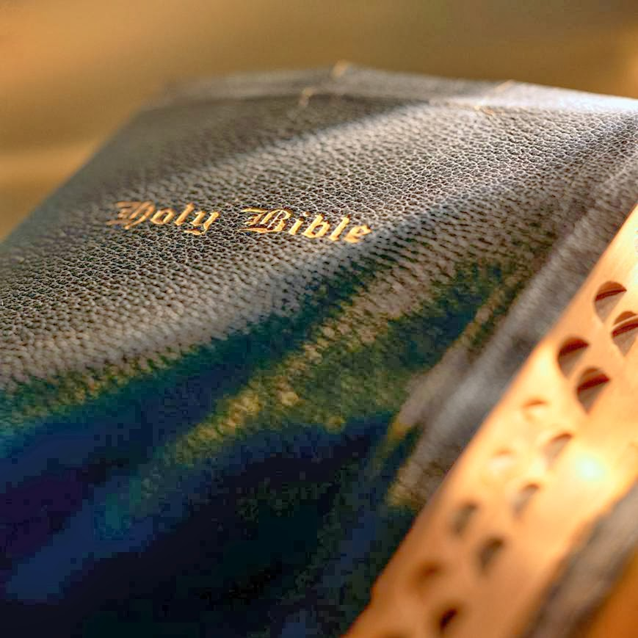
“So Much Better Than the angels”
Hebrews 1:1-14
This Photo by Unknown Author is licensed under CC BY-NC-ND

Slide 2
INTRODUCTION
In the book of Hebrews, the word “better” appears at least 13 times in the King James
This word, “better” was applied to: Christ, to expectations the writer had of the Hebrew brethren, hope, testament, covenant, promises, sacrifices, country, things, resurrection, blood
This letter begins with the writer boldly declaring in Chapter 1 (using six facts), that Christ is “so much better than the angels”!
2
Notes:
The Hebrews writer boldly affirms that Christ is better than anything the Jews had under the Old Law. The letter begins with at least six credentials that place Christ in a class by himself. Using these facts, the writer argues that He is “better than the angels.” Reading Chapter 1
Hebrews 1:1-14 KJV 1 God, who at sundry times and in divers manners spake in time past unto the fathers by the prophets, 2 Hath in these last days spoken unto us by his Son, whom he hath appointed heir of all things, by whom also he made the worlds; 3 Who being the brightness of his glory, and the express image of his person, and upholding all things by the word of his power, when he had by himself purged our sins, sat down on the right hand of the Majesty on high; 4 Being made so much better than the angels, as he hath by inheritance obtained a more excellent name than they. 5 For unto which of the angels said he at any time, Thou art my Son, this day have I begotten thee? (Psa. 2:7), And again, I will be to him a Father, and he shall be to me a Son? 6 And again, when he bringeth in the firstbegotten into the world, he saith, And let all the angels of God worship him. 7 And of the angels he saith, Who maketh his angels spirits, and his ministers a flame of fire. 8 But unto the Son he saith, Thy throne, O God, is for ever and ever: a sceptre of righteousness is the sceptre of thy kingdom. 9 Thou hast loved righteousness, and hated iniquity; therefore God, even thy God, hath anointed thee with the oil of gladness above thy fellows. 10 And, Thou, Lord, in the beginning hast laid the foundation of the earth; and the heavens are the works of thine hands: 11 They shall perish; but thou remainest; and they all shall wax old as doth a garment; 12 And as a vesture shalt thou fold them up, and they shall be changed: but thou art the same, and thy years shall not fail. 13 But to which of the angels said he at any time, Sit on my right hand, until I make thine enemies thy footstool? 14 Are they not all ministering spirits, sent forth to minister for them who shall be heirs of salvation?
Heb 1:4 ¶ Being made so much better than the angels, as he hath by inheritance obtained a more excellent name than they.
Heb 6:9 ¶ But, beloved, we are persuaded better things of you, and things that accompany salvation, though we thus speak.
Heb 7:7 And without all contradiction the less is blessed of the better.
Heb 7:19 For the law made nothing perfect, but the bringing in of a better hope did; by the which we draw nigh unto God.
Heb 7:22 By so much was Jesus made a surety of a better testament.
Heb 8:6 ¶ But now hath he obtained a more excellent ministry, by how much also he is the mediator of a better covenant, which was established upon better promises.
Heb 9:23 ¶ It was therefore necessary that the patterns of things in the heavens should be purified with these; but the heavenly things themselves with better sacrifices than these.
Heb 10:34 For ye had compassion of me in my bonds, and took joyfully the spoiling of your goods, knowing in yourselves that ye have in heaven a better and an enduring substance.
Heb 11:16 But now they desire a better country, that is, an heavenly: wherefore God is not ashamed to be called their God: for he hath prepared for them a city.
Heb 11:35 Women received their dead raised to life again: and others were tortured, not accepting deliverance; that they might obtain a better resurrection:
Heb 11:40 God having provided some better thing for us, that they without us should not be made perfect.
Heb 12:24 And to Jesus the mediator of the new covenant, and to the blood of sprinkling, that speaketh better things than that of Abel.

Slide 3
Hebrews 1:1-4
1 God, who at sundry times and in divers manners spake in time past unto the fathers by the prophets, 2 Hath in these last days spoken unto us by his Son, whom he hath appointed heir of all things, by whom also he made the worlds; 3 Who being the brightness of his glory, and the express image of his person, and upholding all things by the word of his power, when he had by himself purged our sins, sat down on the right hand of the Majesty on high; 4 Being made so much better than the angels, as he hath by inheritance obtained a more excellent name than they.

Slide 4
HOW IS CHRIST “SO MUCH BETTER THAN THE ANGELS”?

Slide 5
His name is more excellent!
“Being made so much better than the angels, as he hath by inheritance obtained a more excellent name than they” (4)
Salvation is linked ONLY to Christ’s name
“…for there is none other name under heaven given among men, whereby we must be saved”
Acts 4:12
He is exalted by God and every knee will bow before Christ and confess His name – Phil. 2:9-11
All things must be done in the name of Christ
Prayer – Col. 3:17; John 14:13, 14; 15:16; 16:23, 24, 26
How Christ Is Better
Notes:
Hebrews 1:1-4 KJV 1 God, who at sundry times and in divers manners spake in time past unto the fathers by the prophets, 2 Hath in these last days spoken unto us by his Son, whom he hath appointed heir of all things, by whom also he made the worlds; 3 Who being the brightness of his glory, and the express image of his person, and upholding all things by the word of his power, when he had by himself purged our sins, sat down on the right hand of the Majesty on high; 4 Being made so much better than the angels, as he hath by inheritance obtained a more excellent name than they.
Acts 4:11-12 KJV 11 This is the stone which was set at nought of you builders, which is become the head of the corner. 12 Neither is there salvation in any other: for there is none other name under heaven given among men, whereby we must be saved.
Philippians 2:9-11 KJV 9 Wherefore God also hath highly exalted him, and given him a name which is above every name: 10 That at the name of Jesus every knee should bow, of things in heaven, and things in earth, and things under the earth; 11 And that every tongue should confess that Jesus Christ is Lord, to the glory of God the Father.
Colossians 3:17 KJV 17 And whatsoever ye do in word or deed, do all in the name of the Lord Jesus, giving thanks to God and the Father by him.
John 14:13 And whatsoever ye shall ask in my name, that will I do, that the Father may be glorified in the Son.
John 14:14 If ye shall ask any thing in my name, I will do it.
John 15:16 Ye have not chosen me, but I have chosen you, and ordained you, that ye should go and bring forth fruit, and that your fruit should remain: that whatsoever ye shall ask of the Father in my name, he may give it you.
John 16:23 ¶ And in that day ye shall ask me nothing. Verily, verily, I say unto you, Whatsoever ye shall ask the Father in my name, he will give it you.
John 16:24 Hitherto have ye asked nothing in my name: ask, and ye shall receive, that your joy may be full.
John 16:26 At that day ye shall ask in my name: and I say not unto you, that I will pray the Father for you:

Slide 6
Angels of God worship Him!
“And again, when he bringeth in the firstbegotten into the world, he saith, And let all the angels of God worship him” (6)
These angelic beings worship the ONLY Begotten Son of God!
Only He is the “Lamb of God” and of worthy of the angel’s worship and praise! Why shouldn’t they?
Revelation 5:11-12; cf. John 1:29, 36
He is God and the “King of Kings and Lord of Lords,” thus worthy of worship by every creature
Revelation 5:13-14; 19:16
How Christ Is Better
Notes:
Hebrews 1:6 KJV 6 And again, when he bringeth in the firstbegotten into the world, he saith, And let all the angels of God worship him.
Revelation 5:11-12 KJV 11 And I beheld, and I heard the voice of many angels round about the throne and the beasts and the elders: and the number of them was ten thousand times ten thousand, and thousands of thousands; 12 Saying with a loud voice, Worthy is the Lamb that was slain to receive power, and riches, and wisdom, and strength, and honour, and glory, and blessing
John 1:29 KJV 29 The next day John seeth Jesus coming unto him, and saith, Behold the Lamb of God, which taketh away the sin of the world.
John 1:36 KJV 36 And looking upon Jesus as he walked, he saith, Behold the Lamb of God!
Revelation 5:13-14 KJV 13 And every creature which is in heaven, and on the earth, and under the earth, and such as are in the sea, and all that are in them, heard I saying, Blessing, and honour, and glory, and power, be unto him that sitteth upon the throne, and unto the Lamb for ever and ever. 14 And the four beasts said, Amen. And the four and twenty elders fell down and worshipped him that liveth for ever and ever.
Revelation 19:16 KJV 16 And he hath on his vesture and on his thigh a name written, KING OF KINGS, AND LORD OF LORDS.

Slide 7
He created the angels!
“And of the angels he saith, Who maketh his angels spirits, and his ministers a flame of fire” (7)
Christ, who is God, is the Creator of all things! – Hebrews 1:2; cf. Colossians 1:15-17
Christ has the power to change the angels form and use them for His own purposes (7)
Therefore, Christ is superior to the angels – He is unchangeable – Hebrews 1:10-13; 13:8
Angels are inferior to Christ in power and position!
How Christ Is Better
Notes:
Hebrews 1:7 KJV 7 And of the angels he saith, Who maketh his angels spirits, and his ministers a flame of fire.
Hebrews 1:2-7 KJV 2 Hath in these last days spoken unto us by his Son, whom he hath appointed heir of all things, by whom also he made the worlds; 3 Who being the brightness of his glory, and the express image of his person, and upholding all things by the word of his power, when he had by himself purged our sins, sat down on the right hand of the Majesty on high; 4 Being made so much better than the angels, as he hath by inheritance obtained a more excellent name than they. 5 For unto which of the angels said he at any time, Thou art my Son, this day have I begotten thee? And again, I will be to him a Father, and he shall be to me a Son? 6 And again, when he bringeth in the firstbegotten into the world, he saith, And let all the angels of God worship him. 7 And of the angels he saith, Who maketh his angels spirits, and his ministers a flame of fire.
Colossians 1:15-17 KJV 15 Who is the image of the invisible God, the firstborn of every creature: 16 For by him were all things created, that are in heaven, and that are in earth, visible and invisible, whether they be thrones, or dominions, or principalities, or powers: all things were created by him, and for him: 17 And he is before all things, and by him all things consist.
Hebrews 1:10-13 KJV 10 And, Thou, Lord, in the beginning hast laid the foundation of the earth; and the heavens are the works of thine hands: 11 They shall perish; but thou remainest; and they all shall wax old as doth a garment; 12 And as a vesture shalt thou fold them up, and they shall be changed: but thou art the same, and thy years shall not fail. 13 But to which of the angels said he at any time, Sit on my right hand, until I make thine enemies thy footstool?
Hebrews 13:8 KJV 8 Jesus Christ the same yesterday, and to day, and for ever.

Slide 8
His scepter is righteousness!
“But unto the Son he saith, Thy throne, O God, is for ever and ever: a sceptre of righteousness is the sceptre of thy kingdom. Thou hast loved righteousness, and hated iniquity; therefore God, even thy God, hath anointed thee with the oil of gladness above thy fellows” (8, 9)
Christ is perfect in all things! – Hebrews 7:11-19
Some angels, being imperfect, have fallen
Jude 6
His Kingdom is established on His perfect righteousness and revealed – Romans 1:16-17
How Christ Is Better
Notes:
Hebrews 1:8-9 KJV 8 But unto the Son he saith, Thy throne, O God, is for ever and ever: a sceptre of righteousness is the sceptre of thy kingdom. 9 Thou hast loved righteousness, and hated iniquity; therefore God, even thy God, hath anointed thee with the oil of gladness above thy fellows.
Here, the writer says, God called him “God” and gave him a kingdom (vv. 8-9). The wording of Psalm 45:6-7 is applied to the Son. God the Father called the Son “God.” This affirms his deity. The Son was given a throne and kingdom established on righteousness. – Rader on Hebrews, p 18.
Hebrews 7:11-19 KJV 11 If therefore perfection were by the Levitical priesthood, (for under it the people received the law,) what further need was there that another priest should rise after the order of Melchisedec, and not be called after the order of Aaron? 12 For the priesthood being changed, there is made of necessity a change also of the law. 13 For he of whom these things are spoken pertaineth to another tribe, of which no man gave attendance at the altar. 14 For it is evident that our Lord sprang out of Juda; of which tribe Moses spake nothing concerning priesthood. 15 And it is yet far more evident: for that after the similitude of Melchisedec there ariseth another priest, 16 Who is made, not after the law of a carnal commandment, but after the power of an endless life. 17 For he testifieth, Thou art a priest for ever after the order of Melchisedec. 18 For there is verily a disannulling of the commandment going before for the weakness and unprofitableness thereof. 19 For the law made nothing perfect, but the bringing in of a better hope did; by the which we draw nigh unto God.
Jude 1:6 KJV 6 And the angels which kept not their first estate, but left their own habitation, he hath reserved in everlasting chains under darkness unto the judgment of the great day.
Romans 1:16-17 KJV 16 For I am not ashamed of the gospel of Christ: for it is the power of God unto salvation to every one that believeth; to the Jew first, and also to the Greek. 17 For therein is the righteousness of God revealed from faith to faith: as it is written, The just shall live by faith.

Slide 9
He is eternal, angels are not!
“They shall perish; but thou remainest; and they all shall wax old as doth a garment; And as a vesture shalt thou fold them up, and they shall be changed: but thou art the same, and thy years shall not fail” (11, 12)
All created things are not eternal as God is eternal – angels are CREATED beings!
Concerning angels, this is to be taken in the sense of RUIN or eternal loss, not in the sense of utter annihilation – cf. Matthew 10:28
The Son is our ETERNAL CREATOR! (2, 10-13)
How Christ Is Better
Notes:
Hebrews 1:11-12 KJV 11 They shall perish; but thou remainest; and they all shall wax old as doth a garment; 12 And as a vesture shalt thou fold them up, and they shall be changed: but thou art the same, and thy years shall not fail.
Matthew 10:28 KJV 28 And fear not them which kill the body, but are not able to kill the soul: but rather fear him which is able to destroy both soul and body in hell.
apollumi, ap-ol'-loo-mee Search for 622 in KJV from 575 and the base of 3639; to destroy fully (reflexively, to perish, or lose), literally or figuratively:--destroy, die, lose, mar, perish.
Hebrews 1:2-7 KJV 2 Hath in these last days spoken unto us by his Son, whom he hath appointed heir of all things, by whom also he made the worlds; 3 Who being the brightness of his glory, and the express image of his person, and upholding all things by the word of his power, when he had by himself purged our sins, sat down on the right hand of the Majesty on high; 4 Being made so much better than the angels, as he hath by inheritance obtained a more excellent name than they. 5 For unto which of the angels said he at any time, Thou art my Son, this day have I begotten thee? And again, I will be to him a Father, and he shall be to me a Son? 6 And again, when he bringeth in the firstbegotten into the world, he saith, And let all the angels of God worship him. 7 And of the angels he saith, Who maketh his angels spirits, and his ministers a flame of fire.
Hebrews 1:10-13 KJV 10 And, Thou, Lord, in the beginning hast laid the foundation of the earth; and the heavens are the works of thine hands: 11 They shall perish; but thou remainest; and they all shall wax old as doth a garment; 12 And as a vesture shalt thou fold them up, and they shall be changed: but thou art the same, and thy years shall not fail. 13 But to which of the angels said he at any time, Sit on my right hand, until I make thine enemies thy footstool?

Slide 10
angels are servants – Christ is god’s only Begotten son!
“But to which of the angels said he at any time, Sit on my right hand, until I make thine enemies thy footstool?” – (13, Cf. 5, 6)
Angels are “ministering spirits” sent by and for the Ruler, Jesus Christ (14)
This passage teaches that the function of angels is to serve according to the Ruler’s purposes
The Son rules and reigns over His Kingdom with all authority and power
1 Cor. 15:24-28; Matt. 28:18; Eph. 1:22-23
How Christ Is Better
Notes:
Hebrews 1:13-14 KJV 13 But to which of the angels said he at any time, Sit on my right hand, until I make thine enemies thy footstool? 14 Are they not all ministering spirits, sent forth to minister for them who shall be heirs of salvation?
Hebrews 1:5-6 KJV 5 For unto which of the angels said he at any time, Thou art my Son, this day have I begotten thee? And again, I will be to him a Father, and he shall be to me a Son? 6 And again, when he bringeth
1 Corinthians 15:24-28 KJV 24 Then cometh the end, when he shall have delivered up the kingdom to God, even the Father; when he shall have put down all rule and all authority and power. 25 For he must reign, till he hath put all enemies under his feet. 26 The last enemy that shall be destroyed is death. 27 For he hath put all things under his feet. But when he saith all things are put under him, it is manifest that he is excepted, which did put all things under him. 28 And when all things shall be subdued unto him, then shall the Son also himself be subject unto him that put all things under him, that God may be all in all.
Matthew 28:18 ASV 18 And Jesus came to them and spake unto them, saying, All authority hath been given unto me in heaven and on earth.
Ephesians 1:19-23 KJV 19 And what is the exceeding greatness of his power to us-ward who believe, according to the working of his mighty power, 20 Which he wrought in Christ, when he raised him from the dead, and set him at his own right hand in the heavenly places, 21 Far above all principality, and power, and might, and dominion, and every name that is named, not only in this world, but also in that which is to come: 22 And hath put all things under his feet, and gave him to be the head over all things to the church, 23 Which is his body, the fulness of him that filleth all in all.n the firstbegotten into the world, he saith, And let all the angels of God worship him.
1. Angels are ministers (v. 7). The author quotes Psalm 104:4 where angels were called spirits (winds ASV), ministers and flames of fire. The point is that angels serve as God’s ministers at his beck and call. “The passage ‘might’ be translated, ‘Who maketh his angels winds, and his ministers a flame of fire;’ that is, ‘who makes his angels like the winds, or as swift as the winds, and his ministers as rapid, as terrible, and as resistless as the lightning.’”14 Thus, angels are instruments that God uses to carry out his purpose just as wind and flames of fire. – Rader on Hebrews, p 18

Slide 11
His Name Is More Excellent!
Angels of God Worship Him!
He Created The Angels!
His Scepter Is Righteousness!
He Is Eternal – Angels Are Not!
Angels Are Servants – Christ Is God’s Only Begotten Son!
NONE OF THESE THINGS IS MENTIONED OF ANY ANGEL!
REVIEW
How Christ Is Better
Notes:
None of these things are mentioned of any angel!

Slide 12
CONCLUSION
No one compares to Christ!
His credentials are unique!
No angel, man or group of men can equal Him!
He is superior and will always be!

Slide 13
Acts
16:30
Sirs, What MUST I do…?
Alien sinners MUST…
Hear the Gospel – Romans 10:17; Hebrews 11:6
Believe it – John 8:24
Repent of sin in your life – Acts 17:30
Confess that Christ is God’s Son – Matthew 10:34
Be baptized to wash away your sins – Acts 2:38
An erring child of God MUST…
Repent and Pray for Forgiveness – 1 John 1:7-9
Christians MUST “be faithful unto death”
Revelation 2:10
Notes:
Acts 16:30-33 KJV 30 And brought them out, and said, Sirs, what must I do to be saved? 31 And they said, Believe on the Lord Jesus Christ, and thou shalt be saved, and thy house. 32 And they spake unto him the word of the Lord, and to all that were in his house. 33 And he took them the same hour of the night, and washed their stripes; and was baptized, he and all his, straightway.
Rom. 10:17 - So then faith cometh by hearing, and hearing by the word of God.
Heb 11:6 But without faith it is impossible to please him: for he that cometh to God must believe that he is, and that he is a rewarder of them that diligently seek him.
Jn. 8:24 - I said therefore unto you, that ye shall die in your sins: for if ye believe not that I am he, ye shall die in your sins.
Acts 17:30-31 - And the times of this ignorance God winked at; but now commandeth all men every where to repent: 31 Because he hath appointed a day, in the which he will judge the world in righteousness by that man whom he hath ordained; whereof he hath given assurance unto all men, in that he hath raised him from the dead.
Matt. 10:34 - Whosoever therefore shall confess me before men, him will I confess also before my Father which is in heaven.
Acts 2:38 - Then Peter said unto them, Repent, and be baptized every one of you in the name of Jesus Christ for the remission of sins, and ye shall receive the gift of the Holy Ghost.
1 Jn. 1:7-9 - But if we walk in the light, as he is in the light, we have fellowship one with another, and the blood of Jesus Christ his Son cleanseth us from all sin. 8 If we say that we have no sin, we deceive ourselves, and the truth is not in us. 9 If we confess our sins, he is faithful and just to forgive us our sins, and to cleanse us from all unrighteousness.
Rev. 2:10 - Fear none of those things which thou shalt suffer: behold, the devil shall cast some of you into prison, that ye may be tried; and ye shall have tribulation ten days: be thou faithful unto death, and I will give thee a crown of life.

