Slide 1
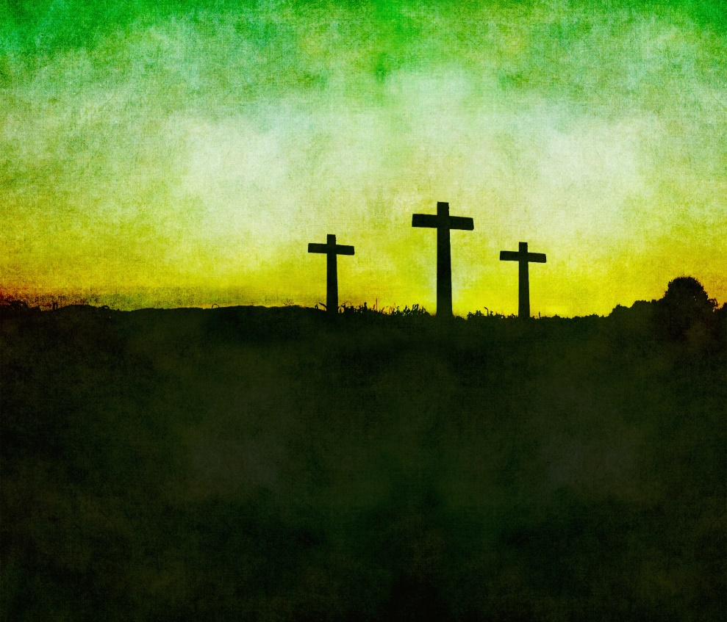
The way of the cross
Mark 8:34-35

Slide 2
Mark 8:34-35 NKJV
“34 When He had called the people to Himself, with His disciples also, He said to them, ‘Whoever desires to come after Me, let him deny himself, and take up his cross, and follow Me. 35 For whoever desires to save his life will lose it, but whoever loses his life for My sake and the gospel’s will save it’”

Slide 3
“The Way of the Cross”, aka “The Way of the Cross Leads Home”
The lyrics of this song were penned by Jessie Hunter Brown Pounds in 1906
(1861-1921)
She also wrote the hymn texts of the following songs:
“Out Of Self And Into Thee”
“Beautiful Isle of Somewhere”
“Soul, A Savior Thou Art Needing”
“Are You Coming To Jesus Tonight?”
“Will You Not Tell It Today?”
“Anywhere With Jesus”
“I Know That My Redeemer Liveth”

Slide 4
“The Way of the Cross”, aka “The Way of the Cross Leads Home”
The tune of this song was composed by Charles Hutchinson Gabriel in 1906
(1856-1932)
Charles Gabriel later wrote that:
“Mrs. Pound’s intention was to give emphasis to the truth, so constantly held up in the teachings of Christ, that heroic Christianity does not follow the line of least resistance”
This song exhorts us to follow the way of the cross that it might lead us to heaven!

Slide 5
To Follow Jesus Is “The Way of The Cross”
Jesus said, “Whoever desires to come after Me, let him deny himself, and take up his cross, and follow Me” – Mark 8:34
To come after Jesus requires SELF-DENIAL!
We must say “NO” to self – Rom. 12:1-2, Gal. 2:20
We must love Jesus above all else, including ourselves…
“If anyone comes to Me and does not hate his father and mother, wife and children, brothers and sisters, yes, and his own life also, he cannot be My disciple” - Luke 14:26 NKJV
Notes:
Mark 8:34-35 NKJV 34 When He had called the people to Himself, with His disciples also, He said to them, "Whoever desires to come after Me, let him deny himself, and take up his cross, and follow Me. 35 "For whoever desires to save his life will lose it, but whoever loses his life for My sake and the gospel's will save it.
Romans 12:1-2 NKJV 1 I beseech you therefore, brethren, by the mercies of God, that you present your bodies a living sacrifice, holy, acceptable to God, which is your reasonable service. 2 And do not be conformed to this world, but be transformed by the renewing of your mind, that you may prove what is that good and acceptable and perfect will of God.
Galatians 2:20 NKJV 20 "I have been crucified with Christ; it is no longer I who live, but Christ lives in me; and the life which I now live in the flesh I live by faith in the Son of God, who loved me and gave Himself for me.
Luke 14:26 NKJV 26 "If anyone comes to Me and does not hate his father and mother, wife and children, brothers and sisters, yes, and his own life also, he cannot be My disciple.

Slide 6
To Follow Jesus Is “The Way of The Cross”
Jesus said, “Whoever desires to come after Me, let him deny himself, and take up his cross, and follow Me” – Mark 8:34
To come after Jesus requires us to Take up OUR cross!
The cross is a symbol of pain, suffering and shame – we must be willing to suffer – Jn. 15:18
Luke 24:46; Acts 3:14-18; Hebrews 12:1-2
“Beloved, do not think it strange concerning the fiery trial which is to try you, as though some strange thing happened to you; but rejoice to the extent that you partake of Christ’s sufferings, that when His glory is revealed, you may also be glad with exceeding joy” - 1 Peter 4:12-13 NKJV
Notes:
Mark 8:34-35 NKJV 34 When He had called the people to Himself, with His disciples also, He said to them, "Whoever desires to come after Me, let him deny himself, and take up his cross, and follow Me. 35 "For whoever desires to save his life will lose it, but whoever loses his life for My sake and the gospel's will save it.
John 15:18 NKJV 18 "If the world hates you, you know that it hated Me before it hated you.
Luke 24:46-47 NKJV 46 Then He said to them, "Thus it is written, and thus it was necessary for the Christ to suffer and to rise from the dead the third day, 47 "and that repentance and remission of sins should be preached in His name to all nations, beginning at Jerusalem.
Acts 3:14-18 NKJV 14 "But you denied the Holy One and the Just, and asked for a murderer to be granted to you, 15 "and killed the Prince of life, whom God raised from the dead, of which we are witnesses. 16 "And His name, through faith in His name, has made this man strong, whom you see and know. Yes, the faith which comes through Him has given him this perfect soundness in the presence of you all. 17 "Yet now, brethren, I know that you did it in ignorance, as did also your rulers. 18 "But those things which God foretold by the mouth of all His prophets, that the Christ would suffer, He has thus fulfilled.
Hebrews 12:1-2 NKJV 1 Therefore we also, since we are surrounded by so great a cloud of witnesses, let us lay aside every weight, and the sin which so easily ensnares us, and let us run with endurance the race that is set before us, 2 looking unto Jesus, the author and finisher of our faith, who for the joy that was set before Him endured the cross, despising the shame, and has sat down at the right hand of the throne of God.
The Old Rugged Cross - #313
Verse 1 On a hill far away stood an old rugged cross, The emblem of suffering and shame; And I love that old cross where the Dearest and Best For a world of lost sinners was slain.
Verse 2 Oh, that old ruggd cross so despised by the world, Has a wondrous attraction for me; For the dear Lamb of God left His glory above, To bear sin on dark Calvary.
Verse 3 In the old rugged cross, stained with blood so divine, A wondrous beauty I see; For ’twas on that old cross Jesus suffered and died, To pardon and sanctify me.
Verse 4 To the old rugged cross I will ever be true, Its shame and reproach gladly bear; Then He’ll call me some day to my home far away, Where His glory forever I’ll share.
Chorus So I’ll cherish the old rugged cross Till my trophies at last I lay down; I will cling to the old rugged cross, And exchange it someday for a crown.

Slide 7
To Follow Jesus Is “The Way of The Cross”
Jesus said, “Whoever desires to come after Me, let him deny himself, and take up his cross, and follow Me” – Mark 8:34
To come after Jesus requires us to follow Jesus!
We do this by following His teachings!
This means a life-long commitment and not a momentary exuberance that quickly fades as emotions subside – Luke 9:62
“If you abide in My word, you are My disciples indeed” – John 8:31 NKJV
Notes:
Mark 8:34-35 NKJV 34 When He had called the people to Himself, with His disciples also, He said to them, "Whoever desires to come after Me, let him deny himself, and take up his cross, and follow Me. 35 "For whoever desires to save his life will lose it, but whoever loses his life for My sake and the gospel's will save it.
Luke 9:62 NKJV 62 But Jesus said to him, "No one, having put his hand to the plow, and looking back, is fit for the kingdom of God.“
Luke 14:28-32 NKJV 28 "For which of you, intending to build a tower, does not sit down first and count the cost, whether he has enough to finish it -- 29 "lest, after he has laid the foundation, and is not able to finish, all who see it begin to mock him, 30 "saying, 'This man began to build and was not able to finish.' 31 "Or what king, going to make war against another king, does not sit down first and consider whether he is able with ten thousand to meet him who comes against him with twenty thousand? 32 "Or else, while the other is still a great way off, he sends a delegation and asks conditions of peace.
John 8:31-32 NKJV 31 Then Jesus said to those Jews who believed Him, "If you abide in My word, you are My disciples indeed. 32 "And you shall know the truth, and the truth shall make you free.“
Luke 14:33 NKJV 33 “So likewise, whoever of you does not forsake all that he has cannot be My disciple.”

Slide 8
“The Way of the Cross” – Stanza 1
This song exhorts us to follow the way of the cross that it might lead us to the heavenly home
The FIRST stanza tells us that the way of the cross is the only way to get to heaven
I must needs go home by the way of the cross,
There’s no other way but this;
I shall ne’er get sight of the gates of light,
If the way of the cross I miss.

Slide 9
“The Way of the Cross” – Stanza 1
This song exhorts us to follow the way of the cross that it might lead us to the heavenly home
The FIRST stanza tells us that the way of the cross is the only way to get to heaven
Jesus spoke of two ways – Matthew 7:13-14
Only ONE way leads to God and Salvation
John 14:6; Acts 4:12
The way of the cross is the ONLY way to the gates of the city of light – Rev. 2:10-13, 21-23
Notes:
Matthew 7:13-14 NKJV 13 "Enter by the narrow gate; for wide is the gate and broad is the way that leads to destruction, and there are many who go in by it. 14 "Because narrow is the gate and difficult is the way which leads to life, and there are few who find it.
John 14:6 NKJV 6 Jesus said to him, "I am the way, the truth, and the life. No one comes to the Father except through Me.
Acts 4:12 NKJV 12 "Nor is there salvation in any other, for there is no other name under heaven given among men by which we must be saved.“
Revelation 21:10-13 NKJV 10 And he carried me away in the Spirit to a great and high mountain, and showed me the great city, the holy Jerusalem, descending out of heaven from God, 11 having the glory of God. Her light was like a most precious stone, like a jasper stone, clear as crystal. 12 Also she had a great and high wall with twelve gates, and twelve angels at the gates, and names written on them, which are the names of the twelve tribes of the children of Israel: 13 three gates on the east, three gates on the north, three gates on the south, and three gates on the west.
Revelation 21:21-23 NKJV 21 The twelve gates were twelve pearls: each individual gate was of one pearl. And the street of the city was pure gold, like transparent glass. 22 But I saw no temple in it, for the Lord God Almighty and the Lamb are its temple. 23 The city had no need of the sun or of the moon to shine in it, for the glory of God illuminated it. The Lamb is its light.

Slide 10
“The Way of the Cross” – Stanza 2
The SECOND stanza tells us that the way of the cross is the blood sprinkled way
I must needs go on in the blood sprinkled way,
The path that the Savior trod,
If I ever climb to the heights sublime,
Where the soul is at home with God.

Slide 11
“The Way of the Cross” – Stanza 2
The SECOND stanza tells us that the way of the cross is the blood sprinkled way
It is the blood of Jesus that provides for the remission of sins – Matthew 26:28
It is the blood of Jesus that provides for our redemption – Ephesians 1:7
And it is the blood of Jesus which provides reconciliation and peace with God
Colossians 1:19-20
Notes:
Matthew 26:26-28 NKJV 26 And as they were eating, Jesus took bread, blessed and broke it, and gave it to the disciples and said, "Take, eat; this is My body." 27 Then He took the cup, and gave thanks, and gave it to them, saying, "Drink from it, all of you. 28 "For this is My blood of the new covenant, which is shed for many for the remission of sins.
Ephesians 1:7 NKJV 7 In Him we have redemption through His blood, the forgiveness of sins, according to the riches of His grace.
Colossians 1:19-20 NKJV 19 For it pleased the Father that in Him all the fullness should dwell, 20 and by Him to reconcile all things to Himself, by Him, whether things on earth or things in heaven, having made peace through the blood of His cross.

Slide 12
“The Way of the Cross” – Stanza 3
The THIRD stanza tells us that the way of the cross is to bid farewell to the way of the world
Then I bid farewell to the way of the world,
To walk in it never more;
For the Lord says, Come, and I seek my home,
Where He waits at the open door.

Slide 13
“The Way of the Cross” – Stanza 3
The THIRD stanza tells us that the way of the cross is to bid farewell to the way of the world
To travel the way of the cross, we must not be conformed to the world – Romans 12:1-2
Rather than walking according to the lust of the flesh, we must walk in the Spirit
Galatians 5:16-17
This is what Jesus wants us to do when He says, “Come unto Me” – Matthew 11:28-30
Notes:
Romans 12:1-2 NKJV 1 I beseech you therefore, brethren, by the mercies of God, that you present your bodies a living sacrifice, holy, acceptable to God, which is your reasonable service. 2 And do not be conformed to this world, but be transformed by the renewing of your mind, that you may prove what is that good and acceptable and perfect will of God.
Galatians 5:15-16 NKJV 15 But if you bite and devour one another, beware lest you be consumed by one another! 16 I say then: Walk in the Spirit, and you shall not fulfill the lust of the flesh. 17 For the flesh lusts against the Spirit, and the Spirit against the flesh; and these are contrary to one another, so that you do not do the things that you wish.
Matthew 11:28-30 NKJV 28 "Come to Me, all you who labor and are heavy laden, and I will give you rest. 29 "Take My yoke upon you and learn from Me, for I am gentle and lowly in heart, and you will find rest for your souls. 30 "For My yoke is easy and My burden is light."

Slide 14
“The Way of the Cross” – Chorus
The CHORUS completes the thought of this song pointing to the importance of following the way of the cross
The way of the cross leads home,
The way of the cross leads home,
It is sweet to know as I onward go,
The way of the cross leads home.
As we journey in this life toward the heavenly home, may we never forget…
“The Way of the Cross Leads Home”

Slide 15
Luke 14:33 NKJV
“So likewise, whoever of you does not forsake all that he has cannot be My disciple”

Slide 16
What Shall We Do?
Acts 2:37
Alien sinners must…
Hear the Gospel – Romans 10:17; Hebrews 11:6
Believe it – John 8:24
Repent of sin in your life – Acts 17:30
Confess that Christ is God’s Son – Matthew 10:34
Be baptized to wash away your sins – Acts 2:38
An erring child of God must…
Repent and Pray for Forgiveness – 1 John 1:7-9
Endure Trials & “be faithful unto death”
Revelation 2:10
Notes:
Acts 2:36-37 - 36 Therefore let all the house of Israel know assuredly, that God hath made that same Jesus, whom ye have crucified, both Lord and Christ. 37 Now when they heard this, they were pricked in their heart, and said unto Peter and to the rest of the apostles, Men and brethren, what shall we do?
Rom. 10:17 - So then faith cometh by hearing, and hearing by the word of God.
Heb 11:6 But without faith it is impossible to please him: for he that cometh to God must believe that he is, and that he is a rewarder of them that diligently seek him.
Jn. 8:24 - I said therefore unto you, that ye shall die in your sins: for if ye believe not that I am he, ye shall die in your sins.
Acts 17:30-31 - And the times of this ignorance God winked at; but now commandeth all men every where to repent: 31 Because he hath appointed a day, in the which he will judge the world in righteousness by that man whom he hath ordained; whereof he hath given assurance unto all men, in that he hath raised him from the dead.
Matt. 10:34 - Whosoever therefore shall confess me before men, him will I confess also before my Father which is in heaven.
Acts 2:38 - Then Peter said unto them, Repent, and be baptized every one of you in the name of Jesus Christ for the remission of sins, and ye shall receive the gift of the Holy Ghost.
1 Jn. 1:7-9 - But if we walk in the light, as he is in the light, we have fellowship one with another, and the blood of Jesus Christ his Son cleanseth us from all sin. 8 If we say that we have no sin, we deceive ourselves, and the truth is not in us. 9 If we confess our sins, he is faithful and just to forgive us our sins, and to cleanse us from all unrighteousness.
Rev. 2:10 - Fear none of those things which thou shalt suffer: behold, the devil shall cast some of you into prison, that ye may be tried; and ye shall have tribulation ten days: be thou faithful unto death, and I will give thee a crown of life.

