Slide 1
The Church Christ Built
The church of Christ

Slide 2
INTRODUCTION
Jesus promised He would build HIS church
Matthew 16:18; Mark 9:1; Acts 1:6-8; 2:1ff
He built IT upon the truth Peter confessed
“You are the Christ, the Son of the living God”
Matthew 16:18, 16
He declared His superior power to build IT
“the gates of hades shall not prevail against it”
Matthew 16:18
His death did not prevent Him from building His church – Acts 2:24-27
Notes:
Matthew 16:13-19 NKJV 13 When Jesus came into the region of Caesarea Philippi, He asked His disciples, saying, "Who do men say that I, the Son of Man, am?" 14 So they said, "Some say John the Baptist, some Elijah, and others Jeremiah or one of the prophets." 15 He said to them, "But who do you say that I am?" 16 Simon Peter answered and said, "You are the Christ, the Son of the living God." 17 Jesus answered and said to him, "Blessed are you, Simon Bar-Jonah, for flesh and blood has not revealed this to you, but My Father who is in heaven. 18 "And I also say to you that you are Peter, and on this rock I will build My church, and the gates of Hades shall not prevail against it. 19 "And I will give you the keys of the kingdom of heaven, and whatever you bind on earth will be bound in heaven, and whatever you loose on earth will be loosed in heaven.“
Mark 9:1 KJV 1 And he said unto them, Verily I say unto you, That there be some of them that stand here, which shall not taste of death, till they have seen the kingdom of God come with power.
Acts 1:6-8 KJV 6 When they therefore were come together, they asked of him, saying, Lord, wilt thou at this time restore again the kingdom to Israel? 7 And he said unto them, It is not for you to know the times or the seasons, which the Father hath put in his own power. 8 But ye shall receive power, after that the Holy Ghost is come upon you: and ye shall be witnesses unto me both in Jerusalem, and in all Judaea, and in Samaria, and unto the uttermost part of the earth.
Jesus said, "I will build My church," and with that clear statement, denoted the value and the identity of His church (Matt. 16:18). He said He would build His church upon the foundational truth confessed by Peter, "You are the Christ, the Son of the living God" (Matt. 16:18, 16). Jesus emphasized His superior power to build His church when He said, "The gates of Hades shall not prevail against it." Even His death would not prevent Him from building His church. Indeed, His death and resurrection showed Jesus to be the Son of God (Rom. 1:4). Jesus built His church due to the redemptive power of His death (Acts 20:28; 2:32-41). The gospel calls the lost to salvation, and Jesus adds to His church those saved by it (Acts 2:47).
Acts 2:24-27 KJV 24 Whom God hath raised up, having loosed the pains of death: because it was not possible that he should be holden of it. 25 For David speaketh concerning him, I foresaw the Lord always before my face, for he is on my right hand, that I should not be moved: 26 Therefore did my heart rejoice, and my tongue was glad; moreover also my flesh shall rest in hope: 27 Because thou wilt not leave my soul in hell, neither wilt thou suffer thine Holy One to see corruption.

Slide 3
INTRODUCTION
His resurrection proved He was the Son of God
Romans 1:4; 1 Peter 1:3; 3:21
The gospel calls the lost to salvation
2 Thessalonians 2:14
Jesus adds to His church those saved by those who gladly receive His word, the gospel
Acts 2:41-47
Notes:
Romans 1:4 KJV 4 And declared to be the Son of God with power, according to the spirit of holiness, by the resurrection from the dead:
1 Peter 1:3 KJV 3 Blessed be the God and Father of our Lord Jesus Christ, which according to his abundant mercy hath begotten us again unto a lively hope by the resurrection of Jesus Christ from the dead,
1 Peter 3:21 KJV 21 The like figure whereunto even baptism doth also now save us (not the putting away of the filth of the flesh, but the answer of a good conscience toward God,) by the resurrection of Jesus Christ:
2 Thessalonians 2:14 KJV 14 Whereunto he called you by our gospel, to the obtaining of the glory of our Lord Jesus Christ.
Acts 2:41-47 KJV 41 Then they that gladly received his word were baptized: and the same day there were added unto them about three thousand souls. 42 And they continued stedfastly in the apostles' doctrine and fellowship, and in breaking of bread, and in prayers. 43 And fear came upon every soul: and many wonders and signs were done by the apostles. 44 And all that believed were together, and had all things common; 45 And sold their possessions and goods, and parted them to all men, as every man had need. 46 And they, continuing daily with one accord in the temple, and breaking bread from house to house, did eat their meat with gladness and singleness of heart, 47 Praising God, and having favour with all the people. And the Lord added to the church daily such as should be saved.

Slide 4
INTRODUCTION
Jesus promised to gave the “keys of the kingdom” to the apostles – the terms of entrance – the gospel – Matthew 16:19
“I will give you the keys of the kingdom of heaven; and whatever you bind on earth shall have been bound in heaven, and whatever you loose on earth shall have been loosed in heaven” – Matthew 16:19, NASB95
In this lesson, we will consider Bible truths about the church Christ built
Notes:
“Whatever you bind on earth shall have been bound in heaven, and whatever you loose on earth shall have been loosed in heaven” (16:19, NASB).

Slide 5
Belongs To Christ
This church does not belong to any man or body of men!
It does not belong to the elders, any member(s) or anyone else!
It is the body OF (belonging to Christ), not the body OF (that belongs) to men!
“And hath put all things under his feet, and gave him to be the head over all things to the church, Which is his body, the fulness of him that filleth all in all” – Eph. 1:22-23
The church of Christ
Notes:
Ephesians 1:22-23 KJV 22 And hath put all things under his feet, and gave him to be the head over all things to the church, 23 Which is his body, the fulness of him that filleth all in all.

Slide 6
Consists of the Redeemed
The word “church” means to called out (individuals)
The gospel calls sinners out of the darkness of sin into the light of God’s word – 1 Peter 2:9-10; Colossians 1:13-14
It is made of those who answer the gospel call of salvation by obeying the words of Jesus – 1 Peter 1:22-23
Mark 16:15-16
The church of Christ
Notes:
1 Peter 2:9-10 KJV 9 But ye are a chosen generation, a royal priesthood, an holy nation, a peculiar people; that ye should shew forth the praises of him who hath called you out of darkness into his marvellous light: 10 Which in time past were not a people, but are now the people of God: which had not obtained mercy, but now have obtained mercy.
Colossians 1:13 NKJV 13 He has delivered us from the power of darkness and conveyed us into the kingdom of the Son of His love, 14 in whom we have redemption through His blood, the forgiveness of sins.
1 Peter 1:22-23 KJV 22 Seeing ye have purified your souls in obeying the truth through the Spirit unto unfeigned love of the brethren, see that ye love one another with a pure heart fervently: 23 Being born again, not of corruptible seed, but of incorruptible, by the word of God, which liveth and abideth for ever.
Mark 16:15-16 KJV 15 And he said unto them, Go ye into all the world, and preach the gospel to every creature. 16 He that believeth and is baptized shall be saved; but he that believeth not shall be damned.

Slide 7
Is The Bride of Christ
Paul likens the church to the husband/ wife relationship
As the husband (groom) is the head of the wife (the bride), so also Christ (the groom) is the Head of His church (the bride)
We are to submit to the Head, as the wife is to obey the husband – vss. 22-24
As Christ loved the church, the husband and wife are to love each other
Vss. 25-33
The church of Christ
Notes:
Ephesians 5:22-24 KJV 22 Wives, submit yourselves unto your own husbands, as unto the Lord. 23 For the husband is the head of the wife, even as Christ is the head of the church: and he is the saviour of the body. 24 Therefore as the church is subject unto Christ, so let the wives be to their own husbands in every thing.
Ephesians 5:25-33 KJV 25 Husbands, love your wives, even as Christ also loved the church, and gave himself for it; 26 That he might sanctify and cleanse it with the washing of water by the word, 27 That he might present it to himself a glorious church, not having spot, or wrinkle, or any such thing; but that it should be holy and without blemish. 28 So ought men to love their wives as their own bodies. He that loveth his wife loveth himself. 29 For no man ever yet hated his own flesh; but nourisheth and cherisheth it, even as the Lord the church: 30 For we are members of his body, of his flesh, and of his bones. 31 For this cause shall a man leave his father and mother, and shall be joined unto his wife, and they two shall be one flesh. 32 This is a great mystery: but I speak concerning Christ and the church. 33 Nevertheless let every one of you in particular so love his wife even as himself; and the wife see that she reverence her husband.

Slide 8
Is Precious To God
The blood of the only begotten Son of God purchased this church – Acts 20:28
NO other church of men can lay claim to the unique truth!
The blood that purchased this church was “the precious blood of Christ”
“Forasmuch as ye know that ye were not redeemed with corruptible things, as silver and gold, from your vain conversation received by tradition from your fathers; But with the precious blood of Christ, as of a lamb without blemish and without spot” –1 Pet. 1:18-19
The church of Christ
Notes:
Acts 20:28 KJV 28 Take heed therefore unto yourselves, and to all the flock, over the which the Holy Ghost hath made you overseers, to feed the church of God, which he hath purchased with his own blood.
Peter 1:18-19 KJV 18 Forasmuch as ye know that ye were not redeemed with corruptible things, as silver and gold, from your vain conversation received by tradition from your fathers; 19 But with the precious blood of Christ, as of a lamb without blemish and without spot:

Slide 9
Is Composed of Christians
Christ’s church is not a conglomerate of the churches we cannot read about in the Bible
Each Christian is a “living stone” in God’s spiritual house – the church of Christ
1 Peter 2:5
Christ adds ONLY saved people to the church of Christ – Acts 2:41, 47
The church of Christ
Notes:
1 Peter 2:5 KJV 5 Ye also, as lively stones, are built up a spiritual house, an holy priesthood, to offer up spiritual sacrifices, acceptable to God by Jesus Christ.
Acts 2:41-47 KJV 41 Then they that gladly received his word were baptized: and the same day there were added unto them about three thousand souls. 42 And they continued stedfastly in the apostles' doctrine and fellowship, and in breaking of bread, and in prayers. 43 And fear came upon every soul: and many wonders and signs were done by the apostles. 44 And all that believed were together, and had all things common; 45 And sold their possessions and goods, and parted them to all men, as every man had need. 46 And they, continuing daily with one accord in the temple, and breaking bread from house to house, did eat their meat with gladness and singleness of heart, 47 Praising God, and having favour with all the people. And the Lord added to the church daily such as should be saved.

Slide 10
Is Not a Denomination of Churches
No one can find any reference to denominations in the Bible
Denominations came about in the religious world because men departed from the “pattern of sound words” in order to cling to false doctrines and false organizations of men’s making
1 Timothy 4:1-3; 2 Timothy 1:13; 3:16-17
There is “ONE body” (one church) of Christ, not many! – Ephesians 4:4
The church of Christ
Notes:
1 Timothy 4:1-3 KJV 1 Now the Spirit speaketh expressly, that in the latter times some shall depart from the faith, giving heed to seducing spirits, and doctrines of devils; 2 Speaking lies in hypocrisy; having their conscience seared with a hot iron; 3 Forbidding to marry, and commanding to abstain from meats, which God hath created to be received with thanksgiving of them which believe and know the truth.
2 Timothy 1:13 KJV 13 Hold fast the form of sound words, which thou hast heard of me, in faith and love which is in Christ Jesus.
2 Timothy 3:13-17 KJV 13 But evil men and seducers shall wax worse and worse, deceiving, and being deceived. 14 But continue thou in the things which thou hast learned and hast been assured of, knowing of whom thou hast learned them; 15 And that from a child thou hast known the holy scriptures, which are able to make thee wise unto salvation through faith which is in Christ Jesus. 16 All scripture is given by inspiration of God, and is profitable for doctrine, for reproof, for correction, for instruction in righteousness: 17 That the man of God may be perfect, throughly furnished unto all good works.
Ephesians 4:1-4 KJV 1 I therefore, the prisoner of the Lord, beseech you that ye walk worthy of the vocation wherewith ye are called, 2 With all lowliness and meekness, with longsuffering, forbearing one another in love; 3 Endeavouring to keep the unity of the Spirit in the bond of peace. 4 There is one body, and one Spirit, even as ye are called in one hope of your calling; 5 One Lord, one faith, one baptism, 6 One God and Father of all, who is above all, and through all, and in you all.

Slide 11
Was Not Built By Men
No one men or group of men built the church of Christ
Only Jesus purchased this church
Acts 20:28
Only Jesus is the BUILDER and the HEAD of this church
Ephesians 1:22-23; 1 Peter 1:18-19
NO MAN can improve on the church Jesus built!
The church of Christ
Notes:
Acts 20:28 KJV 28 Take heed therefore unto yourselves, and to all the flock, over the which the Holy Ghost hath made you overseers, to feed the church of God, which he hath purchased with his own blood.
Ephesians 1:22-23 KJV 22 And hath put all things under his feet, and gave him to be the head over all things to the church, 23 Which is his body, the fulness of him that filleth all in all.
1 Peter 1:18-19 KJV 18 Forasmuch as ye know that ye were not redeemed with corruptible things, as silver and gold, from your vain conversation received by tradition from your fathers; 19 But with the precious blood of Christ, as of a lamb without blemish and without spot:

Slide 12
Is The Church God Will Add You To
Christ will add you to the church of Christ when He saves you from your sins
Acts 2:47; Mark 16:16
Jesus saves sinners who believe and are baptized – Acts 2:37-38, 40-41, 47
You remain lost in your sins unless you have obeyed Jesus!
Believe and obey Jesus, be saved, and be added to His church
1 Corinthians 12:12-13
The church of Christ
Notes:
Acts 2:47 KJV 47 Praising God, and having favour with all the people. And the Lord added to the church daily such as should be saved.
Mark 16:16 KJV 16 He that believeth and is baptized shall be saved; but he that believeth not shall be damned.
Acts 2:37-47 KJV 37 Now when they heard this, they were pricked in their heart, and said unto Peter and to the rest of the apostles, Men and brethren, what shall we do? 38 Then Peter said unto them, Repent, and be baptized every one of you in the name of Jesus Christ for the remission of sins, and ye shall receive the gift of the Holy Ghost. 39 For the promise is unto you, and to your children, and to all that are afar off, even as many as the Lord our God shall call. 40 And with many other words did he testify and exhort, saying, Save yourselves from this untoward generation. 41 Then they that gladly received his word were baptized: and the same day there were added unto them about three thousand souls. 42 And they continued stedfastly in the apostles' doctrine and fellowship, and in breaking of bread, and in prayers. 43 And fear came upon every soul: and many wonders and signs were done by the apostles. 44 And all that believed were together, and had all things common; 45 And sold their possessions and goods, and parted them to all men, as every man had need. 46 And they, continuing daily with one accord in the temple, and breaking bread from house to house, did eat their meat with gladness and singleness of heart, 47 Praising God, and having favour with all the people. And the Lord added to the church daily such as should be saved.
1 Corinthians 12:13 KJV 12 For as the body is one, and hath many members, and all the members of that one body, being many, are one body: so also is Christ. 13 For by one Spirit are we all baptized into one body, whether we be Jews or Gentiles, whether we be bond or free; and have been all made to drink into one Spirit.

Slide 13
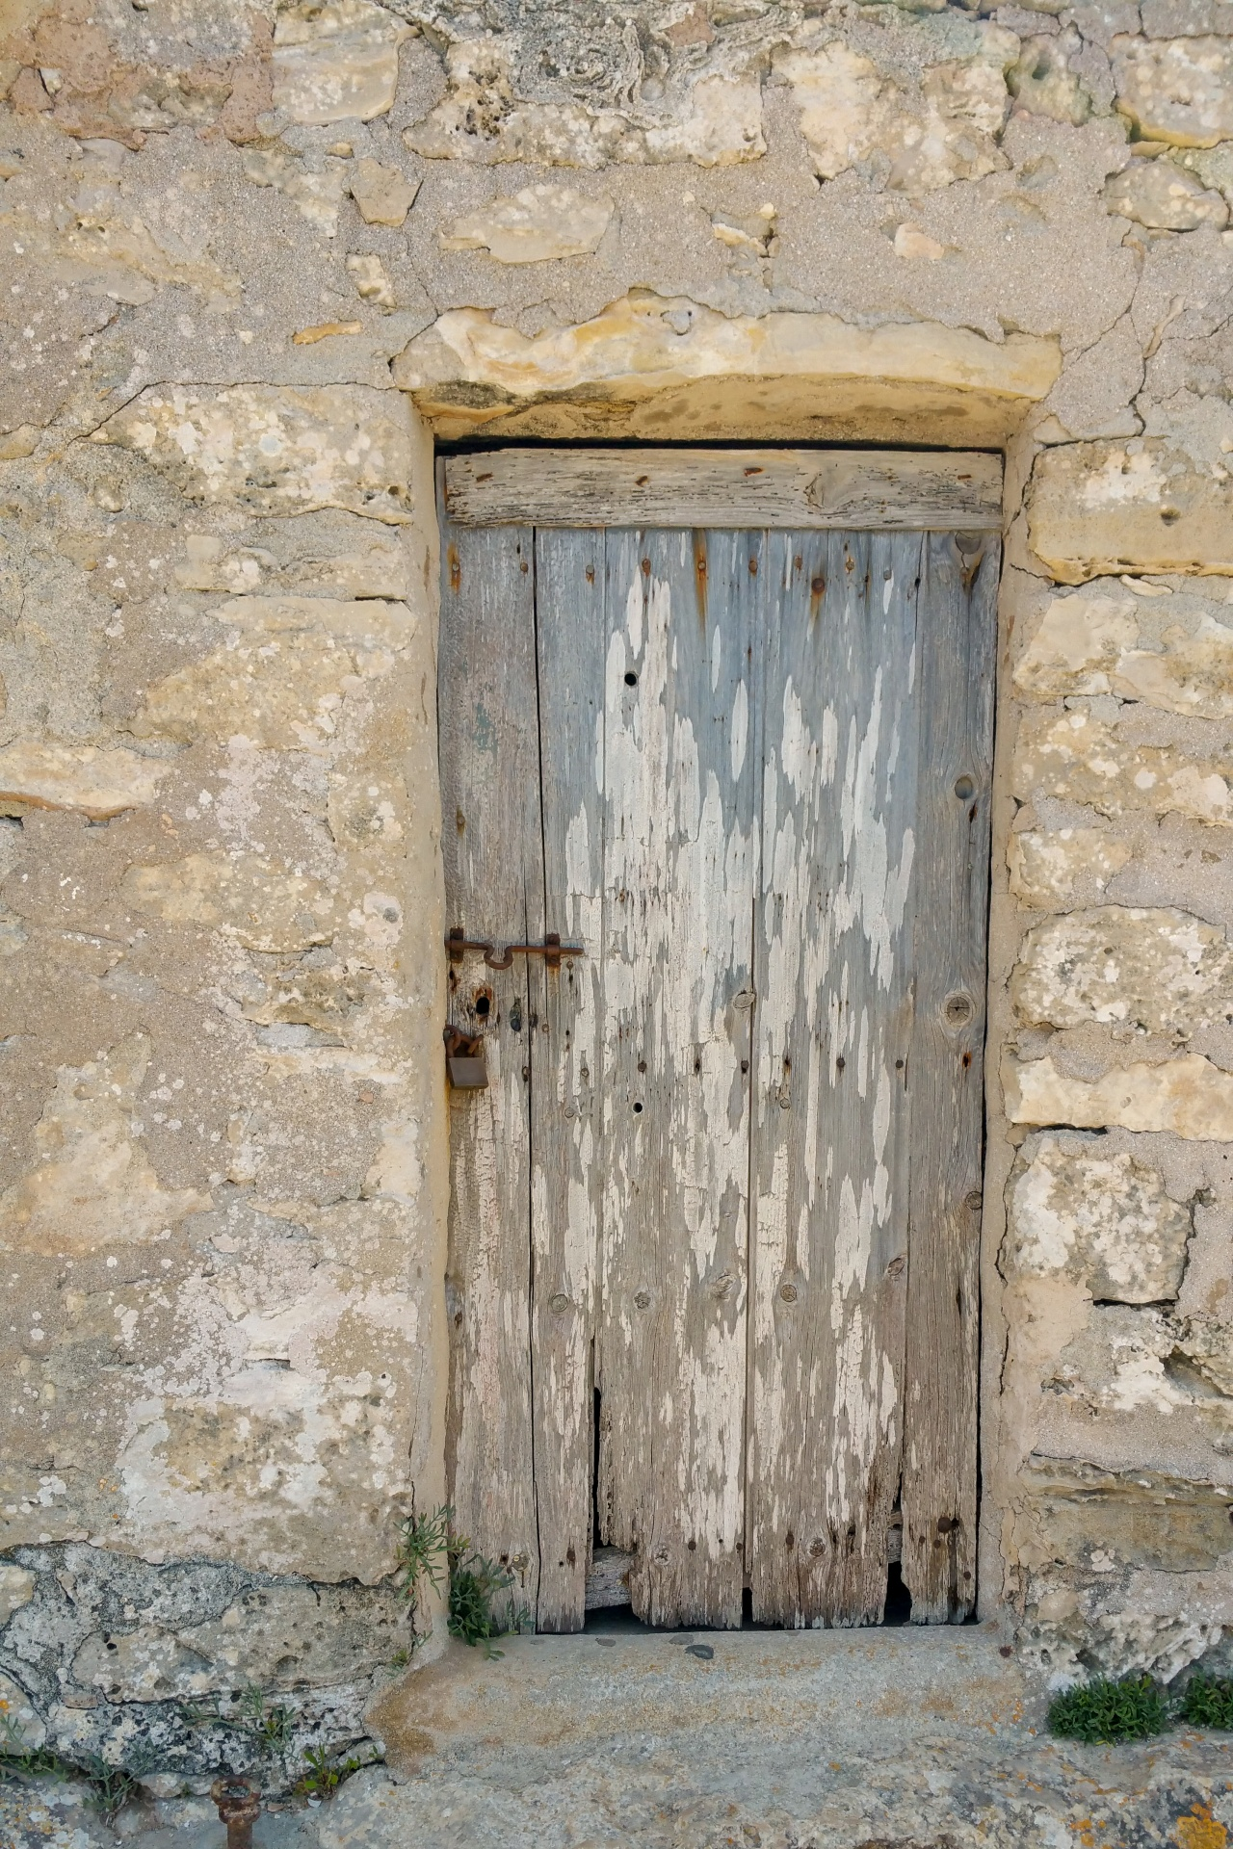
Only Jesus is The Door
John 10:1-9
Notes:
John 10:1-9 KJV 1 Verily, verily, I say unto you, He that entereth not by the door into the sheepfold, but climbeth up some other way, the same is a thief and a robber. 2 But he that entereth in by the door is the shepherd of the sheep. 3 To him the porter openeth; and the sheep hear his voice: and he calleth his own sheep by name, and leadeth them out. 4 And when he putteth forth his own sheep, he goeth before them, and the sheep follow him: for they know his voice. 5 And a stranger will they not follow, but will flee from him: for they know not the voice of strangers. 6 This parable spake Jesus unto them: but they understood not what things they were which he spake unto them. 7 Then said Jesus unto them again, Verily, verily, I say unto you, I am the door of the sheep. 8 All that ever came before me are thieves and robbers: but the sheep did not hear them. 9 I am the door: by me if any man enter in, he shall be saved, and shall go in and out, and find pasture.
John 14:6 KJV 6 Jesus saith unto him, I am the way, the truth, and the life: no man cometh unto the Father, but by me.

Slide 14
“What Must I Do To Be Saved?”
Acts 16:30
Alien sinners must…
Hear the Gospel – Romans 10:17; Hebrews 11:6
Believe it – John 8:24
Repent of sin in your life – Acts 17:30
Confess that Christ is God’s Son – Matt. 10:34
Be baptized to wash away your sins – Acts 2:38
An erring child of God must…
Repent and pray for forgiveness – 1 John 1:7-9
Endure trials & “be faithful unto death”
Revelation 2:10
Notes:
Acts 16:29-33 KJV 29 Then he called for a light, and sprang in, and came trembling, and fell down before Paul and Silas, 30 And brought them out, and said, Sirs, what must I do to be saved? 31 And they said, Believe on the Lord Jesus Christ, and thou shalt be saved, and thy house. 32 And they spake unto him the word of the Lord, and to all that were in his house. 33 And he took them the same hour of the night, and washed their stripes; and was baptized, he and all his, straightway.
Rom. 10:17 - So then faith cometh by hearing, and hearing by the word of God.
Heb 11:6 But without faith it is impossible to please him: for he that cometh to God must believe that he is, and that he is a rewarder of them that diligently seek him.
Jn. 8:24 - I said therefore unto you, that ye shall die in your sins: for if ye believe not that I am he, ye shall die in your sins.
Acts 17:30-31 - And the times of this ignorance God winked at; but now commandeth all men every where to repent: 31 Because he hath appointed a day, in the which he will judge the world in righteousness by that man whom he hath ordained; whereof he hath given assurance unto all men, in that he hath raised him from the dead.
Matt. 10:34 - Whosoever therefore shall confess me before men, him will I confess also before my Father which is in heaven.
Acts 2:38 - Then Peter said unto them, Repent, and be baptized every one of you in the name of Jesus Christ for the remission of sins, and ye shall receive the gift of the Holy Ghost.
1 Jn. 1:7-9 - But if we walk in the light, as he is in the light, we have fellowship one with another, and the blood of Jesus Christ his Son cleanseth us from all sin. 8 If we say that we have no sin, we deceive ourselves, and the truth is not in us. 9 If we confess our sins, he is faithful and just to forgive us our sins, and to cleanse us from all unrighteousness.
Rev. 2:10 - Fear none of those things which thou shalt suffer: behold, the devil shall cast some of you into prison, that ye may be tried; and ye shall have tribulation ten days: be thou faithful unto death, and I will give thee a crown of life.

