Slide 1
Obey The Gospel Today!

Slide 2
In several conversion cases in Acts, a sense of urgency is seen!
“what shall we do?” (2:37)
“what doth hinder me t0 be baptized?” (8:36)
“Lord, what wilt thou have me to do?” (9:6)
“Sirs, what must I do to be saved?” (16:30)
Why should obedience to the gospel be a matter of urgency?
INTRODUCTION
Notes:
Acts 2:36-38 KJV 36 Therefore let all the house of Israel know assuredly, that God hath made that same Jesus, whom ye have crucified, both Lord and Christ. 37 Now when they heard this, they were pricked in their heart, and said unto Peter and to the rest of the apostles, Men and brethren, what shall we do? 38 Then Peter said unto them, Repent, and be baptized every one of you in the name of Jesus Christ for the remission of sins, and ye shall receive the gift of the Holy Ghost.
Acts 8:35-38 KJV 35 Then Philip opened his mouth, and began at the same scripture, and preached unto him Jesus. 36 And as they went on their way, they came unto a certain water: and the eunuch said, See, here is water; what doth hinder me to be baptized? 37 And Philip said, If thou believest with all thine heart, thou mayest. And he answered and said, I believe that Jesus Christ is the Son of God. 38 And he commanded the chariot to stand still: and they went down both into the water, both Philip and the eunuch; and he baptized him.
Acts 9:1-6 KJV 1 And Saul, yet breathing out threatenings and slaughter against the disciples of the Lord, went unto the high priest, 2 And desired of him letters to Damascus to the synagogues, that if he found any of this way, whether they were men or women, he might bring them bound unto Jerusalem. {of this way: Gr. of the way} 3 And as he journeyed, he came near Damascus: and suddenly there shined round about him a light from heaven: 4 And he fell to the earth, and heard a voice saying unto him, Saul, Saul, why persecutest thou me? 5 And he said, Who art thou, Lord? And the Lord said, I am Jesus whom thou persecutest: it is hard for thee to kick against the pricks. 6 And he trembling and astonished said, Lord, what wilt thou have me to do? And the Lord said unto him, Arise, and go into the city, and it shall be told thee what thou must do.
Acts 16:26-34 KJV 26 And suddenly there was a great earthquake, so that the foundations of the prison were shaken: and immediately all the doors were opened, and every one's bands were loosed. 27 And the keeper of the prison awaking out of his sleep, and seeing the prison doors open, he drew out his sword, and would have killed himself, supposing that the prisoners had been fled. 28 But Paul cried with a loud voice, saying, Do thyself no harm: for we are all here. 29 Then he called for a light, and sprang in, and came trembling, and fell down before Paul and Silas, 30 And brought them out, and said, Sirs, what must I do to be saved? 31 And they said, Believe on the Lord Jesus Christ, and thou shalt be saved, and thy house. 32 And they spake unto him the word of the Lord, and to all that were in his house. 33 And he took them the same hour of the night, and washed their stripes; and was baptized, he and all his, straightway. 34 And when he had brought them into his house, he set meat before them, and rejoiced, believing in God with all his house.

Slide 3
?
Why Obey The Gospel NOW?
Notes:
Why Are You Waiting?
Some feel like they must get their life perfect before they obey the gospel.
Some are not willing to cease and let go of their former life of sin.
Some think they are such grievous sinners, God will not save them.
Some intend to obey God but life’s cares distract them from ever doing so.
Some are caught up and overcome in sinful and bad habits.

Slide 4
BEFORE YOU DIE
Use your LIFE to prepare for your DEATH!
We all know we will die!
Psalms 89:48
Ecclesiastes 3:19-21; 9:5-6
It is appointed to man ONCE to die - Hebrews 9:27
“Prepare to meet thy God”
Amos 4:12
“Ye know not what shall be on the morrow…”
James 4:14
Obey the Gospel
Notes:
Psalms 89:48 KJV 48 What man is he that liveth, and shall not see death? shall he deliver his soul from the hand of the grave?
Ecclesiastes 3:19-22 KJV 19 For that which befalleth the sons of men befalleth beasts; even one thing befalleth them: as the one dieth, so dieth the other; yea, they have all one breath; so that a man hath no preeminence above a beast: for all is vanity. 20 All go unto one place; all are of the dust, and all turn to dust again. 21 Who knoweth the spirit of man that goeth upward, and the spirit of the beast that goeth downward to the earth? 22 Wherefore I perceive that there is nothing better, than that a man should rejoice in his own works; for that is his portion: for who shall bring him to see what shall be after him?
Ecclesiastes 12:7 KJV 7 Then shall the dust return to the earth as it was: and the spirit shall return unto God who gave it.
Ecclesiastes 9:5 KJV 5 For the living know that they shall die: but the dead know not any thing, neither have they any more a reward; for the memory of them is forgotten. 6 Also their love, and their hatred, and their envy, is now perished; neither have they any more a portion for ever in any thing that is done under the sun
Hebrews 9:27-28 KJV 27 And as it is appointed unto men once to die, but after this the judgment: 28 So Christ was once offered to bear the sins of many; and unto them that look for him shall he appear the second time without sin unto salvation.
Am 4:12 Therefore thus will I do unto thee, O Israel: and because I will do this unto thee, prepare to meet thy God, O Israel.
Jas 4:14 Whereas ye know not what shall be on the morrow. For what is your life? It is even a vapour, that appeareth for a little time, and then vanisheth away.

Slide 5
BEFORE YOU CAN’T
Anyone can have a serious accident or have a serious health emergency
Accidents, injuries, health conditions can render one incapable of making the decision to obey the gospel or be restored to a right relationship with God
Luke records incidents that resulted in the death of individuals - Luke 13:1-4
“Time and chance” can be a factor in one’s demise
Ecclesiastes 9:11
Obey the Gospel
Notes:
Luke 13:1-5 KJV 1 There were present at that season some that told him of the Galilaeans, whose blood Pilate had mingled with their sacrifices. 2 And Jesus answering said unto them, Suppose ye that these Galilaeans were sinners above all the Galilaeans, because they suffered such things? 3 I tell you, Nay: but, except ye repent, ye shall all likewise perish. 4 Or those eighteen, upon whom the tower in Siloam fell, and slew them, think ye that they were sinners above all men that dwelt in Jerusalem? 5 I tell you, Nay: but, except ye repent, ye shall all likewise perish.
Ecclesiastes 9:11 KJV 11 I returned, and saw under the sun, that the race is not to the swift, nor the battle to the strong, neither yet bread to the wise, nor yet riches to men of understanding, nor yet favour to men of skill; but time and chance happeneth to them al1.

Slide 6
BEFORE YOU BECOME HARD OF HEART
Delaying in obeying the gospel can result in one’s heart becoming hardened to a point of no return
1 Timothy 4:2
2 Timothy 4:3-4
The Hebrew writer warns of the impossibility of one being renewed
Hebrews 6:4-6
Strive to have an “honest and good heart” that bears much fruit for God
Luke 8:15
Obey the Gospel
Notes:
1 Timothy 4:1-2 KJV 1 Now the Spirit speaketh expressly, that in the latter times some shall depart from the faith, giving heed to seducing spirits, and doctrines of devils; 2 Speaking lies in hypocrisy; having their conscience seared with a hot iron;
2 Timothy 4:3-4 KJV 3 For the time will come when they will not endure sound doctrine; but after their own lusts shall they heap to themselves teachers, having itching ears; 4 And they shall turn away their ears from the truth, and shall be turned unto fables.
Hebrews 6:4-9 KJV 4 For it is impossible for those who were once enlightened, and have tasted of the heavenly gift, and were made partakers of the Holy Ghost, 5 And have tasted the good word of God, and the powers of the world to come, 6 If they shall fall away, to renew them again unto repentance; seeing they crucify to themselves the Son of God afresh, and put him to an open shame. 7 For the earth which drinketh in the rain that cometh oft upon it, and bringeth forth herbs meet for them by whom it is dressed, receiveth blessing from God: 8 But that which beareth thorns and briers is rejected, and is nigh unto cursing; whose end is to be burned. 9 But, beloved, we are persuaded better things of you, and things that accompany salvation, though we thus speak.
Luke 8:15 But that on the good ground are they, which in an honest and good heart, having heard the word, keep it, and bring forth fruit with patience.

Slide 7
BEFORE YOU LEAD OTHERS TO SIN
We must always be aware of the example we display before others
A bad example can spread to others - Galatian 5:9
Be an example of one who BELIVES and OBEYS God’s word - 1 Timothy 4:12
What kind of an example are you?
Obey the Gospel
Notes:
Galatians 5:9 KJV 9 A little leaven leaveneth the whole lump.
1 Timothy 4:8-14 KJV 8 For bodily exercise profiteth little: but godliness is profitable unto all things, having promise of the life that now is, and of that which is to come. 9 This is a faithful saying and worthy of all acceptation. 10 For therefore we both labour and suffer reproach, because we trust in the living God, who is the Saviour of all men, specially of those that believe. 11 These things command and teach. 12 Let no man despise thy youth; but be thou an example of the believers, in word, in conversation, in charity, in spirit, in faith, in purity. 13 Till I come, give attendance to reading, to exhortation, to doctrine. 14 Neglect not the gift that is in thee, which was given thee by prophecy, with the laying on of the hands of the presbytery

Slide 8
BEFORE JESUS COMES
Christians are comforted in the fact that the Lord is coming at the resurrection
1 Thessalonians 4:13-18
The Lord’s coming will be sudden - “as a thief in the night” - 1 Thess. 5:2, 4
2 Peter 3:10
Prepare for the “day of the Lord” - Isaiah 2:12
Obey the Gospel
Notes:
1 Thessalonians 4:13-18 KJV 13 But I would not have you to be ignorant, brethren, concerning them which are asleep, that ye sorrow not, even as others which have no hope. 14 For if we believe that Jesus died and rose again, even so them also which sleep in Jesus will God bring with him. 15 For this we say unto you by the word of the Lord, that we which are alive and remain unto the coming of the Lord shall not prevent them which are asleep. 16 For the Lord himself shall descend from heaven with a shout, with the voice of the archangel, and with the trump of God: and the dead in Christ shall rise first: 17 Then we which are alive and remain shall be caught up together with them in the clouds, to meet the Lord in the air: and so shall we ever be with the Lord. 18 Wherefore comfort one another with these words
1 Thessalonians 5:1-4 KJV 1 But of the times and the seasons, brethren, ye have no need that I write unto you. 2 For yourselves know perfectly that the day of the Lord so cometh as a thief in the night. 3 For when they shall say, Peace and safety; then sudden destruction cometh upon them, as travail upon a woman with child; and they shall not escape. 4 But ye, brethren, are not in darkness, that that day should overtake you as a thief.
2 Peter 3:10 KJV 10 But the day of the Lord will come as a thief in the night; in the which the heavens shall pass away with a great noise, and the elements shall melt with fervent heat, the earth also and the works that are therein shall be burned up.
Isaiah 2:12 KJV 12 For the day of the LORD of hosts shall be upon every one that is proud and lofty, and upon every one that is lifted up; and he shall be brought low:

Slide 9
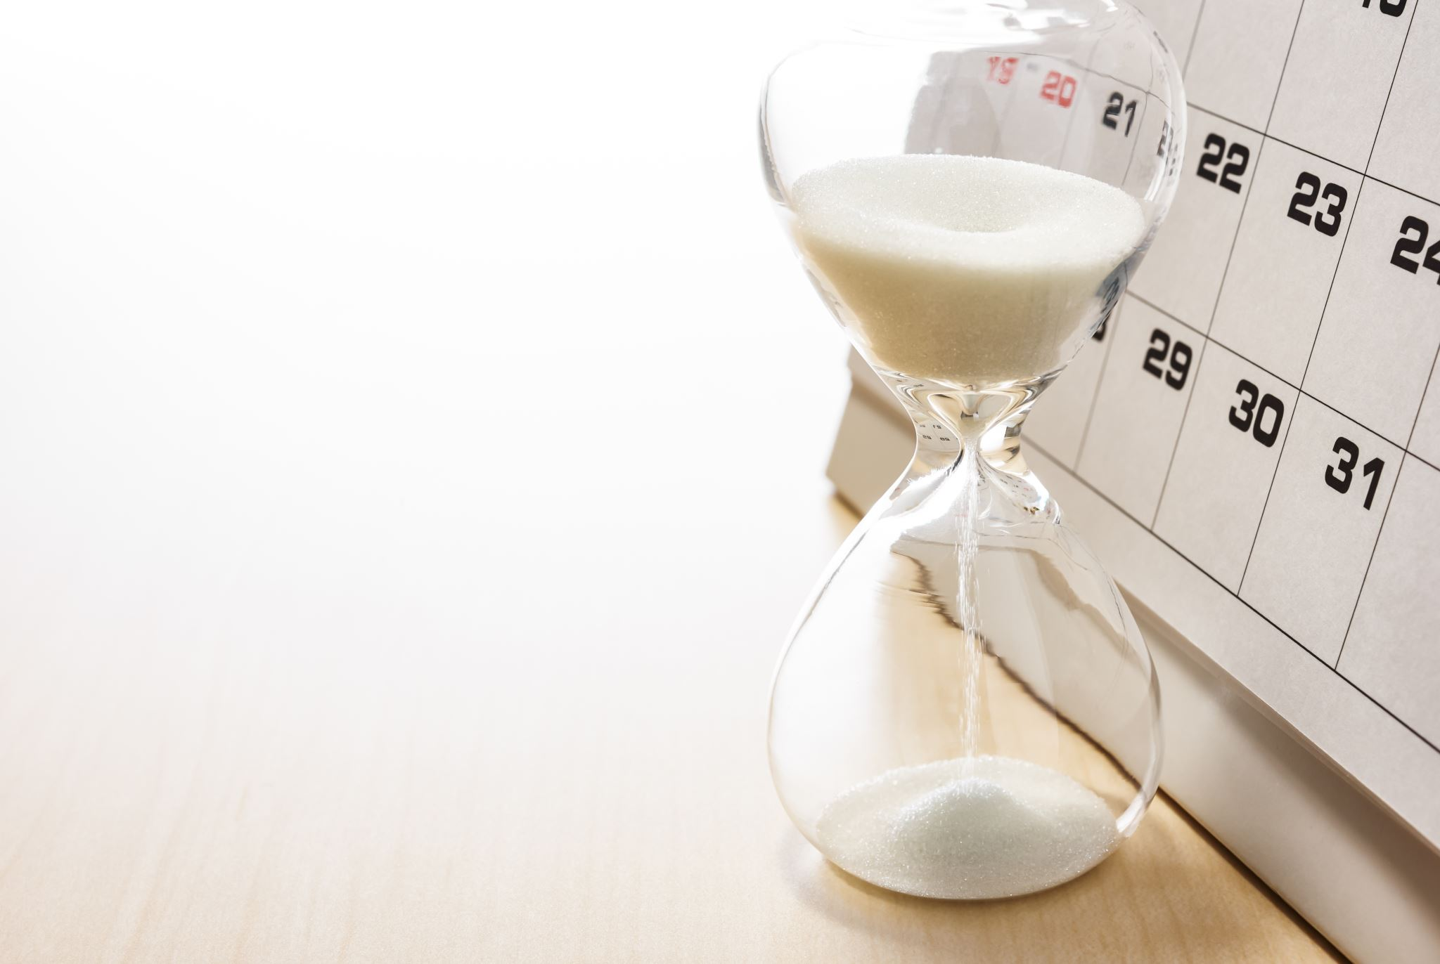
“For the time is come that judgment must begin at the house of God: and if it first begin at us, what shall the end be of them that obey not the gospel of God?” (1 Peter 4:17)

Slide 10
Are You Ready?

Slide 11
What Shall We Do?
Acts 2:37
Alien sinners must…
Hear the Gospel – Romans 10:17; Hebrews 11:6
Believe it – John 8:24
Repent of sin in your life – Acts 17:30
Confess that Christ is God’s Son – Matthew 10:34
Be baptized to wash away your sins – Acts 2:38
An erring child of God must…
Repent and Pray for Forgiveness – 1 John 1:7-9
Endure Trials & “be faithful unto death”
Revelation 2:10
Notes:
Acts 2:36-37 - 36 Therefore let all the house of Israel know assuredly, that God hath made that same Jesus, whom ye have crucified, both Lord and Christ. 37 Now when they heard this, they were pricked in their heart, and said unto Peter and to the rest of the apostles, Men and brethren, what shall we do?
Rom. 10:17 - So then faith cometh by hearing, and hearing by the word of God.
Heb 11:6 But without faith it is impossible to please him: for he that cometh to God must believe that he is, and that he is a rewarder of them that diligently seek him.
Jn. 8:24 - I said therefore unto you, that ye shall die in your sins: for if ye believe not that I am he, ye shall die in your sins.
Acts 17:30-31 - And the times of this ignorance God winked at; but now commandeth all men every where to repent: 31 Because he hath appointed a day, in the which he will judge the world in righteousness by that man whom he hath ordained; whereof he hath given assurance unto all men, in that he hath raised him from the dead.
Matt. 10:34 - Whosoever therefore shall confess me before men, him will I confess also before my Father which is in heaven.
Acts 2:38 - Then Peter said unto them, Repent, and be baptized every one of you in the name of Jesus Christ for the remission of sins, and ye shall receive the gift of the Holy Ghost.
1 Jn. 1:7-9 - But if we walk in the light, as he is in the light, we have fellowship one with another, and the blood of Jesus Christ his Son cleanseth us from all sin. 8 If we say that we have no sin, we deceive ourselves, and the truth is not in us. 9 If we confess our sins, he is faithful and just to forgive us our sins, and to cleanse us from all unrighteousness.
Rev. 2:10 - Fear none of those things which thou shalt suffer: behold, the devil shall cast some of you into prison, that ye may be tried; and ye shall have tribulation ten days: be thou faithful unto death, and I will give thee a crown of life.

