Slide 1
Nots That Must NOT Be Loosed

Slide 2
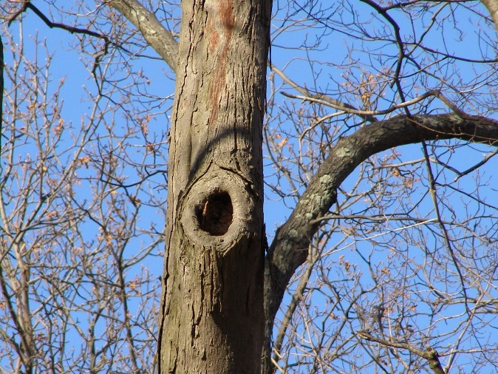
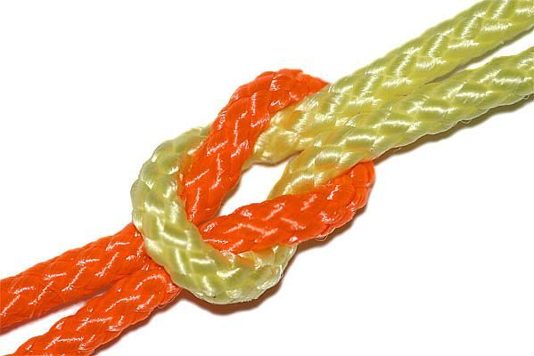
Nots That Must NOT Be Loosed

Slide 3
God’s Word vs. Satan’s Lie
God Said…
“16 And the LORD God commanded the man, saying, Of every tree of the garden thou mayest freely eat: 17 But of the tree of the knowledge of good and evil, thou shalt not eat of it: for in the day that thou eatest thereof thou shalt surely die” (Gen. 2:16-17)
The Devil’s Lie…
“2 And the woman said unto the serpent, We may eat of the fruit of the trees of the garden: 3 But of the fruit of the tree which is in the midst of the garden, God hath said, Ye shall not eat of it, neither shall ye touch it, lest ye die. 4 And the serpent said unto the woman, Ye shall not surely die” (Gen. 3:2-4)
Notes:
Jn. 8:44 - Ye are of your father the devil, and the lusts of your father ye will do. He was a murderer from the beginning, and abode not in the truth, because there is no truth in him. When he speaketh a lie, he speaketh of his own: for he is a liar, and the father of it.
Duet. 4:2 - Ye shall not add unto the word which I command you, neither shall ye diminish ought from it, that ye may keep the commandments of the LORD your God which I command you.
Rev. 22:18-19 - 18 For I testify unto every man that heareth the words of the prophecy of this book, If any man shall add unto these things, God shall add unto him the plagues that are written in this book: 19 And if any man shall take away from the words of the book of this prophecy, God shall take away his part out of the book of life, and out of the holy city, and from the things which are written in this book.

Slide 4
Matthew 25:41-46
41 Then shall he say also unto them on the left hand, Depart from me, ye cursed, into everlasting fire, prepared for the devil and his angels:
42 For I was an hungred, and ye gave me no meat: I was thirsty, and ye gave me no drink:
43 I was a stranger, and ye took me not in: naked, and ye clothed me not: sick, and in prison, and ye visited me not.
44 Then shall they also answer him, saying, Lord, when saw we thee an hungred, or athirst, or a stranger, or naked, or sick, or in prison, and did not minister unto thee?
45 Then shall he answer them, saying, Verily I say unto you, Inasmuch as ye did it not to one of the least of these, ye did it not to me.
46 And these shall go away into everlasting punishment: but the righteous into life eternal.

Slide 5
Nots That Must NOT Be Loosed
NOT To Live by Bread Alone - Matthew 4:4
Be NOT Children in Understanding - 1 Corinthians 14:20; 13:11
Love NOT the World - 1 John 2:15-17
Let NOT Sin Reign Over You - Romans 6:12-13
Be NOT Deceived - 1 Corinthians 6:9-10; Galatians 6:7-8
Make NOT Provision for the Flesh - Romans 13:14; Gal. 5:16
Be NOT Overcome With Evil - Romans 12:21; 1 Peter 3:9
NOT Set Affections on Things on Earth - Colossians 3:1-2
Lay NOT Up Treasures Upon Earth - Matthew 6:19-21
Do NOT Your Alms Before Men - Matthew 6:1-2
Do NOT Use Vain Repetition - Matthew 6:7-8
Be NOT Weary in Well Doing - 2 Thessalonians 3:13
Notes:
Matt. 4:4 - But he answered and said, It is written, Man shall not live by bread alone, but by every word that proceedeth out of the mouth of God.
Cf. Duet. 8:3 - And he humbled thee, and suffered thee to hunger, and fed thee with manna, which thou knewest not, neither did thy fathers know; that he might make thee know that man doth not live by bread only, but by every word that proceedeth out of the mouth of the LORD doth man live.
1 Cor. 14:20 - Brethren, be not children in understanding: howbeit in malice be ye children, but in understanding be men. 13:11 - When I was a child, I spake as a child, I understood as a child, I thought as a child: but when I became a man, I put away childish things.
1 Jn. 2:15-17 - 5 Love not the world, neither the things that are in the world. If any man love the world, the love of the Father is not in him. 16 For all that is in the world, the lust of the flesh, and the lust of the eyes, and the pride of life, is not of the Father, but is of the world. 17 And the world passeth away, and the lust thereof: but he that doeth the will of God abideth for ever.
Rom. 6:12-13 - Let not sin therefore reign in your mortal body, that ye should obey it in the lusts thereof. 13 Neither yield ye your members as instruments of unrighteousness unto sin: but yield yourselves unto God, as those that are alive from the dead, and your members as instruments of righteousness unto God.
1 Cor. 6:9-10 - Know ye not that the unrighteous shall not inherit the kingdom of God? Be not deceived: neither fornicators, nor idolaters, nor adulterers, nor effeminate, nor abusers of themselves with mankind, 10 Nor thieves, nor covetous, nor drunkards, nor revilers, nor extortioners, shall inherit the kingdom of God.
Gal. 6:7-8 - Be not deceived; God is not mocked: for whatsoever a man soweth, that shall he also reap. 8 For he that soweth to his flesh shall of the flesh reap corruption; but he that soweth to the Spirit shall of the Spirit reap life everlasting.
Rom. 13:14 - But put ye on the Lord Jesus Christ, and make not provision for the flesh, to fulfil the lusts thereof. READ vs. 11-14
Gal. 5:16 - This I say then, Walk in the Spirit, and ye shall not fulfil the lust of the flesh.
Rom. 12:21 - Be not overcome of evil, but overcome evil with good.
1 Pet. 3:9 - Not rendering evil for evil, or railing for railing: but contrariwise blessing; knowing that ye are thereunto called, that ye should inherit a blessing.
Col. 3:1-2 - If ye then be risen with Christ, seek those things which are above, where Christ sitteth on the right hand of God. 2 Set your affection on things above, not on things on the earth.
Matt. 6:19-21 - Lay not up for yourselves treasures upon earth, where moth and rust doth corrupt, and where thieves break through and steal: 20 But lay up for yourselves treasures in heaven, where neither moth nor rust doth corrupt, and where thieves do not break through nor steal: 21 For where your treasure is, there will your heart be also.
Matt. 6:1-2 - Take heed that ye do not your alms before men, to be seen of them: otherwise ye have no reward of your Father which is in heaven. 2 Therefore when thou doest thine alms, do not sound a trumpet before thee, as the hypocrites do in the synagogues and in the streets, that they may have glory of men. Verily I say unto you, They have their reward.
Matt. 6:7-8 - But when ye pray, use not vain repetitions, as the heathen do: for they think that they shall be heard for their much speaking. 8 Be not ye therefore like unto them: for your Father knoweth what things ye have need of, before ye ask him.
2 Thess. 3:13 - But ye, brethren, be not weary in well doing.

Slide 6
Nots That Must NOT Be Loosed
NOT Forsake the Assembling Of The Saints - Hebrews 10:25
Swear NOT at All - Matthew 5:34; James 5:12
Lie NOT One to Another - Colossians 3:9; Ephesians 4:24-25
Speak NOT Evil of One Another - James 4:11
Give NOT Holy Things To Dogs & Swine - Matthew 7:6
Defraud NOT - 1 Corinthians 7:5; 1 Thessalonians 4:6
Let NOT Man Put Asunder What God Joins - Matthew 19:4-6
Provoke NOT Your Children to Wrath - Ephesians 6:4
Speak NOT to Please Men - 1 Thess. 2:4; Galatians 1:10
Fear NOT Him That Kills The Body - Matthew 10:28
Be NOT Ignorant of Death - 1 Thessalonians 4:13-18
Let NOT Your Heart Be Troubled - John 14:1-11, 14
Notes:
Heb. 10:25 - Not forsaking the assembling of ourselves together, as the manner of some is; but exhorting one another: and so much the more, as ye see the day approaching.
Matt. 5:34 - But I say unto you, Swear not at all; neither by heaven; for it is God's throne:
Jas. 5:12 - But above all things, my brethren, swear not, neither by heaven, neither by the earth, neither by any other oath: but let your yea be yea; and your nay, nay; lest ye fall into condemnation. Christians ought to always
live in such a way that reflects that complete divine revelation and truth. When the Christian, whose life is governed by truth and a hope of heaven, tells someone that a matter is so, said statement will need no accompanying oath. Christians can be trusted by their word and their word alone!
Col. 3:9 - Lie not one to another, seeing that ye have put off the old man with his deeds;
Eph. 4:24-25 - And that ye put on the new man, which after God is created in righteousness and true holiness. 25 Wherefore putting away lying, speak every man truth with his neighbour: for we are members one of another.
Jas. 4:11 - Speak not evil one of another, brethren. He that speaketh evil of his brother, and judgeth his brother, speaketh evil of the law, and judgeth the law: but if thou judge the law, thou art not a doer of the law, but a judge.
Matt. 7:6 - Give not that which is holy unto the dogs, neither cast ye your pearls before swine, lest they trample them under their feet, and turn again and rend you.
1 Cor. 7:5 - Defraud (deprive not) ye not one the other, except it be with consent for a time, that ye may give yourselves to fasting and prayer; and come together again, that Satan tempt you not for your incontinency (self-control).
1 Thess. 4:6 - That no man go beyond and defraud (take advantage of) his brother in any matter: because that the Lord is the avenger of all such, as we also have forewarned you and testified.
Matt. 19:4-6 - And he answered and said unto them, Have ye not read, that he which made them at the beginning made them male and female, 5 And said, For this cause shall a man leave father and mother, and shall cleave to his wife: and they twain shall be one flesh? 6 Wherefore they are no more twain, but one flesh. What therefore God hath joined together, let not man put asunder.
Eph. 6:4 - And, ye fathers, provoke not your children to wrath: but bring them up in the nurture and admonition of the Lord.
1 Thess. 2:4 - But as we were allowed of God to be put in trust with the gospel, even so we speak; not as pleasing men, but God, which trieth our hearts.
Gal. 1:10 - For do I now persuade men, or God? or do I seek to please men? for if I yet pleased men, I should not be the servant of Christ.
Matt. 10:28 - And fear not them which kill the body, but are not able to kill the soul: but rather fear him which is able to destroy both soul and body in hell.
1 Thess. 4:13-18 - READ
Jn. 14:1-11, 14 - READ

Slide 7
Nots That Must NOT Be Loosed
Let Us NOT forget these Nots!

Slide 8
Matthew 7:21-23
“21 Not every one that saith unto me, Lord, Lord, shall enter into the kingdom of heaven; but he that doeth the will of my Father which is in heaven. 22 Many will say to me in that day, Lord, Lord, have we not prophesied in thy name? and in thy name have cast out devils? and in thy name done many wonderful works? 23 And then will I profess unto them, I never knew you: depart from me, ye that work iniquity”

Slide 9
2 Thessalonians 1:7-9
7 And to you who are troubled rest with us, when the Lord Jesus shall be revealed from heaven with his mighty angels, 8 In flaming fire taking vengeance on them that know not God, and that obey not the gospel of our Lord Jesus Christ: 9 Who shall be punished with everlasting destruction from the presence of the Lord, and from the glory of his power;

Slide 10
“…what shall we do?” Acts 2:37
Alien Sinners Must…
Hear the gospel – Romans 10:17
Believe the gospel – Romans 10:10
Repent of their sins – Acts 17:30
Confess Christ before men – Matthew 10:32
Be baptized in water for the remission of sins – Acts 2:38
An Erring Child of God Must…
Repent and pray – Acts 8:22
Children of God Must…
Live “faithful UNTO death” - Revelation 2:10
Notes:
Acts 2:36 - Therefore let all the house of Israel know assuredly, that God hath made that same Jesus, whom ye have crucified, both Lord and Christ.
Acts 2:37 - Now when they heard this, they were pricked in their heart (cut to the heart), and said unto Peter and to the rest of the apostles, Men and brethren, what shall we do?
Rom. 10:17 - So then faith cometh by hearing, and hearing by the word of God.
Rom. 10:10 - For with the heart man believeth unto righteousness; and with the mouth confession is made unto salvation.
Acts. 17:30-31 - And the times of this ignorance God winked at; but now commandeth all men every where to repent: 31 Because he hath appointed a day, in the which he will judge the world in righteousness by that man whom he hath ordained; whereof he hath given assurance unto all men, in that he hath raised him from the dead.
Matt. 10:32 - Whosoever therefore shall confess me before men, him will I confess also before my Father which is in heaven.
Acts. 2:38 - Then Peter said unto them, Repent, and be baptized every one of you in the name of Jesus Christ for the remission of sins, and ye shall receive the gift of the Holy Ghost.
Acts 8:22 - Repent therefore of this thy wickedness, and pray God, if perhaps the thought of thine heart may be forgiven thee.
Rev. 2:10 - Fear none of those things which thou shalt suffer: behold, the devil shall cast some of you into prison, that ye may be tried; and ye shall have tribulation ten days: be thou faithful unto death, and I will give thee a crown of life.

