Slide 1
Four wise Little Things
Proverbs 30:24-28

Slide 2
Introduction
Animals Often Mentioned In the Bible
Often Used As Illustrations..
Birds - Matthew 6:26
Sheep, Wolves, Snakes & Doves
  Matthew 10:16
Dogs & Hogs - 2 Peter 2:22; Matthew 7:6
Sheep & Goats - Matthew 25:31-33
Lion - 1 Peter 5:8
Notes:
Matt. 6:26 - Behold the fowls of the air: for they sow not, neither do they reap, nor gather into barns; yet your heavenly Father feedeth them. Are ye not much better than they?
Matt. 10:16 - Behold, I send you forth as sheep in the midst of wolves: be ye therefore wise as serpents, and harmless as doves.
2 Pet. 2:22 - But it is happened unto them according to the true proverb, The dog is turned to his own vomit again; and the sow that was washed to her wallowing in the mire.
Matt. 7:6 - Give not that which is holy unto the dogs, neither cast ye your pearls before swine, lest they trample them under their feet, and turn again and rend you.
Matt. 25:31-33 - When the Son of man shall come in his glory, and all the holy angels with him, then shall he sit upon the throne of his glory: 32 And before him shall be gathered all nations: and he shall separate them one from another, as a shepherd divideth his sheep from the goats: 33 And he shall set the sheep on his right hand, but the goats on the left.
1 Pet. 5:8 - Be sober, be vigilant; because your adversary the devil, as a roaring lion, walketh about, seeking whom he may devour:

Slide 3
Proverbs 30:24-28
“24 There be four things which are little upon the earth, but they are exceeding wise: 25 The ants are a people not strong, yet they prepare their meat in the summer; 26 The conies are but a feeble folk, yet make they their houses in the rocks; 27 The locusts have no king, yet go they forth all of them by bands; 28 The spider taketh hold with her hands, and is in kings' palaces”
Notes:
There be four things, Of which it is said, they are very little but very wise. 1. The ants. 2. The conies. 3. The locusts. 4. The spider.

Slide 4
The Ants - vs. 25
Proverbs 6:6-9
Example of Labor & Teamwork
Must have a mind to work - Neh. 4:6-23
  Success was because of cooperation
We Must Work While It Is Day
The night is coming- John 9:4
Do Not Become Weary in Well Doing
Galatians 6:9
Steadfastly Endure To The End
1 Corinthians 15:58; Matthew 24:13
“The ants are a people not strong, yet they prepare their meat in the summer”
“6 Go to the ant, thou sluggard; consider her ways, and be wise: 7 Which having no guide, overseer, or ruler, 8 Provideth her meat in the summer, and gathereth her food in the harvest. 9 How long wilt thou sleep, O sluggard? when wilt thou arise out of thy sleep?”
Wise Little Things
Notes:
Prov. 30:25 - The ants are a people not strong, yet they prepare their meat in the summer;
Prov. 6:6-9 - Go to the ant, thou sluggard; consider her ways, and be wise: 7 Which having no guide, overseer, or ruler, 8 Provideth her meat in the summer, and gathereth her food in the harvest. 9 How long wilt thou sleep, O sluggard? when wilt thou arise out of thy sleep?
Neh. 4:6-23 - READ
Jn. 9:4 - I must work the works of him that sent me, while it is day: the night cometh, when no man can work.
Gal. 6:9 - And let us not be weary in well doing: for in due season we shall reap, if we faint not.
1 Cor. 15:58 - Therefore, my beloved brethren, be ye stedfast, unmoveable, always abounding in the work of the Lord, forasmuch as ye know that your labour is not in vain in the Lord.
Matt. 24:13 - But he that shall endure unto the end, the same shall be saved.

Slide 5
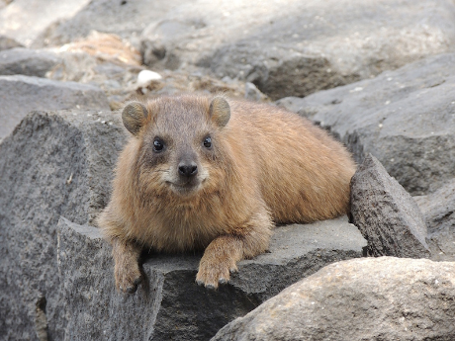
The Conies - vs. 26
Psalms 104:18
Example of Seeking Refuge
We must seek Refuge in God
Psalms 62:7; 94:22; 18:1-6, 30, 31
Must Build Our Hope On Solid Rock
Matthew 16:13-19; 7:24-29
Seek God’s Protection in…
Truth - John 6:66-68
Faith In Christ - 1 John 5:4, 5
Hope - 1 Thessalonians 5:8; Titus 1:2
“The conies (rock Badgers) are but a feeble folk, yet make they their houses in the rocks”
“The high hills are a refuge for the wild goats; and the rocks for the conies.”
Wise Little Things
Notes:
Prov. 30:26 - The conies are but a feeble folk, yet make they their houses in the rocks;
The New American Standard (NAS) translates the Hebrew word (shaphan) as badger, while the King James Version (KJV) translates it as "cony" (rabbit). Young's translates the Hebrew "shaphan" as "a hare, hedgehog, or rabbit," while Matthew Henry calls them "Arabian mice"!
Psa. 62:7 - In God is my salvation and my glory; The rock of my strength, And my refuge, is in God.
Psa. 94:22 - But the LORD is my defence; and my God is the rock of my refuge.
Psa. 18:1-6 - READ; vs. 30-31 - As for God, his way is perfect: the word of the LORD is tried: he is a buckler to all those that trust in him. {tried: or, refined} 31 For who is God save the LORD? or who is a rock save our God?
Matt. 16:33-19 - vs. 18 - And I say also unto thee, That thou art Peter (Petros -a (piece of) rock- Strong) , and upon this rock (petra - a (mass of) rock (literally or figuratively) I will build my church; and the gates of hell shall not prevail against it.
Matt. 7:24-29 - READ
Jn. 6:66-69 - From that time many of his disciples went back, and walked no more with him. 67 Then said Jesus unto the twelve, Will ye also go away? 68 Then Simon Peter answered him, Lord, to whom shall we go? thou hast the words of eternal life. 69 And we believe and are sure that thou art that Christ, the Son of the living God.
1 Jn. 5:4-5 - For whatsoever is born of God overcometh the world: and this is the victory that overcometh the world, even our faith. 5 Who is he that overcometh the world, but he that believeth that Jesus is the Son of God?
1 Thess. 5:8 - But let us, who are of the day, be sober, putting on the breastplate of faith and love; and for an helmet, the hope of salvation.
Tit. 1:2 - In hope of eternal life, which God, that cannot lie, promised before the world began;

Slide 6
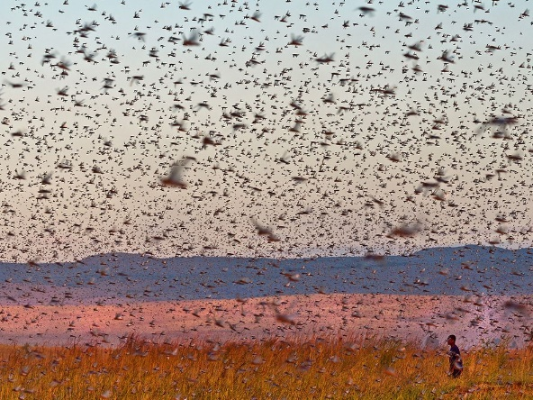
The Locusts - vs. 27
Example of Power in Unity
Unity is Good & Pleasant
Psalms 133:1
Can Accomplish Much When United
  1 Corinthians 1:10
Teach with great influence - John 17:20-21
The Church will grow - Acts 4:32-33
  Acts 5:12-14
United in one body - Romans 12:5
  1 Corinthians 12:12, 27
“The locusts have no king, yet go they forth all of them by bands”
Wise Little Things
Notes:
Prov. 30:27 - The locusts have no king, yet go they forth all of them by bands; NKJV - The locusts have no king, Yet they all advance in ranks.
Psa. 133:1 - Behold, how good and how pleasant it is for brethren to dwell together in unity! 2 It is like the precious ointment upon the head, that ran down upon the beard, even Aaron's beard: that went down to the skirts of his garments; 3 As the dew of Hermon, and as the dew that descended upon the mountains of Zion: for there the LORD commanded the blessing, even life for evermore.
1 Cor. 1:10 - Now I beseech you, brethren, by the name of our Lord Jesus Christ, that ye all speak the same thing, and that there be no divisions among you; but that ye be perfectly joined together in the same mind and in the same judgment.
Jn. 17:20-21 - Neither pray I for these alone, but for them also which shall believe on me through their word; 21 That they all may be one; as thou, Father, art in me, and I in thee, that they also may be one in us: that the world may believe that thou hast sent me.
Acts 4:32-33 - And the multitude of them that believed were of one heart and of one soul: neither said any of them that ought of the things which he possessed was his own; but they had all things common. 33 And with great power gave the apostles witness of the resurrection of the Lord Jesus: and great grace was upon them all.
Acts 5:12-14 - And by the hands of the apostles were many signs and wonders wrought among the people; (and they were all with one accord in Solomon's porch. 13 And of the rest durst no man join himself to them: but the people magnified them. 14 And believers were the more added to the Lord, multitudes both of men and women.)
Rom. 12:5 - So we, being many, are one body in Christ, and every one members one of another.
1 Cor. 12:12 - For as the body is one, and hath many members, and all the members of that one body, being many, are one body: so also is Christ. 27 Now ye are the body of Christ, and members in particular.

Slide 7
The Locusts - vs. 27
Example of Power in Unity
Unity is Good & Pleasant
Psalms 133:1
Can Accomplish Much When United
  1 Corinthians 1:10
Glorifies God - Romans 15:5-7
Members are edified - Romans 14:19
Unity in love & in the mind of Christ
  Philippians 2:1-5
Unity must be guarded - Ephesians 4:1-3
Proverbs 6:16-19; Romans 16:17
Wise Little Things
Notes:
Prov. 30:27 - The locusts have no king, yet go they forth all of them by bands; NKJV - The locusts have no king, Yet they all advance in ranks.
Rom. 15:5-7 - Now the God of patience and consolation grant you to be likeminded one toward another according to Christ Jesus: 6 That ye may with one mind and one mouth glorify God, even the Father of our Lord Jesus Christ. 7 Wherefore receive ye one another, as Christ also received us to the glory of God.
Rom.14:19 - Let us therefore follow after the things which make for peace, and things wherewith one may edify another.
Phil. 2:1-5 - READ
Eph. 4:1-3 - I therefore, the prisoner of the Lord, beseech you that ye walk worthy of the vocation wherewith ye are called, 2 With all lowliness and meekness, with longsuffering, forbearing one another in love; 3 Endeavouring to keep the unity of the Spirit in the bond of peace.
God hates - Prov. 6:16-19 - These six things doth the LORD hate: yea, seven are an abomination unto him: 17 A proud look, a lying tongue, and hands that shed innocent blood, 18 An heart that deviseth wicked imaginations, feet that be swift in running to mischief, 19 A false witness that speaketh lies, and he that soweth discord among brethren.
Rom. 16:17 - Now I beseech you, brethren, mark them which cause divisions and offences contrary to the doctrine which ye have learned; and avoid them.

Slide 8

The Spider - vs. 28
Example of Boldness & Persistence
Must Face Challenges…
Temptation - Hebrews 4:15, 16
Sin - Hebrews 10:19-26
When preaching the gospel - Acts 4:29
  Ephesians 6:19, 10
When threatened by men - Acts 5:29, 42
  Hebrews 13:5, 6
In the day of Judgment - 1 John 4:17, 18
“The spider taketh hold with her hands, and is in kings' palaces”
Wise Little Things
Notes:
Prov. 30:28 - The spider taketh hold with her hands, and is in kings' palaces.
Heb. 4:15-16 - For we have not an high priest which cannot be touched with the feeling of our infirmities; but was in all points tempted like as we are, yet without sin. 16 Let us therefore come boldly unto the throne of grace, that we may obtain mercy, and find grace to help in time of need.
Heb. 10:19-26 - READ
Acts 4:29 - And now, Lord, behold their threatenings: and grant unto thy servants, that with all boldness they may speak thy word,
Eph. 6:19-20 - And for me, that utterance may be given unto me, that I may open my mouth boldly, to make known the mystery of the gospel, 20 For which I am an ambassador in bonds: that therein I may speak boldly, as I ought to speak.
Acts. 5:29 - Then Peter and the other apostles answered and said, We ought to obey God rather than men. 42 And daily in the temple, and in every house, they ceased not to teach and preach Jesus Christ.
Heb. 13:5-6 - Let your conversation be without covetousness; and be content with such things as ye have: for he hath said, I will never leave thee, nor forsake thee. 6 So that we may boldly say, The Lord is my helper, and I will not fear what man shall do unto me.
1 Jn. 4:17-18 - Herein is our love made perfect, that we may have boldness in the day of judgment: because as he is, so are we in this world. 18 There is no fear in love; but perfect love casteth out fear: because fear hath torment. He that feareth is not made perfect in love.

Slide 9
Proverbs 30:24-28
“24 There be four things which are little upon the earth, but they are exceeding wise: 25 The ants are a people not strong, yet they prepare their meat in the summer; 26 The conies are but a feeble folk, yet make they their houses in the rocks; 27 The locusts have no king, yet go they forth all of them by bands; 28 The spider taketh hold with her hands, and is in kings' palaces”

Slide 10
Conclusion
Do We Recognize the Wisdom of These Four “Little Things” In Our Spiritual Lives?
The value of teamwork and endurance in the Christian life
The need to seek refuge with God
The power of unity in Truth
The divine expectation to be bold and persistent in our service to God

Slide 11

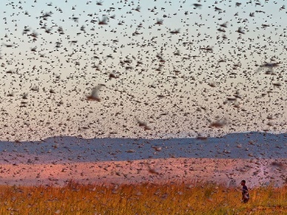
The Spider - vs. 28
An example of boldness and persistence
The Ants - vs. 25
An example of teamwork
The Conies - vs. 26
An example of seeking refuge
The Locusts - vs. 27
An example of strength in unity
Four Wise Little Things

Slide 12
“…what shalI we do?”
Acts 2:37
An alien sinner must…
  Hear the Gospel – Romans 10:17
  Believe – John 8:34
  Repent – Acts 17:30
  Confess Christ – Matthew 10:34
  Be Baptized – Acts 2:38
An erring Child of God must…
  Repent and Pray – Acts 8:22
Live “faithful unto death”
  Revelation 2:10
Notes:
Acts 2:37 - Now when they heard this, they were pricked in their heart (cut to the heart), and said unto Peter and to the rest of the apostles, Men and brethren, what shall we do?
Rom. 10:17 - So then faith cometh by hearing, and hearing by the word of God.
Jn. 8:34 - I said therefore unto you, that ye shall die in your sins: for if ye believe not that I am he, ye shall die in your sins.
Acts. 17:30-31 - And the times of this ignorance God winked at; but now commandeth all men every where to repent: 31 Because he hath appointed a day, in the which he will judge the world in righteousness by that man whom he hath ordained; whereof he hath given assurance unto all men, in that he hath raised him from the dead.
Matt. 10:34 - Whosoever therefore shall confess me before men, him will I confess also before my Father which is in heaven.
Acts. 2:38 - Then Peter said unto them, Repent, and be baptized every one of you in the name of Jesus Christ for the remission of sins, and ye shall receive the gift of the Holy Ghost.
Acts 8:22 - Repent therefore of this thy wickedness, and pray God, if perhaps the thought of thine heart may be forgiven thee.
Rev. 2:10 - Fear none of those things which thou shalt suffer: behold, the devil shall cast some of you into prison, that ye may be tried; and ye shall have tribulation ten days: be thou faithful unto death, and I will give thee a crown of life.

