Slide 1
The True Vine
John 15

Slide 2
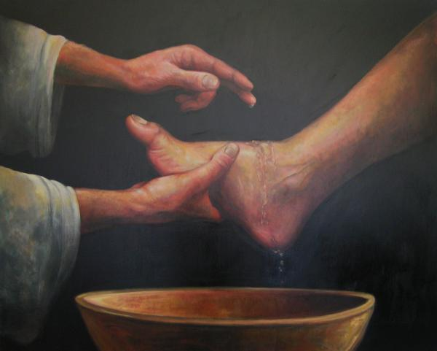
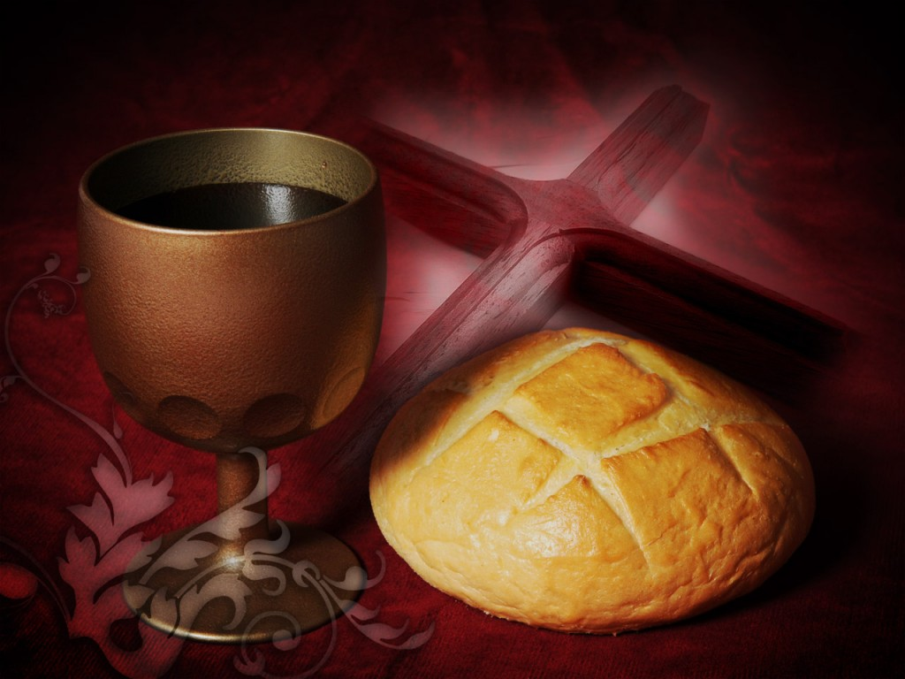
Setting the Scene – Time Was Short

Slide 3
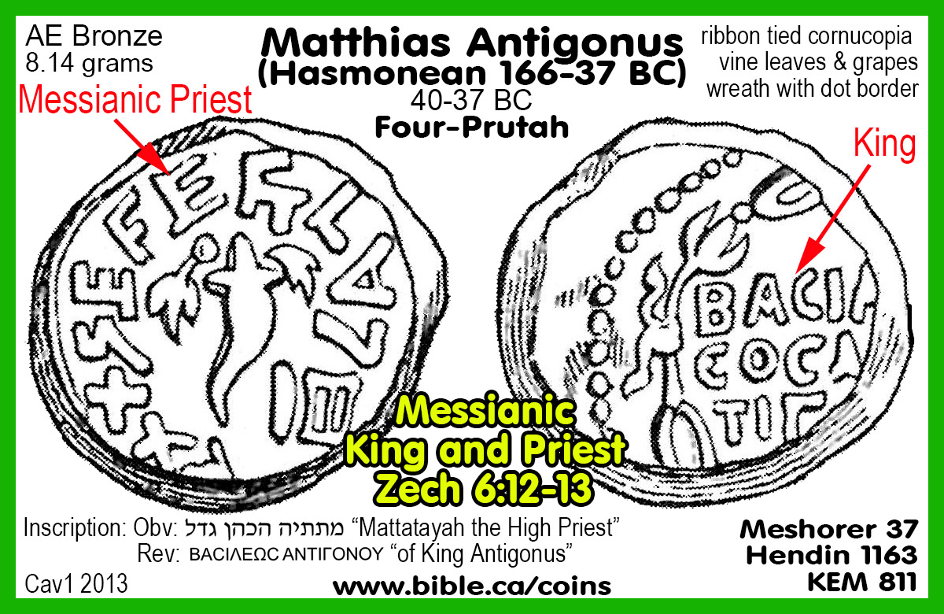
The Vine
  Psalm 80 - Israel is a vine
  Isaiah 5 - God planted a vineyard
  Jeremiah 2:21 – God planted a choice vine
  Ezekiel 15 –a useless vine
  Gate of the temple – a golden vine
  Maccabean coins – a vine

Slide 4
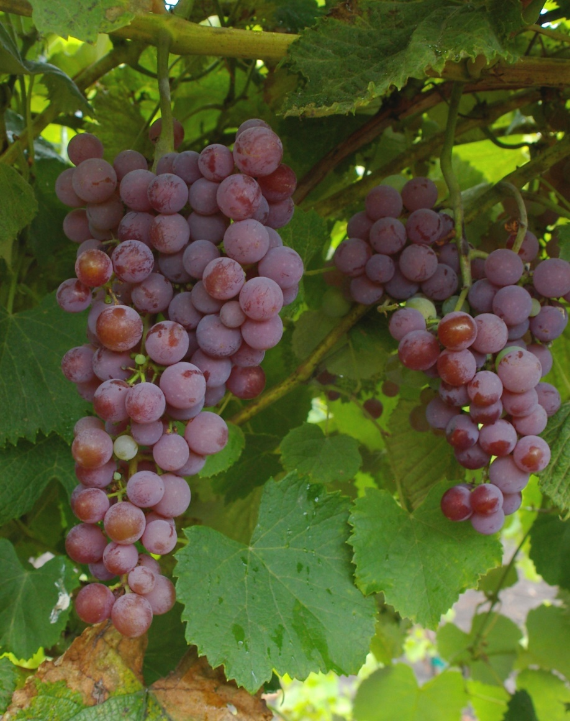
I Am the True Vine (Jn. 15:1-6)
THE VINE IS EVERYTHING TO THE BRANCHES
Must be joined to the vine
Fruits don’t pay admission
“Apart from me you can do nothing”
Nothing = Zero

Slide 5
The Primary Focus Is Abiding
1 John 5:12
Whoever has the Son has life; whoever does not have the Son of God does not have life.

Slide 6

We Are Not the Vine – We Are the Branches
1 Jn. 1:5-9 Jesus sustains us
Gal. 2: 20-21 We live for Jesus
1 Pt. 4:1-2 His purpose is our purpose
2 Cor. 13:5 Test yourselves

Slide 7
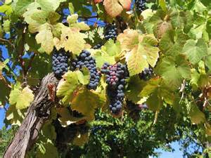
Abiding Requires Obedience (Jn. 15:7-12)
You are not cemented in.
You make a choice to abide.
Abiding means listening to his voice.
Abiding means obeying his voice
Abiding requires ongoing obedience

Slide 8
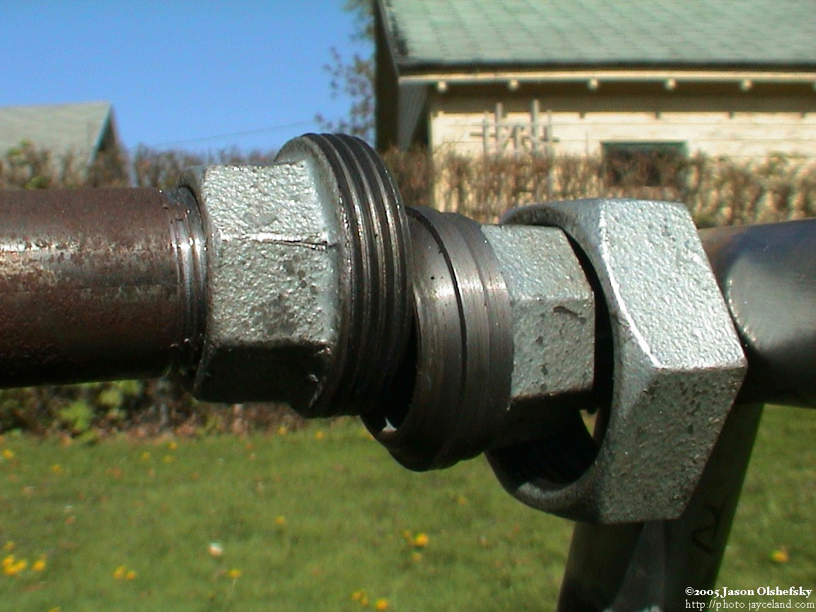
Jesus Showed Us How It is Done
Jn. 4:34
Jn. 5:30
Jn. 6:38

Slide 9
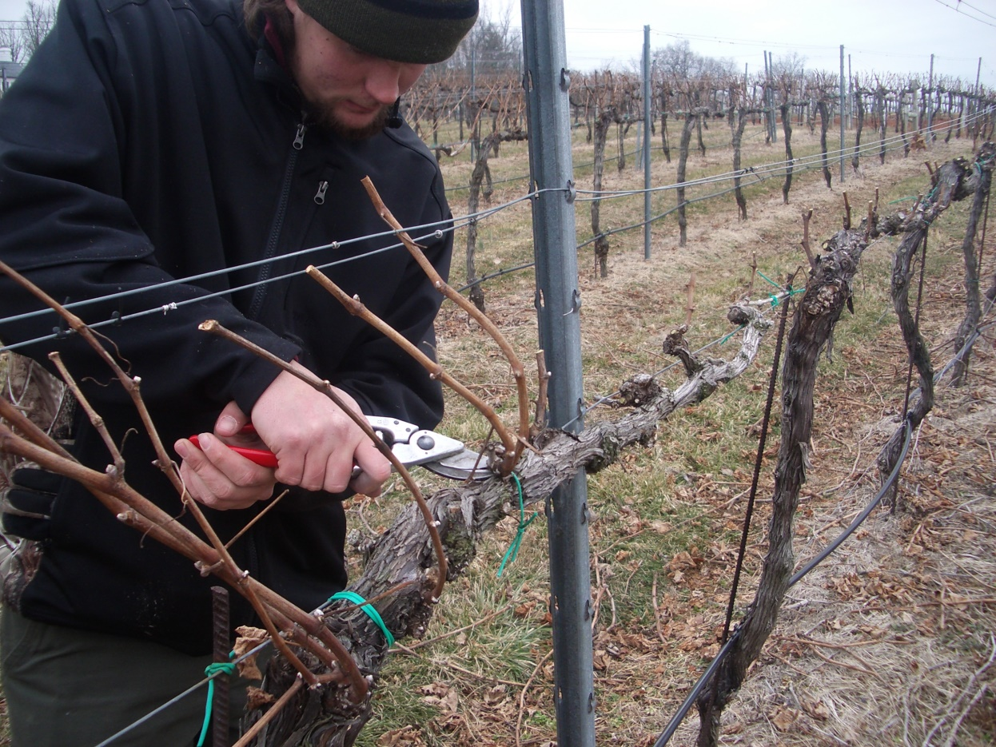
If We Abide, We Will Bear Fruit
Jn. 15:1-2 God does something to every branch
It’s bear or burn

Slide 10
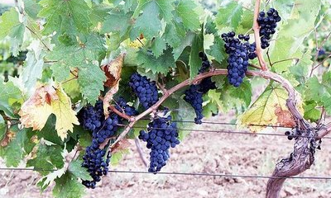
Are You In Christ?
(Gal. 3:27)

