Slide 1
What We Need Is More Love

Slide 2
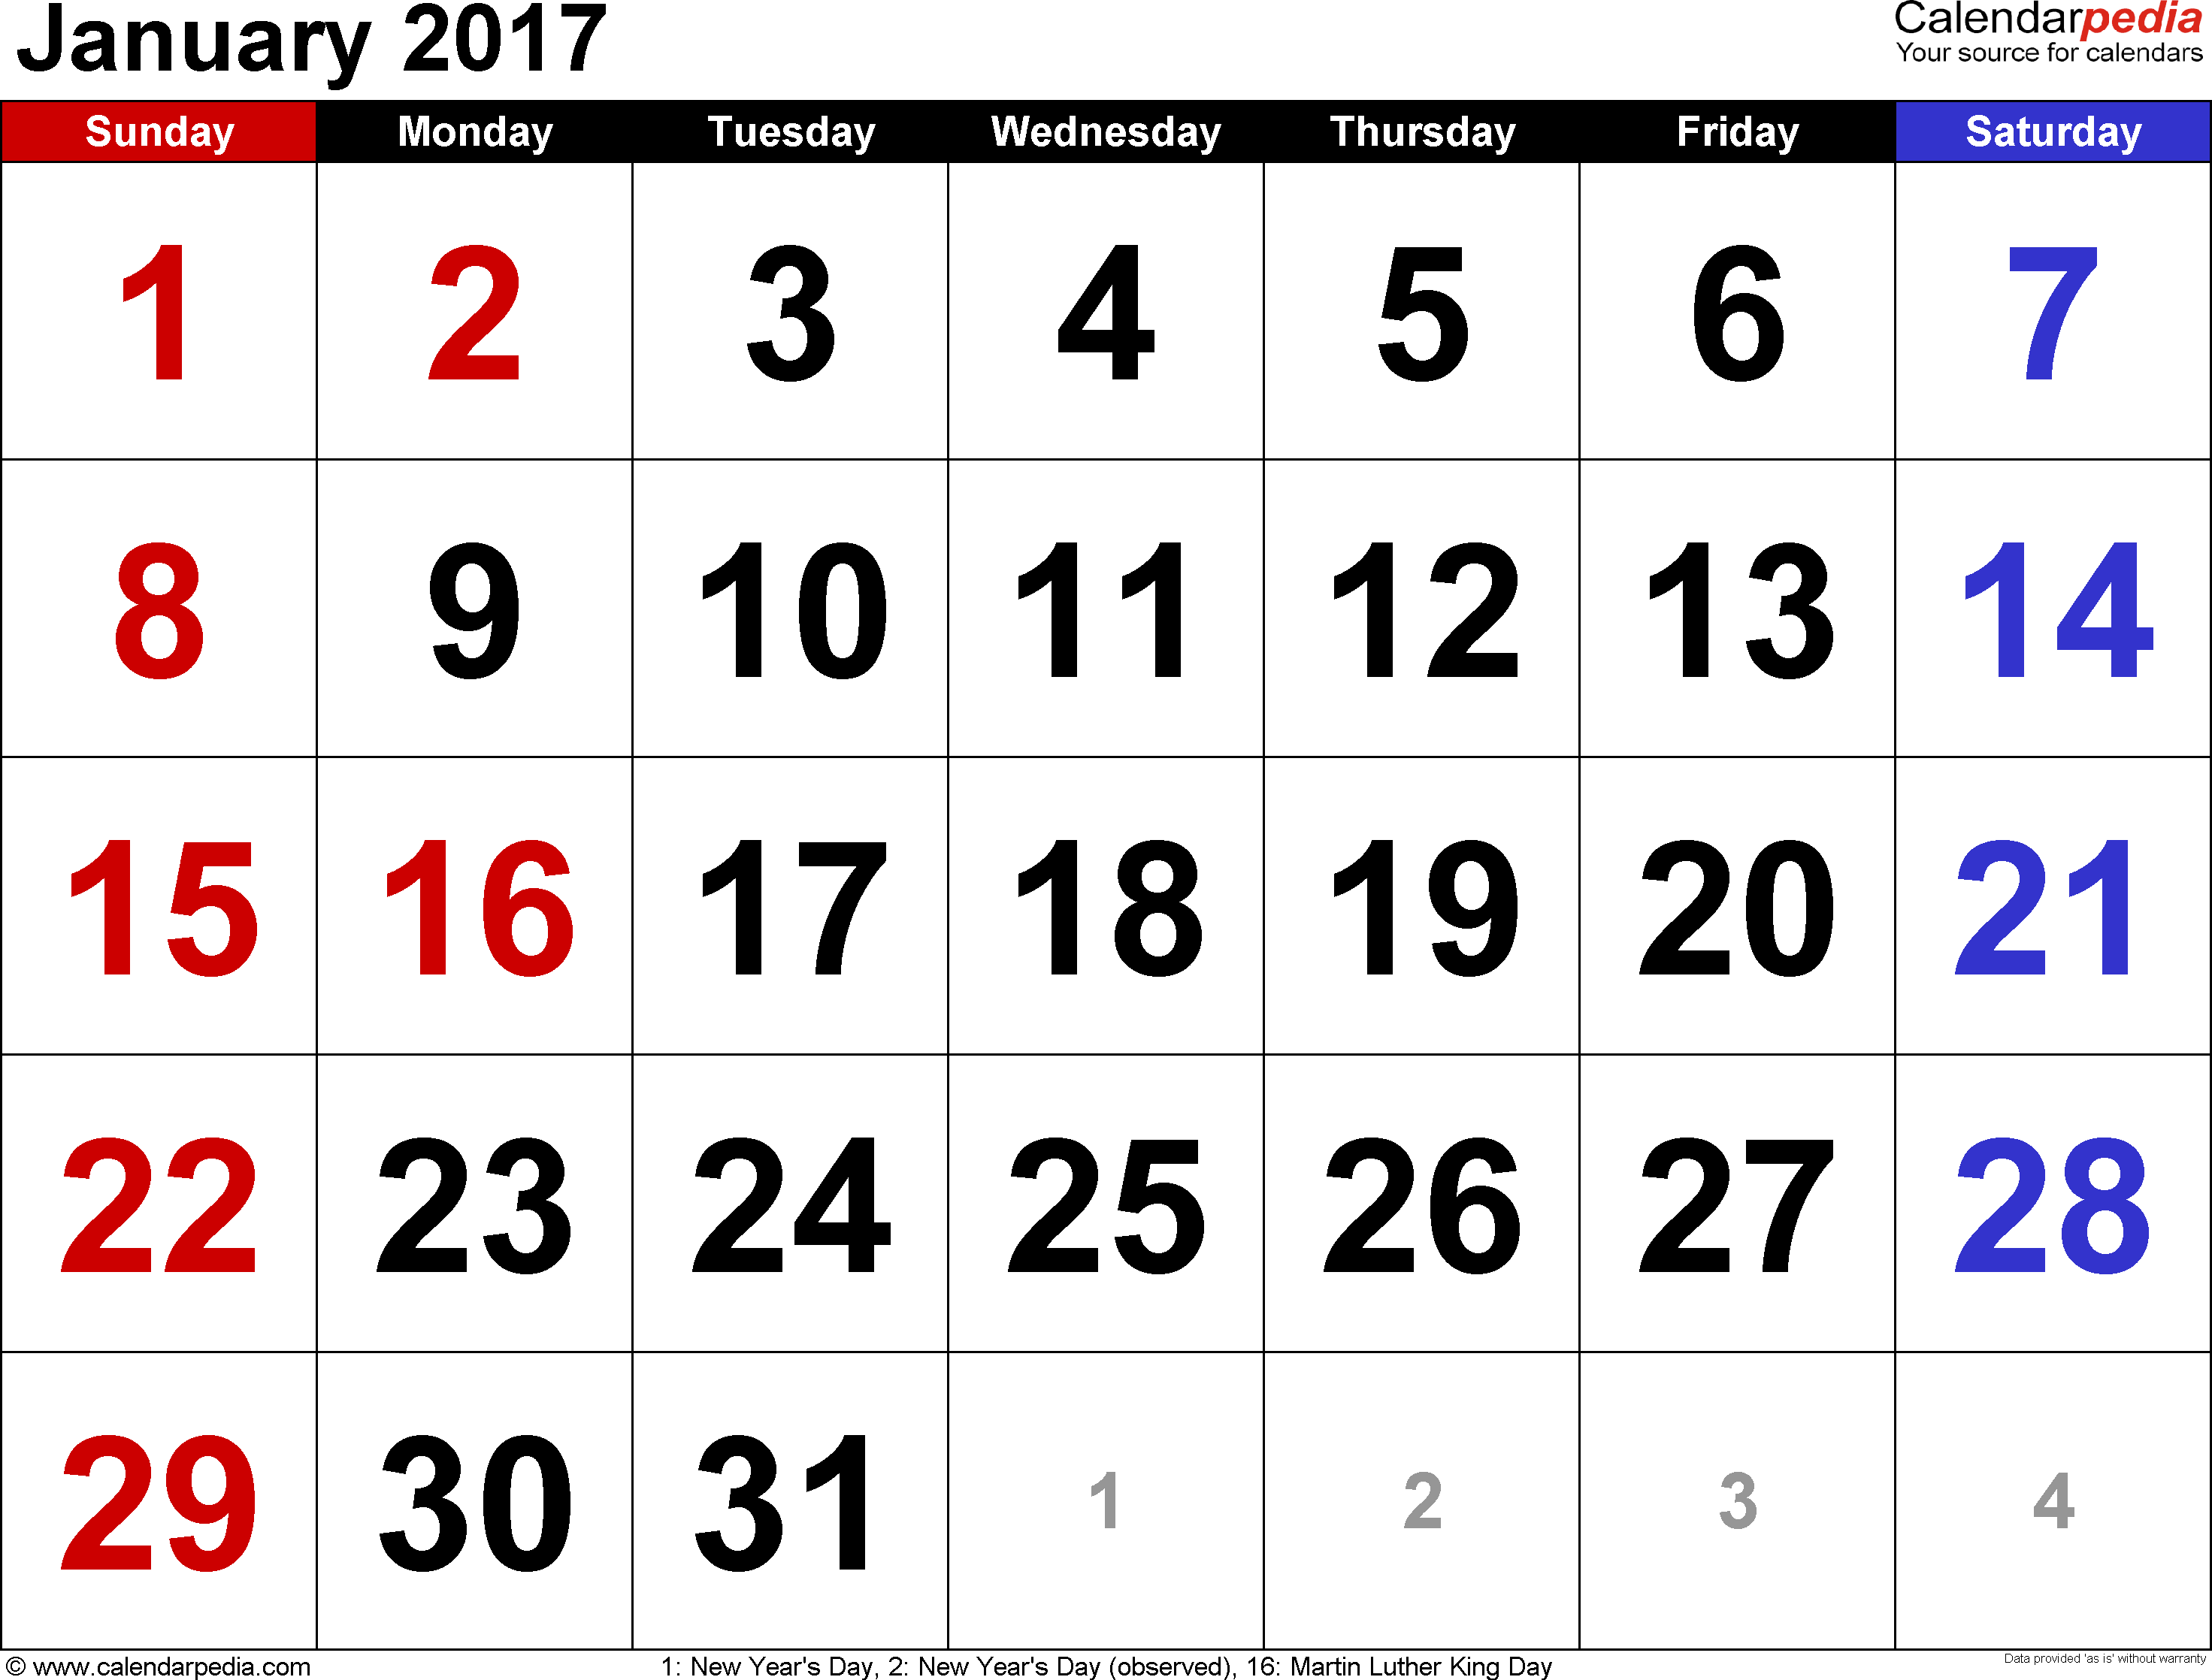
In A previous Lesson
“What We Need Is LESS Love”
We need Less Love for…
Self
Money
The Pleasures Of This World
Preeminence
The Wages of Unrighteousness
The Praise of Men

Slide 3
Introduction
The Bible has much to say about love
John 3:16-17

Slide 4
John 3:16-17
16 For God so loved the world, that he gave his only begotten Son, that whosoever believeth in him should not perish, but have everlasting life. 17 For God sent not his Son into the world to condemn the world; but that the world through him might be saved.

Slide 5
John 3:16
Power – “For God…”
Emotion – “…so loved…”
Measure – “…the world…”
Gift – “…that He gave…”
Sacrifice – “…His only begotten Son…”
Invitation – “…that whoever believeth…”
Blessings – “…should not perish…”
Reward – “…but have everlasting life”
Greatest Things In

Slide 6
Introduction
The Bible has much to say about love
John 3:16-17
Many have love for the WRONG things rather than the RIGHT things
1 John 4:7-11
2 Timothy 3:1-5

Slide 7
1 John 4:7-11
7 Beloved, let us love one another: for love is of God; and every one that loveth is born of God, and knoweth God. 8 He that loveth not knoweth not God; for God is love. 9 In this was manifested the love of God toward us, because that God sent his only begotten Son into the world, that we might live through him. 10 Herein is love, not that we loved God, but that he loved us, and sent his Son to be the propitiation for our sins. 11 Beloved, if God so loved us, we ought also to love one another.

Slide 8
2 Timothy 3:1-5
1 This know also, that in the last days perilous times shall come. 2 For men shall be lovers of their own selves, covetous, boasters, proud, blasphemers, disobedient to parents, unthankful, unholy, 3 Without natural affection, trucebreakers, false accusers, incontinent, fierce, despisers of those that are good, 4 Traitors, heady, highminded, lovers of pleasures more than lovers of God; 5 Having a form of godliness, but denying the power thereof: from such turn away.

Slide 9
introduction
Most religious people would agree that more love is needed
In the home
In our schools
In our business connections
Among political leaders
Among brethren in the church especially
For God
I agree! Do You?

Slide 10
Bold preaching
Many preachers avoid controversy
Not like Paul & Barnabas – “waxed bold”
Acts 13:42-51
Apostles were never “politically correct”
Acts 5:27-42
We need preaching that marks sin, error and false teachers
Romans 16:17; 2 Timothy 2:16-18; 3:13
Must teach “all the counsel of God”
Acts 20:27; 26:19-23; 2 Timothy 4:1-4
We Need MORE Love For…
Notes:
Acts 13:46-51 - READ - Paul & Baranabas in Antioch of Pisidia, See vs 46 - “bold” - parrhesiazomai, par-hray-see-ad'-zom-ahee middle voice from 3954; to be frank in utterance, or confident in spirit and demeanor:--be (wax) bold, (preach, speak) boldly.
Acts 5:27-42 - READ, Before the Sanhedrin counsel
Rom. 16:17-18 - Now I beseech you, brethren, mark them which cause divisions and offences contrary to the doctrine which ye have learned; and avoid them. 18 For they that are such serve not our Lord Jesus Christ, but their own belly; and by good words and fair speeches deceive the hearts of the simple. “Fair, Smooth speech” - “Smooth” (chrestologia) = “fair or smooth speech” (LS 895)... “bland address, fair speaking”
(Moulton 439). “Fair” (eulogia) = “good or fine language... a fair speech, specious talk (deceptively attractive... having the ring of truth or plausibility but actually fallacious)”
2 Tim. 2:16-18 - But shun profane and vain babblings: for they will increase unto more ungodliness. 17 And their word will eat as doth a canker: of whom is Hymenaeus and Philetus; 18 Who concerning the truth have erred, saying that the resurrection is past already; and overthrow the faith of some.
2 Tim. 3:13 - But evil men and seducers shall wax (grow) worse and worse, deceiving, and being deceived.
Acts 20:27 - Wherefore I take you to record this day, that I am pure from the blood of all men. 27 For I have not shunned to declare unto you all the counsel of God.
Acts 26:19-23 - READ - Paul before King Agrippa & Festus
2 Tim. 4:1-4 - I charge thee therefore before God, and the Lord Jesus Christ, who shall judge the quick and the dead at his appearing and his kingdom; 2 Preach the word; be instant in season, out of season; reprove, rebuke, exhort with all longsuffering and doctrine. 3 For the time will come when they will not endure sound doctrine; but after their own lusts shall they heap to themselves teachers, having itching ears; 4 And they shall turn away their ears from the truth, and shall be turned unto fables.

Slide 11
Other Bold Preachers of the 1st century
Jesus – crucified because of His teaching
Matthew 23; Matthew 27:11-25
John – lost his head
Condemned the marriage of Herod & Herodias
Matthew 14:1-12
Steven – stoned for preaching the truth
Acts 7:51-60
Notes:
Matt. 23 - COMMENT - Scathing rebuke of the Scribes & Pharisees
Matt. 27:11-25 - READ
Matt. 14:1-12 - READ
Acts 7:51-60 - Rebuked the Jews of his day

Slide 12
Divine authority
Cannot act without Divine Authority and please God
Christ has ALL Authority
Matthew 28:18-19; 7:21-29
Worship must be “in spirit and in truth”
John 4:21-24
This prohibits – Fun, food, frolic and any other social gospel gimmicks or programs!
Must demand authority for all religious acts
Matthew 21:23-27
We Need MORE Love For…
Notes:
Matt. 28:18-19 - And Jesus came and spake unto them, saying, All power is given unto me in heaven and in earth. 19 Go ye therefore, and teach all nations, baptizing them in the name of the Father, and of the Son, and of the Holy Ghost: 20 Teaching them to observe all things whatsoever I have commanded you: and, lo, I am with you alway, even unto the end of the world. Amen.
Matt. 7:21-29 - READ
Jn. 4:21-24 - Jesus saith unto her, Woman, believe me, the hour cometh, when ye shall neither in this mountain, nor yet at Jerusalem, worship the Father. 22 Ye worship ye know not what: we know what we worship: for salvation is of the Jews. 23 But the hour cometh, and now is, when the true worshippers shall worship the Father in spirit and in truth: for the Father seeketh such to worship him. 24 God is a Spirit: and they that worship him must worship him in spirit and in truth. - “in spirit and in truth” - The “spirit” is the “the vital principle by which the body is animated” (Thayer 520). Worship to the Father must take into consideration His being. God is within (I Cor. 6:19) as is His kingdom (Lk. 17:21). Truth directs and instructs man that he may please the Father (Duet. 12:32; Jn. 14:6; Eph. 1:13; 2 Tim. 1:13; Heb. 8:5). Truth reveals five acts of worship in the first day of the week assembly:
1. Lord’s Supper (Acts 20:7; I Cor. 11:23-24). 2. Singing (Eph. 5:19; Col. 3:16 etc.). 3. Praying (Acts 2:42; I Tim. 2:8). 4. Giving of our means on the first day of the week (I Cor. 16:2; II Cor. 9:6-7). 5. Gospel preaching (Acts 20:7).
Matt. 21:23-17 READ

Slide 13
The lord’s church
Purchased with Christ’s blood
Acts 20:28; 1 Peter 1:18-19; Ephesians 5:25-27
Lack of Love disrespects “the blood of the covenant”
Hebrews 10:29
Must love the Divine mission – Spiritual not physical or social
Evangelism – Matthew 28:18-20
Edification – Ephesians 4:11-16; 29: 1 Corinthians 14:26
Benevolence – Aid needy saints only - 1 Corinthians 16:1-2
Discipline – of wayward members - 2 Thessalonians 3:6-15
Must love the assembling of the Saints
Hebrews 10:23-26
We Need MORE Love For…
Notes:
Acts 20:28 - Take heed therefore unto yourselves, and to all the flock, over the which the Holy Ghost hath made you overseers, to feed the church of God, which he hath purchased with his own blood.
1 Peter 1:18-19 - Forasmuch as ye know that ye were not redeemed with corruptible things, as silver and gold, from your vain conversation received by tradition from your fathers; 19 But with the precious blood of Christ, as of a lamb without blemish and without spot:
Eph. 5:25-27 - Husbands, love your wives, even as Christ also loved the church, and gave himself for it; 26 that He might sanctify and cleanse her with the washing of water by the word, 27 That he might present it to himself a glorious church, not having spot, or wrinkle, or any such thing; but that it should be holy and without blemish.
Heb. 10:28-29 - He that despised Moses' law died without mercy under two or three witnesses: 29 Of how much sorer punishment, suppose ye, shall he be thought worthy, who hath trodden under foot the Son of God, and hath counted the blood of the covenant, wherewith he was sanctified, an unholy thing, and hath done despite unto the Spirit of grace?
Matt. 28:18-20 - READ
Eph. 4:11-16, 29 - READ
1 Cor. 14:26 - How is it then, brethren? when ye come together, every one of you hath a psalm, hath a doctrine, hath a tongue, hath a revelation, hath an interpretation. Let all things be done unto edifying.
1 Cor. 16:1-2 - Now concerning the collection for the saints, as I have given order to the churches of Galatia, even so do ye. 2 Upon the first day of the week let every one of you lay by him in store, as God hath prospered him, that there be no gatherings when I come.
2 Thess. 3:6-15 - READ
Heb. 10:23-26 - READ

Slide 14
purity
Sin is violation of God’s law and is universal
1 John 3:4; Romans 3:23; 5:12
All Unrighteousness is sin
1 John 5:17
Sin is pleasurable
Only for a season – Hebrews 11:24-27
Pleasures are short lived!
The paycheck of sin is death
Romans 6:23
Many overcome by perceived benefits of sin
Preachers who teach error
Brethren who support error
Must “keep unspotted from the world” & seek holiness
Romans 6:13; James 1:27
1 Peter 1:15, 16; 1 Corinthians 6:9-11
We Need MORE Love For…
Notes:
1 Jn. 3:4 - Whosoever committeth sin transgresseth also the law: for sin is the transgression of the law.
Rom. 3:23 - For all have sinned, and come short of the glory of God;
Rom. 5:12 - Wherefore, as by one man sin entered into the world, and death by sin; and so death passed upon all men, for that all have sinned:
1 Jn. 5:17 - If any man see his brother sin a sin which is not unto death, he shall ask, and he shall give him life for them that sin not unto death. There is a sin unto death: I do not say that he shall pray for it. 17 All unrighteousness is sin: and there is a sin not unto death.
Heb. 11:24-27 - By faith Moses, when he was come to years, refused to be called the son of Pharaoh's daughter; 25 Choosing rather to suffer affliction with the people of God, than to enjoy the pleasures of sin for a season; 26 Esteeming the reproach of Christ greater riches than the treasures in Egypt: for he had respect unto the recompence of the reward. 27 By faith he forsook Egypt, not fearing the wrath of the king: for he endured, as seeing him who is invisible.
Rev. 6:23 - For the wages of sin is death; but the gift of God is eternal life through Jesus Christ our Lord.
Rom. 6:13 - Neither yield ye your members as instruments of unrighteousness unto sin: but yield yourselves unto God, as those that are alive from the dead, and your members as instruments of righteousness unto God.
Jas. 1:27 - Pure religion and undefiled before God and the Father is this, To visit the fatherless and widows in their affliction, and to keep himself unspotted from the world.
1 Pet. 1:15-16 - But as he which hath called you is holy, so be ye holy in all manner of conversation; 16 Because it is written, Be ye holy; for I am holy.
1 Cor. 6:9-11 - READ

Slide 15
knowledge
Ignorance of God’s word is a danger
Hosea 4:6; Romans 10:1-10
Must read God’s Word
1 Timothy 4:13; Ephesians 3:2-8
Colossians 4:16; 1 Thessalonians 5:27
Hebrew writer condemned ignorance
Hebrews 5:12-14; Ephesians 5:17
Study is required so we can handle God’s word correctly
2 Timothy 2:15; 1 Peter 4:11
We Need MORE Love For…
Notes:
Hosea 4:6 - My people are destroyed for lack of knowledge: because thou hast rejected knowledge, I will also reject thee, that thou shalt be no priest to me: seeing thou hast forgotten the law of thy God, I will also forget thy children.
Rom. 10:1-10 - READ
1 Tim. 4:13 - Till I come, give attendance to reading, to exhortation, to doctrine.
Eph. 3:2-8 - READ
Col. 4:16 - And when this epistle is read among you, cause that it be read also in the church of the Laodiceans; and that ye likewise read the epistle from Laodicea.
1 Thess. 5:27 - I charge you by the Lord that this epistle be read unto all the holy brethren.
Heb. 5:12-14 - READ
Eph. 5:17 - Wherefore be ye not unwise, but understanding what the will of the Lord is. - 1 Thess. 4:3 - For this is the will of God, even your sanctification, that ye should abstain from fornication:
2 Tim. 2:15 - Study to shew thyself approved unto God, a workman that needeth not to be ashamed, rightly dividing the word of truth. - The Revision reads, "Handling aright." The Greek word [orthotomeo] means, literally, "cutting straight." The thought, probably, is to present the truth clearly, truthfully, without blunders, and with an exactness which cannot be gainsaid. - to cut straight; expound soundly; to manage rightly, to treat truthfully without falsification. In handling the word of God one must hold a straight course without deviating either to the right or left. He must “tell it like it is,” and “let the chips fall where they may.” In essence, the ASV expresses the thought more clearly: Handling aright the word of truth.
1 Pet. 4:11 - If any man speak, let him speak as the oracles of God; if any man minister, let him do it as of the ability which God giveth: that God in all things may be glorified through Jesus Christ, to whom be praise and dominion for ever and ever. Amen.

Slide 16
Comment by paul blake
“This author has been observing a frightening trend among professed sound preachers and congregations. Some have a very simple menu when it comes to spiritual food: milquetoast, weak tea, doctrinal jello, and religious cotton candy, and they serve it to the local church on a weekly basis, yielding to the whims and will of the weak and sinful. Israel’s downfall was a loss of appetite for strong preaching (Isa. 30:8-14). God’s children in every dispensation need to cultivate a hunger for sound preaching; today they need a appetite for the truth delivered as it was by the apostle Paul.”
Philippians, by Paul Blake, p. 36
Notes:
Isa. 30:8-14 - Now go, write it before them in a table, and note it in a book, that it may be for the time to come for ever and ever: 9 That this is a rebellious people, lying children, children that will not hear the law of the LORD: 10 Which say to the seers, See not; and to the prophets, Prophesy not unto us right things, speak unto us smooth things, prophesy deceits: 11 Get you out of the way, turn aside out of the path, cause the Holy One of Israel to cease from before us. 12 Wherefore thus saith the Holy One of Israel, Because ye despise this word, and trust in oppression and perverseness, and stay thereon: 13 Therefore this iniquity shall be to you as a breach ready to fall, swelling out in a high wall, whose breaking cometh suddenly at an instant. 14 And he shall break it as the breaking of the potters' vessel that is broken in pieces; he shall not spare: so that there shall not be found in the bursting of it a sherd to take fire from the hearth, or to take water withal out of the pit.

Slide 17
Sacrificial living
Christ sacrificed Himself for us
Hebrews 7:27; 9:26; 10:5-12
Galatians 1:3-4; 2:20; Philippians 2:5-11
We must give our bodies as a living sacrifice
Romans 12:1-2; 1 Peter 2:5
Must glorify God in our bodies
Matthew 5:13-16; 1 Corinthians 6:20; 1 Peter 4:13-16
Remain faithful in Christ come what may
James 1:12
We Need MORE Love For…
Notes:
Heb. 7:27 - who needth not daily, as those high priests, to offer up sacrifice, first for his own sins, and then for the people's: for this he did once, when he offered up himself.
Heb. 9:26 - For then must he often have suffered since the foundation of the world: but now once in the end of the world hath he appeared to put away sin by the sacrifice of himself.
Heb. 10:5-12 - READ
Gal. 1:3-4 - Grace be to you and peace from God the Father, and from our Lord Jesus Christ, 4 Who gave himself for our sins, that he might deliver us from this present evil world, according to the will of God and our Father:
Gal. 2:20 - I am crucified with Christ: nevertheless I live; yet not I, but Christ liveth in me: and the life which I now live in the flesh I live by the faith of the Son of God, who loved me, and gave himself for me.
Phil. 2:5-11 - READ
Rom. 12:1-2 - I beseech you therefore, brethren, by the mercies of God, that ye present your bodies a living sacrifice, holy, acceptable unto God, which is your reasonable service. 2 And be not conformed to this world: but be ye transformed by the renewing of your mind, that ye may prove what is that good, and acceptable, and perfect, will of God.
1 Pet. 2:5 - Ye also, as lively stones, are built up a spiritual house, an holy priesthood, to offer up spiritual sacrifices, acceptable to God by Jesus Christ.
Matt 5:13-16 - Ye are the salt of the earth: but if the salt have lost his savour, wherewith shall it be salted? it is thenceforth good for nothing, but to be cast out, and to be trodden under foot of men. 14 Ye are the light of the world. A city that is set on an hill cannot be hid. 15 Neither do men light a candle, and put it under a bushel, but on a candlestick; and it giveth light unto all that are in the house. 16 Let your light so shine before men, that they may see your good works, and glorify your Father which is in heaven.
1 Cor. 6:20 - For ye are bought with a price: therefore glorify God in your body, and in your spirit, which are God's.
1 Pet. 4:13-16 - READ
Jas. 1:12 - Blessed is the man that endureth temptation: for when he is tried, he shall receive the crown of life, which the Lord hath promised to them that love him.

Slide 18
Conclusion
We Need More Love For…
BOLD PREACHERS & PREACHING
DIVINE AUTHORITY
THE LORD’S CHURCH
PURITY
KNOWLEDGE
SACRAFICAL LIVING

Slide 19
1 John 5:2-5
2 By this we know that we love the children of God, when we love God, and keep his commandments. 3 For this is the love of God, that we keep his commandments: and his commandments are not grievous. 4 For whatsoever is born of God overcometh the world: and this is the victory that overcometh the world, even our faith. 5 Who is he that overcometh the world, but he that believeth that Jesus is the Son of God?

Slide 20
“What Must I Do…?” Acts 2:38
An alien sinner must…
Hear the Gospel - Romans 10:17
Believe - Romans 10:10
Repent – Acts 17:30
Confess Christ - Acts 8:37
Be Baptized in water - Acts 2:38
An erring Child of God must…
Repent and Pray - Acts 8:22
Live “faithful unto death”
Revelation 2:10
Notes:
Rom. 10:17 - So then faith cometh by hearing, and hearing by the word of God.
Rom. 10:10 - For with the heart man believeth unto righteousness; and with the mouth confession is made unto salvation.
Acts. 17:30-31 - And the times of this ignorance God winked at; but now commandeth all men every where to repent: 31 Because he hath appointed a day, in the which he will judge the world in righteousness by that man whom he hath ordained; whereof he hath given assurance unto all men, in that he hath raised him from the dead.
Acts - 8:37 - And Philip said, If thou believest with all thine heart, thou mayest. And he answered and said, I believe that Jesus Christ is the Son of God.
Acts. 2:38 - Then Peter said unto them, Repent, and be baptized every one of you in the name of Jesus Christ for the remission of sins, and ye shall receive the gift of the Holy Ghost.
Acts 8:22 - Repent therefore of this thy wickedness, and pray God, if perhaps the thought of thine heart may be forgiven thee.
Rev. 2:10 - Fear none of those things which thou shalt suffer: behold, the devil shall cast some of you into prison, that ye may be tried; and ye shall have tribulation ten days: be thou faithful unto death, and I will give thee a crown of life.

