Slide 1
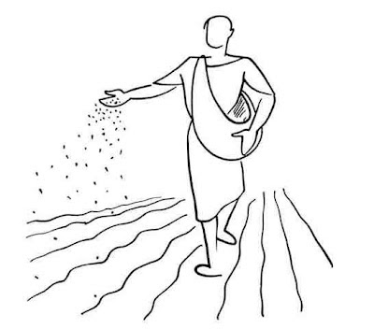
Are You Sewing The Seed?
Luke 8:4-15

Slide 2
The Parable Stated - Luke 8:5-8
5 A sower went out to sow his seed: and as he sowed, some fell by the way side; and it was trodden down, and the fowls of the air devoured it.
6 And some fell upon a rock; and as soon as it was sprung up, it withered away, because it lacked moisture.
7 And some fell among thorns; and the thorns sprang up with it, and choked it.
8 And other fell on good ground, and sprang up, and bare fruit an hundredfold. And when he had said these things, he cried, He that hath ears to hear, let him hear

Slide 3
The Parable Explained - Luke 8:11-15
11 Now the parable is this: The seed is the word of God.
12 Those by the way side are they that hear; then cometh the devil, and taketh away the word out of their hearts, lest they should believe and be saved.
13 They on the rock are they, which, when they hear, receive the word with joy; and these have no root, which for a while believe, and in time of temptation fall away.
14 And that which fell among thorns are they, which, when they have heard, go forth, and are choked with cares and riches and pleasures of this life, and bring no fruit to perfection.
15 But that on the good ground are they, which in an honest and good heart, having heard the word, keep it, and bring forth fruit with patience.

Slide 4
What is Personal Evangelism?
Evangelism is the personal responsibil­ity of every Christian. We have been saved to save (1 Tim. 4:16), taught to teach (2 Tim. 2:2), and won to win (Prov. 11:30). Per­sonal evangelism is described different ways in the Scriptures…
Personal Evangelism Is….
Sowing Seed - Luke 8:5-15
Fishing for Men - Matthew 4:18-19
Is Winning Souls - Proverbs 11:30
From article by John Isaac Edwards
Notes:
1 Tim. 4:16 - Take heed unto thyself, and unto the doctrine; continue in them: for in doing this thou shalt both save thyself, and them that hear thee.
2 Tim. 2:2 - And the things that thou hast heard of me among many witnesses, the same commit thou to faithful men, who shall be able to teach others also.
Prov. 11:30 - The fruit of the righteous is a tree of life; and he that winneth souls is wise.
Matt. 4:18-19 - And Jesus, walking by the sea of Galilee, saw two brethren, Simon called Peter, and Andrew his brother, casting a net into the sea: for they were fishers. 19 And he saith unto them, Follow me, and I will make you fishers of men.

Slide 5
Study - Why Some Became Interested*
The Institute for American Church Growth interviewed 10,000 church attenders to learn how they came into their church:
People attended for the following reasons:
2.0% - Due to a special Need
3.0% - Just walked in
6.0% - Because of the Pastor’s influence
1.0% - In response to visitation from the church
5.0% - Due to interest in Sunday School
0.5% - In response to a special crusade
3.0% - Because of interest in a particular program
79.0% - From the influence of a friend or relative
* From the book, “What People Ask About The Church,” by Dale A. Robbins

Slide 6
Evangelism
Responsibility of all Christians - Charge given & Obeyed!
Matthew 28:18-19; Mark 16:15, 16
Are you involved in personal evangelism?
Was Carried Out in the 1st Century & the 21st Century!
Acts 8:4, 5; 1 Thessalonians 1:1-8
“The India Story”
The Gospel Spread Then & Spreads Today!
Colossian 1:28, 29; Romans 10:17-18
Gospel is being preach to all the world
US, Philippines, India, Africa & other places
Notes:
Matt. 28:18-20 - And Jesus came and spake unto them, saying, All power is given unto me in heaven and in earth. 19 Go ye therefore, and teach all nations, baptizing them in the name of the Father, and of the Son, and of the Holy Ghost: 20 Teaching them to observe all things whatsoever I have commanded you: and, lo, I am with you alway, even unto the end of the world. Amen.
Mk. 16:15-16 - And he said unto them, Go ye into all the world, and preach the gospel to every creature. 16 He that believeth and is baptized shall be saved; but he that believeth not shall be damned.
Acts 8:4-5 - Therefore they that were scattered abroad went every where preaching the word. 5 Then Philip went down to the city of Samaria, and preached Christ unto them.
1 Thess. 1:1-8 - READ
Col. 1:28-29 - Whom we preach, warning every man, and teaching every man in all wisdom; that we may present every man perfect in Christ Jesus: 29 Whereunto I also labour, striving according to his working, which worketh in me mightily.
Rom. 10:17-18 - So then faith cometh by hearing, and hearing by the word of God. 18 But I say, Have they not heard? Yes verily, their sound went into all the earth, and their words unto the ends of the world

Slide 7
Perquisites for Success…
Must Be A Member of the Lord’s Church
Acts 11:26; Acts 26:28; 1 Peter 4:16
Being Saved
The saved are added to the church by the Lord - Acts 2:47
Adhering to the teaching of Jesus
Abstain from all sin - Hebrews 4:15; 1 Peter 1:22, 23
If you talk the talk, you must walk the walk
Notes:
Acts 11:26 - And when he had found him, he brought him unto Antioch. And it came to pass, that a whole year they assembled themselves with the church, and taught much people. And the disciples were called Christians first in Antioch.
Acts 26:28 - Then Agrippa said unto Paul, Almost thou persuadest me to be a Christian.
1 Peter 4:16 - Yet if any man suffer as a Christian, let him not be ashamed; but let him glorify God on this behalf.
Acts 2:47 - Praising God, and having favour with all the people. And the Lord added to the church daily such as should be saved.
Heb. 4:15 - For we have not an high priest which cannot be touched with the feeling of our infirmities; but was in all points tempted like as we are, yet without sin.
1 Pet. 1:22, 23 - Seeing ye have purified your souls in obeying the truth through the Spirit unto unfeigned love of the brethren, see that ye love one another with a pure heart fervently: 23 Being born again, not of corruptible seed, but of incorruptible, by the word of God, which liveth and abideth for ever.

Slide 8
Perquisites for Success…
Must Realize All Outside of Christ are Lost…
As Jesus did
Matthew 9:36-38; John 4:35-38
As Paul did
2 Corinthians 5:14; Ephesians 2:1, 11, 12
As the early disciples did
Acts 8:4
Notes:
Matt. 1:36-38 - But when he saw the multitudes, he was moved with compassion on them, because they fainted, and were scattered abroad, as sheep having no shepherd. 37 Then saith he unto his disciples, The harvest truly is plenteous, but the labourers are few; 38 Pray ye therefore the Lord of the harvest, that he will send forth labourers into his harvest.
Jn. 4:35-38 - Say not ye, There are yet four months, and then cometh harvest? behold, I say unto you, Lift up your eyes, and look on the fields; for they are white already to harvest. 36 And he that reapeth receiveth wages, and gathereth fruit unto life eternal: that both he that soweth and he that reapeth may rejoice together. 37 And herein is that saying true, One soweth, and another reapeth. 38 I sent you to reap that whereon ye bestowed no labour: other men laboured, and ye are entered into their labours.
2 Cor. 5:14 - For the love of Christ constraineth us; because we thus judge, that if one died for all, then were all dead;
Eph. 2:1, 11, 12 - READ
Acts 8:4 - Therefore they that were scattered abroad went every where preaching the word.

Slide 9
Perquisites for Success…
This Work Must be Characterized by Love…
Of God & Christ
To the point of obedience - 1 John 5:3; John 14:23
Of the Truth
To the point of studying, practicing, teaching & defending it
2 Timothy 3:16-17; Jude 3
Of the Lost
To the point of seeking & saving - Romans 11:14; 1 Corinthians 9:22
Notes:
1 Jn. 5:3 - For this is the love of God, that we keep his commandments: and his commandments are not grievous.
Jn. 14:23 - Jesus answered and said unto him, If a man love me, he will keep my words: and my Father will love him, and we will come unto him, and make our abode with him.
2 Tim. 3:16-17 - Cite
Jude 3 - Beloved, when I gave all diligence to write unto you of the common salvation, it was needful for me to write unto you, and exhort you that ye should earnestly contend for the faith which was once delivered unto the saints.
Rom. 11:14 - If by any means I may provoke to emulation them which are my flesh, and might save some of them.
1 Cor. 9:22 - To the weak became I as weak, that I might gain the weak: I am made all things to all men, that I might by all means save some.

Slide 10
Perquisites for Success…
Pray for Efforts to Seek & Save the Lost & Erring
Romans 10:1-4
Ephesians 6:18-20
1 Thessalonians 5:17
James 5:13-20
John 17:14-23
Notes:
Rom. 10:1-4 - READ
Eph. 6:18-20 - Praying always with all prayer and supplication in the Spirit, and watching thereunto with all perseverance and supplication for all saints;
19 And for me, that utterance may be given unto me, that I may open my mouth boldly, to make known the mystery of the gospel,
20 For which I am an ambassador in bonds: that therein I may speak boldly, as I ought to speak.
1 Thess. 5:17 - Cite
Jas 5:13-20 - READ
Jn. 17:14-23 READ

Slide 11
Perquisites for Success…
A Practical Knowledge of the Bible is Needed
Bible (God’ Word) contains “all truth”
2 Timothy 3:16, 17; John 16:13
Produces Faith
Romans 10:17
Convicts Men of Sin
Act 2:37, 38
Brings About the New Birth
1 Peter 1:23
Cleanses
John 15:3
Notes:
2 Tim. 3:16-17 - Cite
Jn. 16:13 - Howbeit when he, the Spirit of truth, is come, he will guide you into all truth: for he shall not speak of himself; but whatsoever he shall hear, that shall he speak: and he will shew you things to come.
Rom. 10:17 - Cite
Acts 2:37, 38 - Cite
1 Pet. 1:23 - Being born again, not of corruptible seed, but of incorruptible, by the word of God, which liveth and abideth for ever.
Jn. 15:3 - Cite

Slide 12
Perquisites for Success…
We Must Be Willing To Study…
The Bible - 2 Timothy 2:15
Must know something about what you are teaching
Different Types of People - Jude 1:22, 23
Dignified - approach in a dignified manner
Jolly - approach in a casual manner
Intellectual - approach in logical manner
Emotional - Appeal to certain emotional trends in their life
Other Material & Books
Commentaries, Bible study aids, dictionaries, maps
Books on church history, denominational doctrine
Books on doctrinal issues, debate books, etc.
Notes:
2 Tim. 15 - Cite
Jude 1:22, 23 - And of some have compassion, making a difference: 23 And others save with fear, pulling them out of the fire; hating even the garment spotted by the flesh.

Slide 13
Difficulties You May Experience
“I’m such a sinner the Lord wouldn’t have me.”
Reply - Saul persecuted Christians and was saved - Acts 22:16
“I’m a good moral person.”
Reply - So was Cornelius - Acts 10:1, 2, 48
“I’m satisfied with my religion.”
Reply - It is God we must please, not man - Acts 5:29
Matthew 7:21-23; 15:7-9
“There too many hypocrites in the church.”
Reply - Yes, one is too many! If you go to hell, you will be with all the hypocrites of all time - eternally!
Don’t take rejection personally!
Jesus said it would happen - John 12:48
Don’t you reject Him! Go to another - Matthew 7:6; Acts 13:45, 46
Notes:
Acts 22:16 - Cite
Acts 10:1, 2 - There was a certain man in Caesarea called Cornelius, a centurion of the band called the Italian band, 2 A devout man, and one that feared God with all his house, which gave much alms to the people, and prayed to God alway. 48 And he commanded them to be baptized in the name of the Lord. Then prayed they him to tarry certain days.
Acts 5:29 - Cite
Matt. 7:21-23 - Cite
Matt 15:7-9 - Ye hypocrites, well did Esaias prophesy of you, saying, 8 This people draweth nigh unto me with their mouth, and honoureth me with their lips; but their heart is far from me. 9 But in vain they do worship me, teaching for doctrines the commandments of men.
Jn. 12:48 - He that rejecteth me, and receiveth not my words, hath one that judgeth him: the word that I have spoken, the same shall judge him in the last day.
Matt. 7:6 - Give not that which is holy unto the dogs, neither cast ye your pearls before swine, lest they trample them under their feet, and turn again and rend you.
Acts 13:45, 46 - But when the Jews saw the multitudes, they were filled with envy, and spake against those things which were spoken by Paul, contradicting and blaspheming. 46 Then Paul and Barnabas waxed bold, and said, It was necessary that the word of God should first have been spoken to you: but seeing ye put it from you, and judge yourselves unworthy of everlasting life, lo, we turn to the Gentiles.

Slide 14
Challenges of Evangelism
Finding prospects for study
Setting up the study
Teaching the material
Answering questions
Asking for a decision
These challenges have hindered some from getting involved.

Slide 15
Making Contacts
Make a list of people you want to contact
Invite those you know to our services
Hand out study tracts
Tell people about our website
Send them the link in an email
www.lodiCAchurchofchrist.com
Offer them a copy of a bulletin
Sometimes a general conversation will open a door of opportunity
Offer a Bible Correspondence Course

Slide 16
Benefits of a Correspondence Course
Eliminates Some of the Challenges
Can offer the course by simple advertising or to a friend or acquaintance...
You will find people who want to study the Bible
The study is automatically set up by those who respond to the offer
The students teach themselves at their own pace
If questions are raised, you can study and answer them at your leisure
People are given the opportunity to make a decision
It becomes easy to share the gospel, even if one is a new Christian!

Slide 17
Recommended Bible Courses
Know Your Bible, by Gene Tope
6 lesson course
Jesus the Way, by Sewell Hall
7 lesson course
Jule Miller Visualized Bible Course
5 lesson course -
How to Understand The Bible, by Robert Harkrider
5 lesson course
Notes:
Gene Tope Couse
Jule Miller Course:
1-The Patriarchal Age
2-The Mosaic Age
3-The Christian Age
4-God's Plan for Redeeming Man
5-History of the Lord's Church

Slide 18
The India Story
In 2002, Joshua requested a Bible Correspondence Course
He completed the course and returned it about 2 months later
He desired assistance in being scripturally baptized
An American brother contacted Joshua who was working at a refinery in Kuwait at the time
Joshua and one other man were baptized
A small congregation was started
Later, Joshua returned to his home in Bangalore, India
Brother Bobby Holmes went there in 2004 and taught classes
Since then, several gospel preachers have held preacher training classes in India
Joe Price is there now - 29 baptized during this trip!

Slide 19
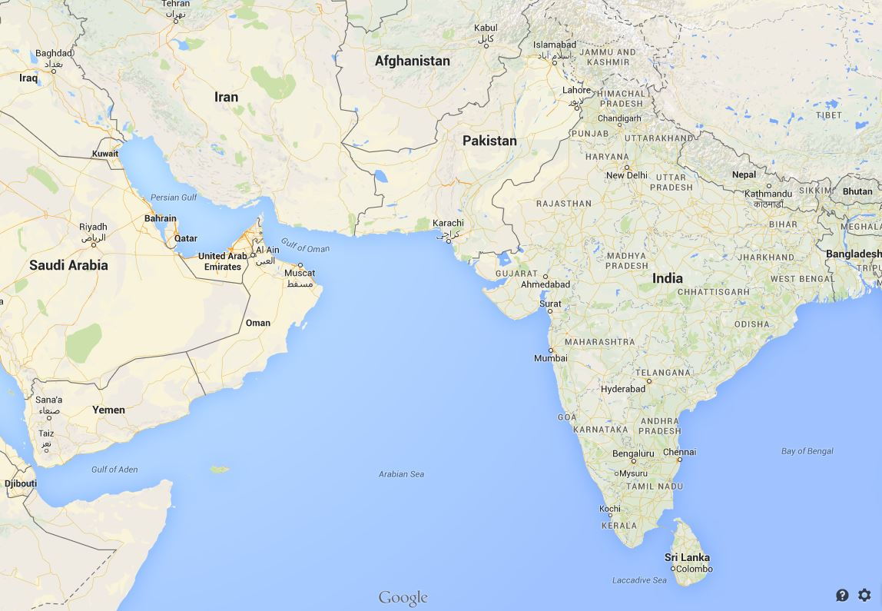

Slide 20
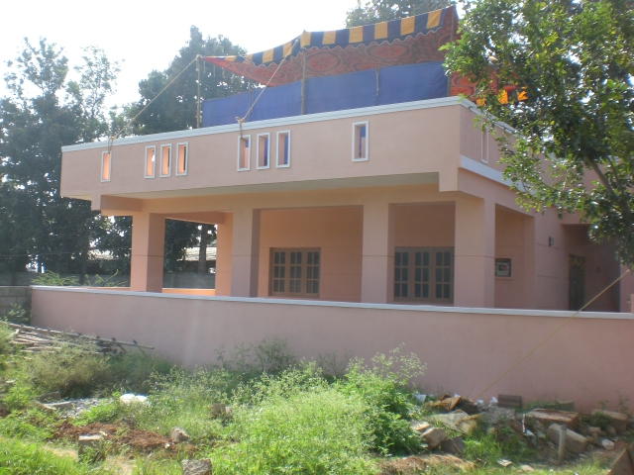
Church Building in Bangalore, India Completed in 2013

Slide 21
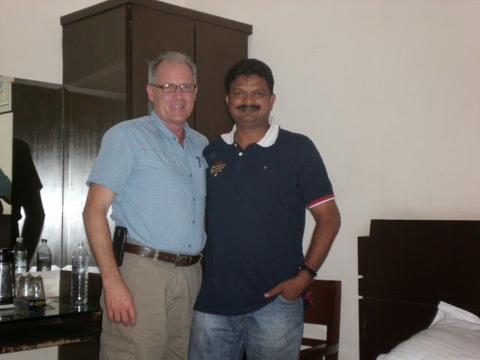
Joe Price & Joshua Mahendranath
See India Updates for more information

Slide 22
“The Increase…”
“I estimate we’ve had 300-400 students (preachers) in classes since 2004. The fruit they have borne easily reaches 1000-2000.
This is a guess - no real way to know for sure!”
- Joe Price, 2014

Slide 23
“…but God that giveth the increase”
5 What then is Apollos? and what is Paul? Ministers through whom ye believed; and each as the Lord gave to him.
6 I planted, Apollos watered; but God gave the increase.
7 So then neither is he that planteth anything, neither he that watereth; but God that giveth the increase.
8 Now he that planteth and he that watereth are one: but each shall receive his own reward according to his own labor.
9 For we are God’s fellow-workers: ye are God’s husbandry, God’s building - 1 Corinthians 3:5-9 - ASV

Slide 24
Conclusion
“The seed is the word of God” - Luke 8:11
This seed will produce “after his kind” - Gen. 1:12
It MUST be sown - Matt. 28:19, 20; Mark 16:15, 16
“Are You Sewing The Seed Of The Kingdom, Brother?”

